Slide 1

Module 1: Introduction

Slide 2

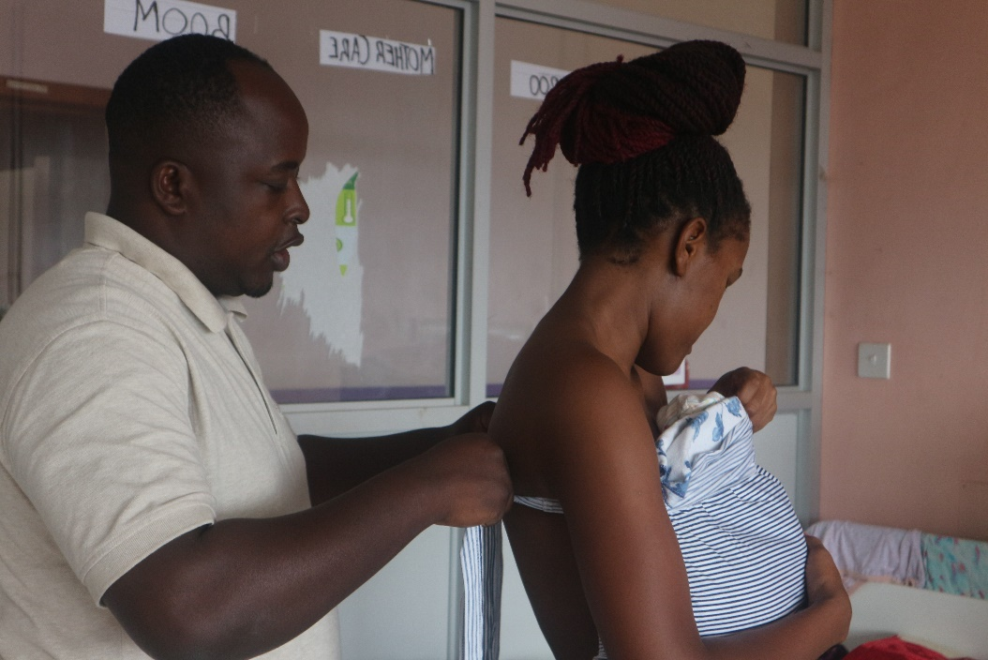
Welcome to Module 1: Introduction
The key learning objectives from this module include:
Define key terms relating to infant gestation and weight.
Describe the key aims of nutrition in newborn care.
Explain the purpose and benefits of kangaroo mother care (KMC).
Recall the key components of a healthy newborn breastfed diet.
Notes:
In this introductory module, you will be introduced to some of the key terms and concepts that will be discussed throughout the rest of the course. This module will also include the first of our case studies, where you can decide on effective treatment plans and interact with other learners.

Slide 3
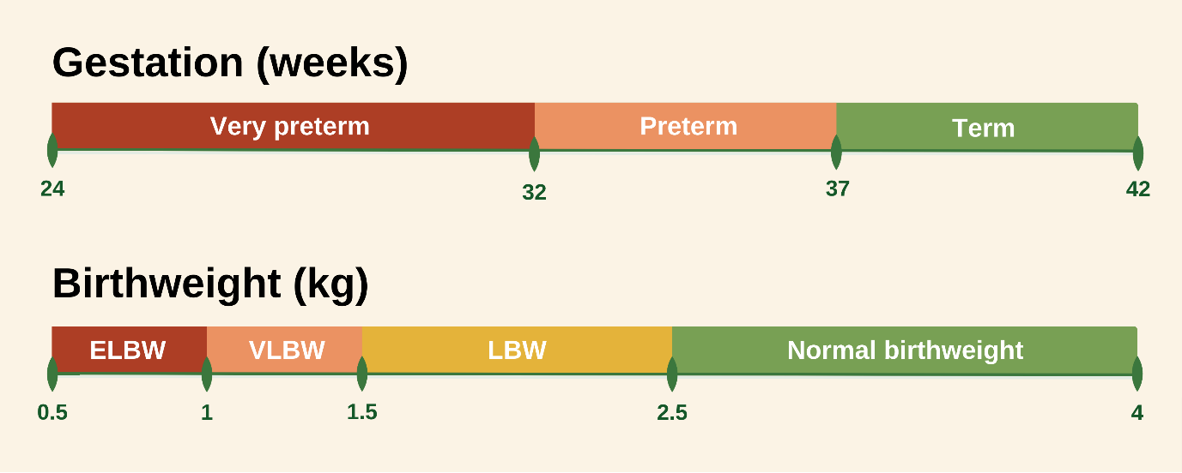
Nutrition in preterm and LBW infants
- a global perspective
Very preterm infants are born before 32 weeks
Preterm infants are born before 37 completed weeks
Term infants are born between 37 and 42 weeks
Extremely low birthweight infants are born weighing under 1kg
Very low birthweight infants are born weighing under 1.5kg
Low birthweight infants are born weighing under 2.5kg
A normal birthweight is considered to be between 2.5kg and 4.5kg
Notes:
In this course, we will discuss all infants born preterm and/or low birthweight (LBW). It is important to understand the key terms used to describe different patients. Read through the slide to learn how we define the different cases.

Slide 4
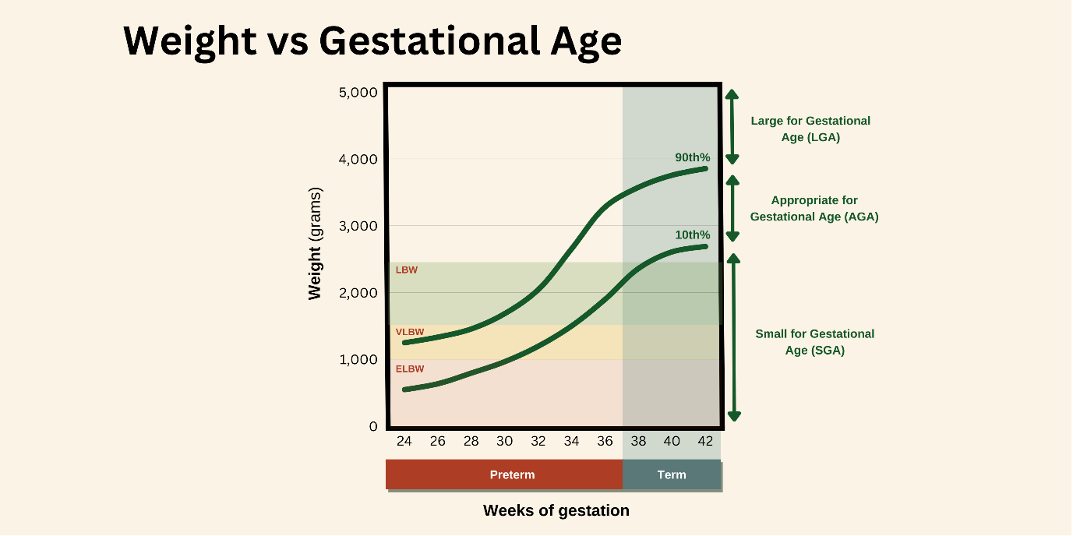
Nutrition in preterm and LBW infants
- a global perspective
Infants can also be described as small for gestational age (SGA), meaning their weight is below the 10th centile.
Notes:
The two key factors that are relevant when describing a baby are gestation and birthweight. In the graph above, you can see that LBW infants may be term (37-42 weeks) or preterm (<37 weeks) gestation, however, almost all VLBW infants will have been born preterm. SGA refers to infants born below the 10th centile for that gestation and may be preterm or term. Many SGA infants (but not all) are small because of slow foetal growth that is usually due to placental dysfunction. This is termed in-utero growth restriction (IUGR).
In this course, we focus on nutritional care in preterm and low birthweight infants. The WHO describes this as feeding in exceptionally difficult circumstances. The nutrition and care advised is applicable to all preterm and low birthweight infants, however some infants, including extremely low birthweight infants <1000g, may need additional support that is not covered in this course.

Slide 5
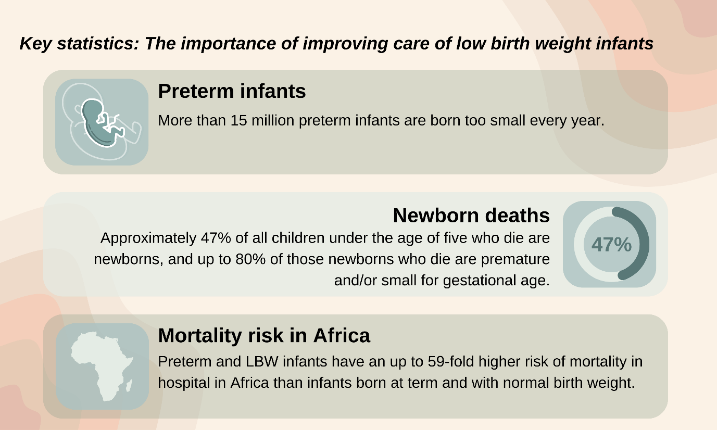
Why is it important to improve nutrition in preterm and LBW infants?
Notes:
Optimising nutrition in preterm and LBW infants has potential to improve their survival, growth, and long-term health outcomes. Nutrition is critical to brain development in early life. However, providing adequate nutrition in this situation can be challenging as this group are particularly vulnerable to respiratory complications, poor body temperature regulation, feed intolerance, and infection.
Failure to meet recommended nutrient intakes results in poor growth and is associated with increased short-term risks, such as late onset sepsis, and predisposes them to long-term neurodevelopmental impairment and adult onset metabolic and cardiovascular disease.
There is strong evidence that neonatal complications and death are lower where “mother's own milk” (MOM) is the main source of nutrition. Therefore, a key principle of early nutritional care is the provision of MOM.

Slide 6
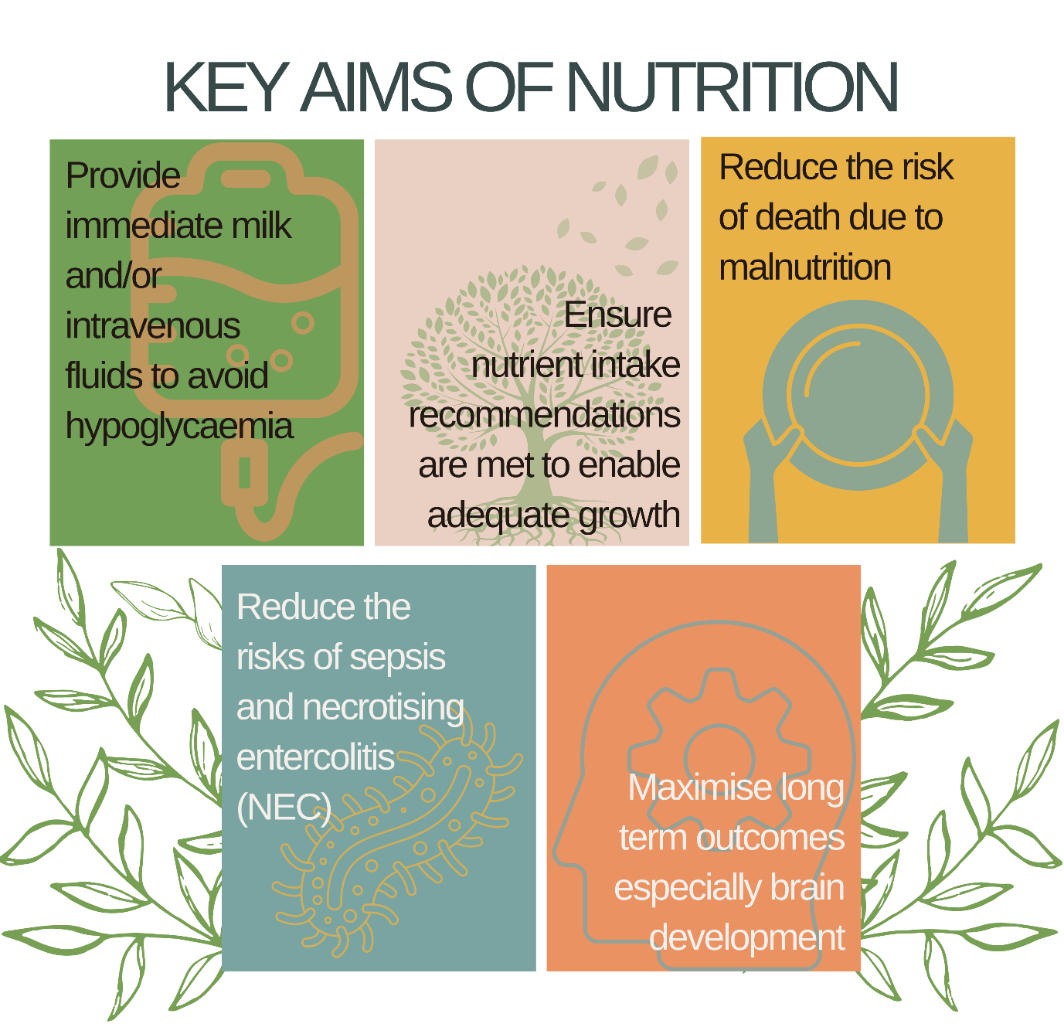
Why is it important to improve nutrition in preterm and LBW infants?
Notes:
Providing adequate nutrition is an essential component of newborn care. The key aims of nutrition are shown here.
It is important to note, however, that nutrition encompasses much more than just providing adequate nutrients.
Nutrition requires a holistic approach in which we consider a wide range of factors that we will discuss in this course, including:
Kangaroo mother care (KMC)
Macronutrients and micronutrients
Maternal psychological status and support
Parental involvement in decision making
Infection control practices
Anti-infective components in breastmilk
The neonatal unit environment
Providing preterm and LBW infants with appropriate nutrition in hospitals or healthcare facilities with limited resources can be extremely challenging.
A downloadable summary of key WHO and ANNN recommendations for care of low birthweight infants is available in the ‘downloadable resources’ section. We will highlight and share individual recommendations throughout the rest of the course.
Please note: The African Neonatal Nutrition Network (ANNN) is not responsible for the practices of physicians and provides recommendations as an indication of good clinical practice only. WHO recommendations should be checked against their latest guidelines. Diagnosis and treatment is at the discretion of local health care providers.

Slide 7

Kangaroo mother care (KMC)
Kangaroo mother care (KMC) refers to the care of preterm and LBW infants in continuous and prolonged skin-to-skin contact for 8-24 hours per day, initiated immediately after birth with support for exclusive breastfeeding or breast milk feeding (WHO, 2022).
KMC provides the basis upon which nutritional care can be planned and provided.
Notes:
KMC - the best start for infant nutrition
Newborn infants who are born preterm and LBW require immediate care and this is best provided by KMC whenever possible. Infants receiving KMC may be managed on a postnatal ward with other infants, or some may require admission to a neonatal unit. Very sick or unstable infants will be placed in an incubator or cot, but many vulnerable newborn infants can still be effectively cared for using KMC.
KMC is one of the most important and effective interventions in neonatal care to reduce morbidity and improve continued breastfeeding, and it is estimated that KMC alone will save more than half a million lives between 2012 and 2025.
In all vulnerable newborns, except those who are critically sick, KMC should be considered and started immediately. Wherever possible, KMC should be provided by mothers, although fathers and other family members can participate depending on parental preference. Breastfeeding should be commenced as soon as possible, but KMC also supports the use of feeding with expressed breastmilk through feeding (gastric) tubes, spoons, or cups. It is also important that KMC is encouraged following hospital discharge.
High quality data show that immediate KMC in babies as small as 1000g reduces the risk of death and adverse outcomes such as sepsis and hypothermia, and that non-separation between mother and baby results in numerous physiological benefits.
You can learn more about these benefits through the KMC resources hosted on our website.

Slide 8
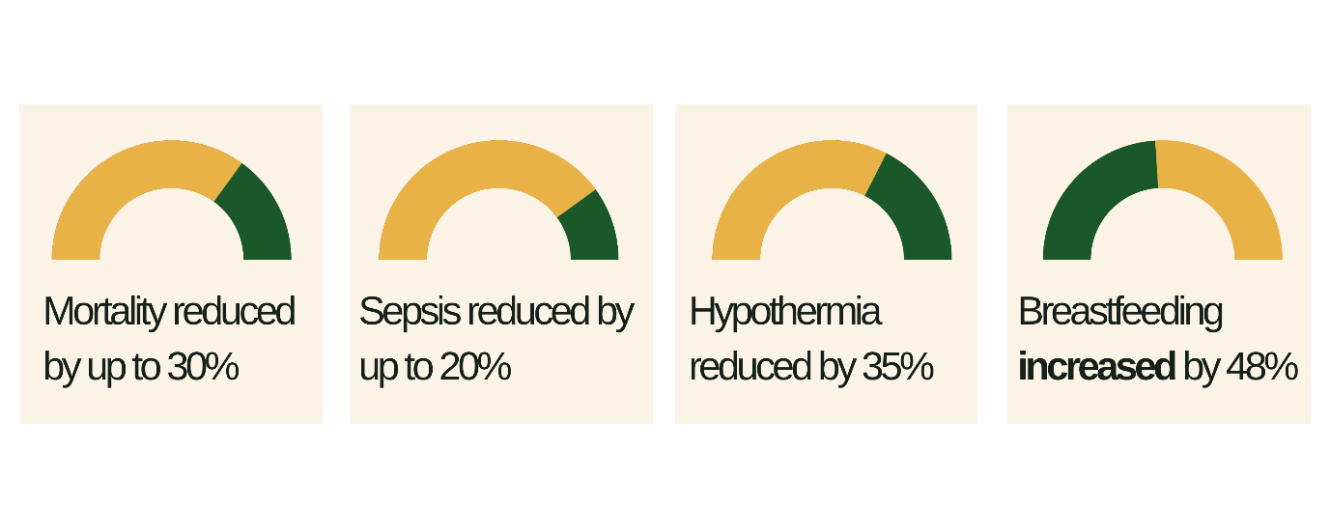
Benefits of KMC
The proven benefits of KMC (WHO, 2023) include:
Notes:
Why is KMC important to holistic nutrition?
Providing vulnerable infants with appropriate nutrition in hospitals or healthcare facilities with limited resources can be extremely challenging, and KMC provides the basis upon which nutritional care can be planned and provided.
KMC emphasises the importance of involving parents/carers in nutritional management and helps the mother to establish lactation and successful breastfeeding. It encourages healthcare professionals to work with parents/carers, avoid mother-infant separation (non-separation), and promote respectful care by being aware of specific cultural and religious aspects that may affect its practice.
Immediate KMC
Immediate KMC involves initiating kangaroo mother care soon after birth and before stabilisation.
An immediate KMC (iKMC) trial was conducted in Ghana, India, Malawi, Nigeria, and Tanzania among infants who weighed 1-1.799kg. Results showed that infants who received immediate KMC had 25% lower mortality at 28 days of age, 35% lower incidence of hypothermia up to discharge, and 18% less suspected sepsis compared with control infants who received conventional newborn care.
This means that by utilising the benefits of iKMC, one newborn death can be prevented for every 30 babies born preterm or LBW, and iKMC demonstrates significantly greater benefits compared to later initiation.

Slide 9
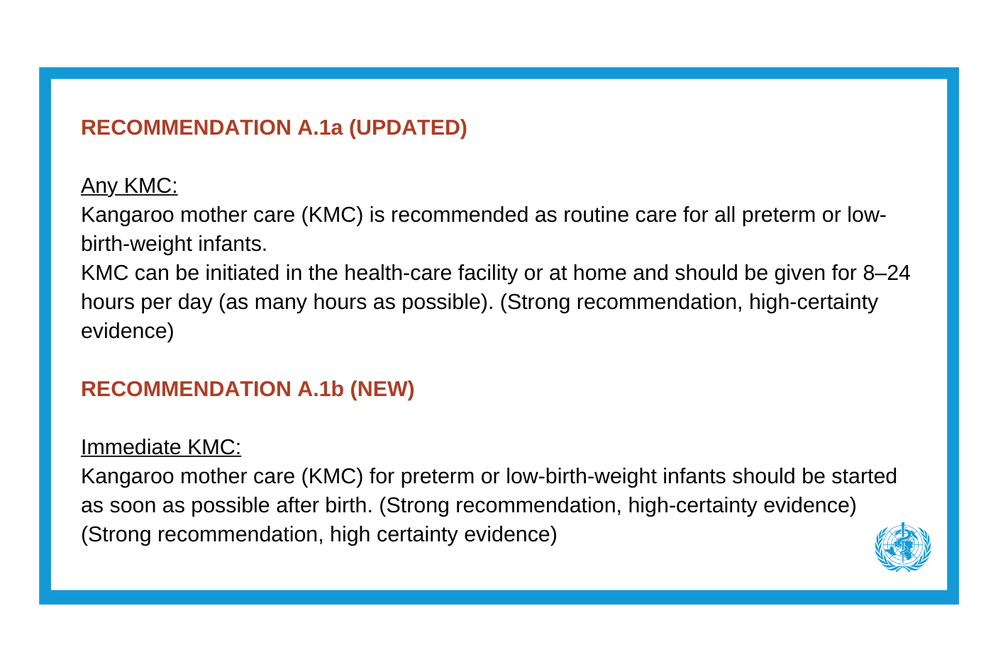
WHO recommendation

Slide 10
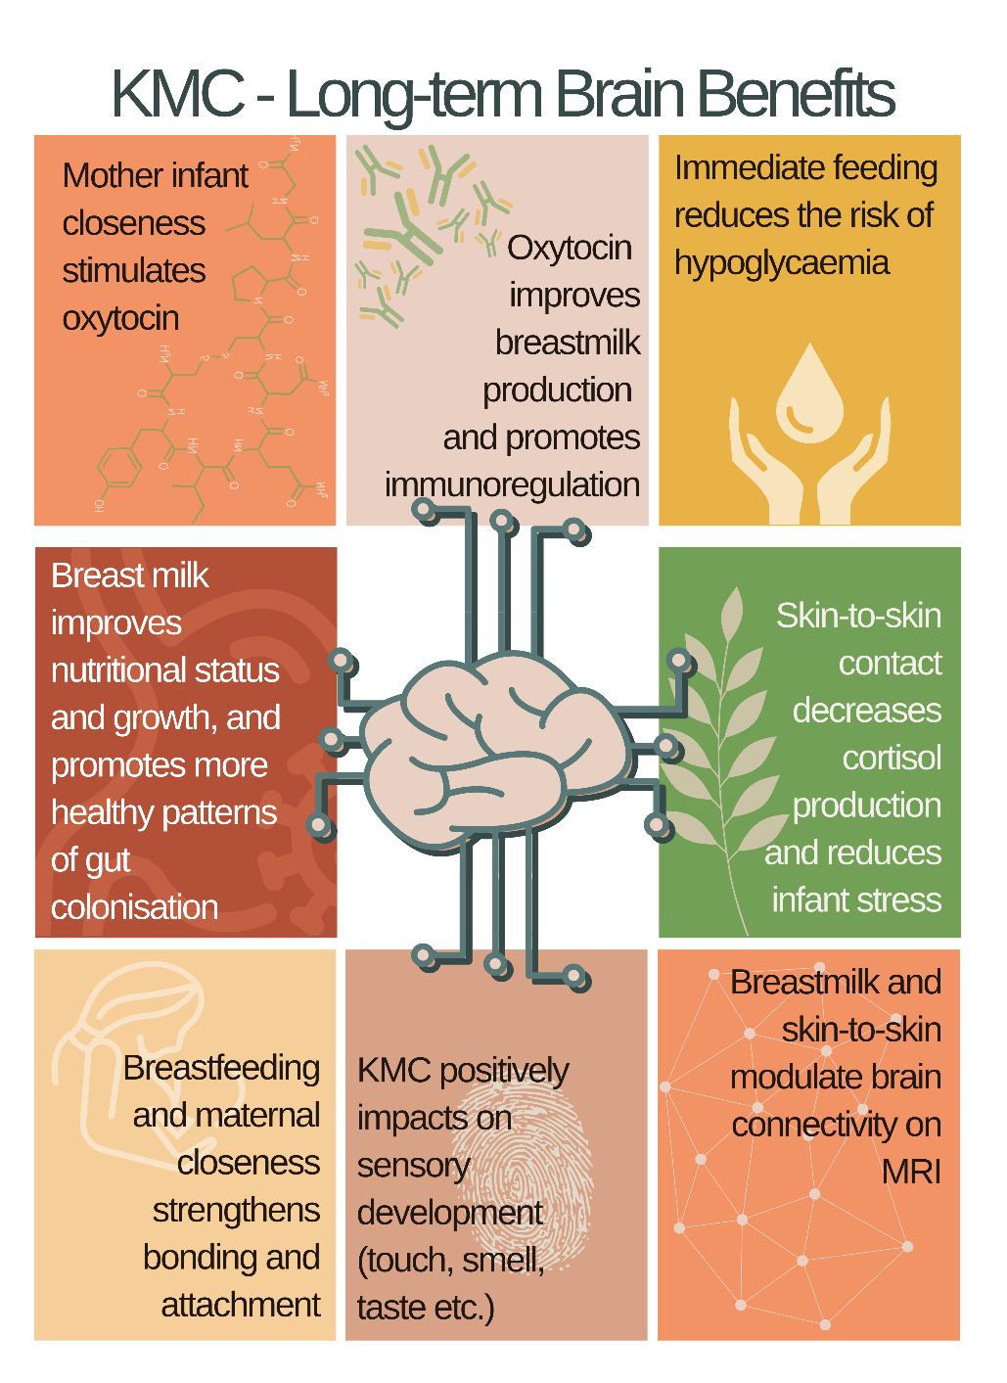
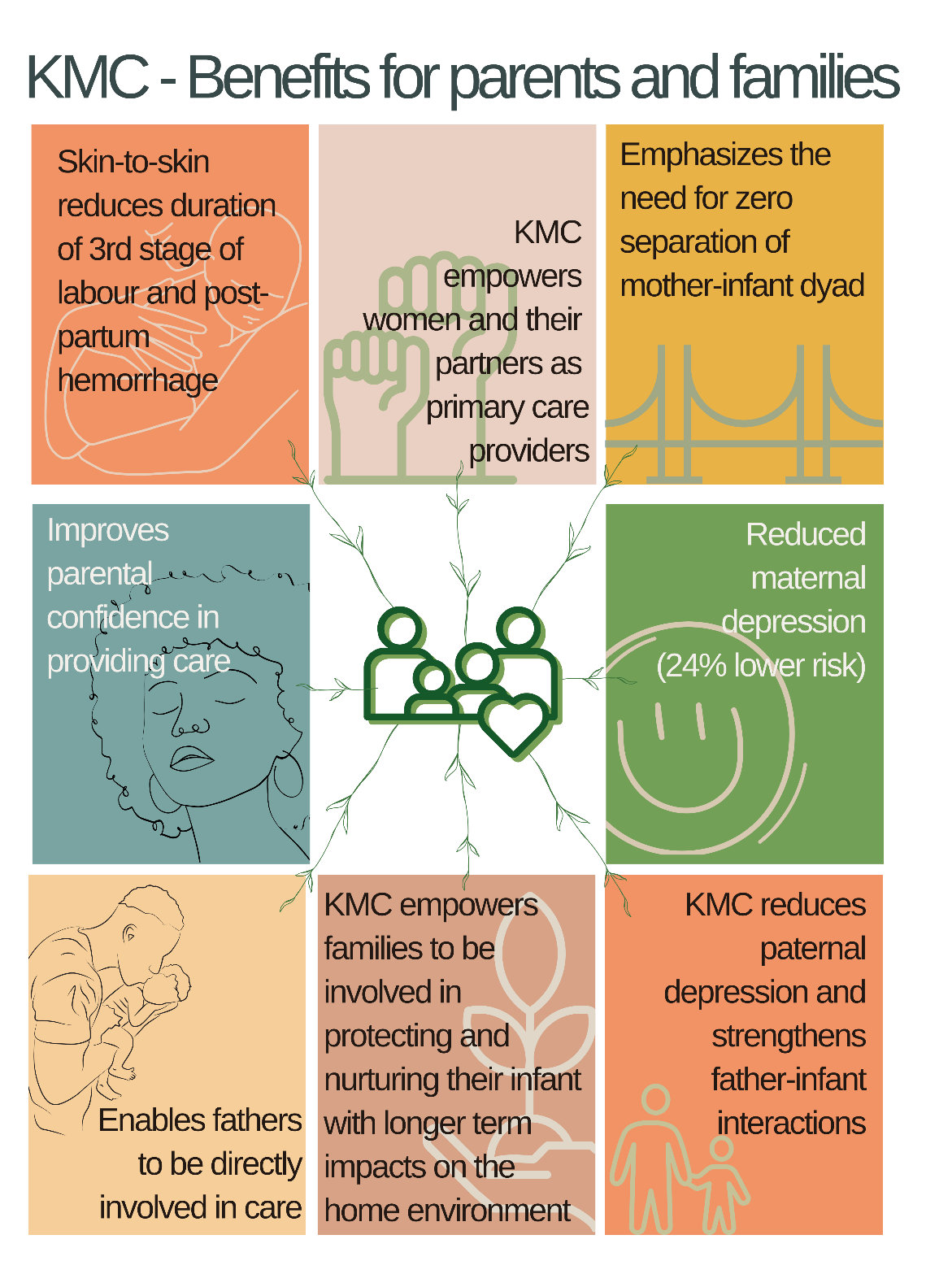
Benefits of KMC
Notes:
KMC – Long-term brain benefits
Several studies have shown KMC is associated with improved cognitive and motor development, and better longer-term social and behavioural outcomes. Studies conducted in Colombia have shown that preterm infants who received KMC had improved intelligence, attention, memory, and coordination 20 years later compared with those who received incubator care (Charpak et al., 2017). There will be multiple mechanisms that link KMC to better brain outcomes, including:
KMC – Benefits for parents and families
KMC allows parents/carers to feel intimately involved in care of their infant, which positively impacts on their own mental health, as well as decreases infant handling by multiple health workers (which may increase the risk of infections).
KMC is associated with multiple benefits for parents/carers and families, some of which are presented in the graphic on this slide.
Qualitative studies show that parents/carers want to be actively involved in care of their preterm and LBW infants and view KMC as an opportunity to be directly involved in care and parenting. Caregiver knowledge of the processes and benefits of KMC improve practice and outcomes, and parents/carers deserve careful explanation of these aspects so they can make an informed choice. Economic analysis also shows that KMC is cheaper and more effective than traditional care.

Slide 11

KMC: Physical resources for parents/carers
Effective KMC also requires…

Slide 12
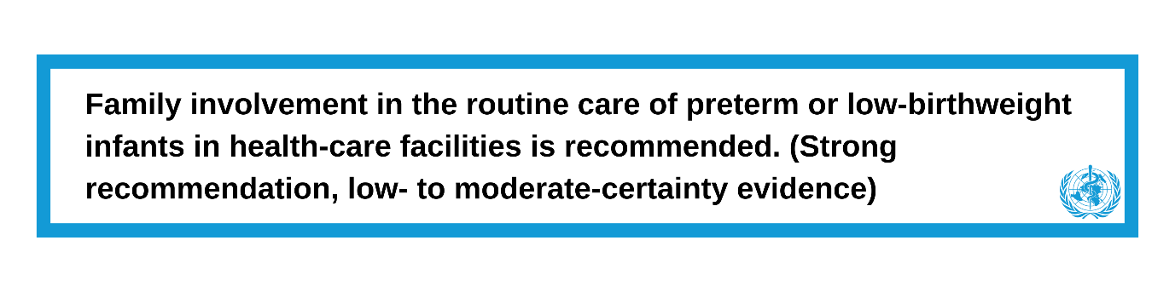
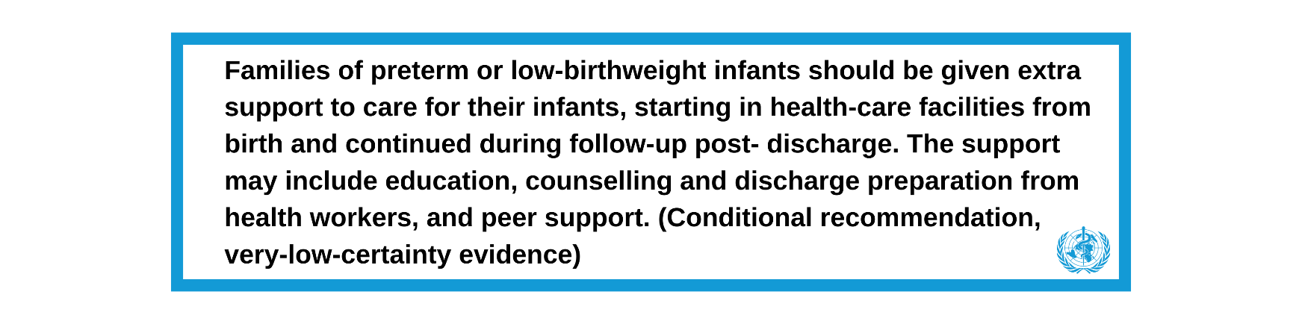
WHO recommendation

Slide 13
Which babies cannot have immediate KMC?
iKMC may be considered unsafe in infants who are unstable, for example if they:
Are unable to breathe spontaneously after resuscitation.
Are in shock.
Require mechanical ventilation.
However, KMC has been shown to be possible and effective in stable infants receiving respiratory support, especially those receiving non-invasive respiratory support such as continuous positive airway pressure (cpap).
Where vulnerable infants are too sick or unstable to receive KMC, care should focus on their immediate needs, including:
Avoiding hypothermia.
Implementing infection control policies to reduce sepsis.
Supporting mothers to express “mother's own milk” or MOM.
Ensuring non-separation of the mother-infant dyad.
Providing intravenous fluids if required to avoid dehydration and hypoglycaemia.
Notes:
This may differ depending on healthcare resources and settings. In general, most infants, whether they are well or not, can receive iKMC when the healthcare team considers it safe to do so and when the parents/carers wish to do so.

Slide 14
How to provide KMC
A detailed description of the practical processes involved in providing KMC is beyond the scope of this course, but further resources can be found as PDFs and links on our website.
Providing KMC requires:
Hospital policies and guidelines.
Training and education for staff.
Resources for parents/carers and staff.
Respectful discussions with parents/carers.
Notes:
For further detail on the WHO recommendations for KMC, please see page 12 of the ‘WHO recommendations for care of the preterm or low-birth-weight infant’, available in the downloadable resources section.

Slide 15
Case study: Introduction
Abeni was born at 33 weeks’ gestation weighing 1.6kg (25th centile).
Her mother developed Pregnancy Induced Hypertension and she was treated with labetalol during the pregnancy.
There was spontaneous labour at 33 weeks following prolonged rupture of the membranes for 36 hours.
She is placed in immediate skin-to-skin contact with her mother.

Slide 16
Case study: Introduction
At birth and at 20 minutes of age after birth, Abeni has a normal respiratory rate, has good tone, and appears well. However, the medical team note that Abeni’s mother has a temperature of 38°C.

Slide 17
Case study: Initial care
What are Abeni’s most important needs over the first 12-24 hours?
Choose all that apply, then go to the next slide to see the correct answer:
  Preventing hypothermia and hypoglycemia
  Optimising micronutrient intakes
  Observing for respiratory distress/infection
  Septic screen
  Oral antibiotics
  IV antibiotics

Slide 18
Case study: Initial care
Correct answers:
  a) Preventing hypothermia and hypoglycemia
  c) Observing for respiratory distress/infection
  d) Septic screen
  f) IV antibiotics
Notes:
Abeni is preterm and LBW and is at risk of hypothermia and hypoglycemia. Although she has a normal respiratory rate, she requires careful observation for any signs of respiratory distress or infection. Given the maternal pyrexia, spontaneous labour, and prolonged rupture of the membranes, many hospitals would recommend a “septic screen” and start intravenous antibiotics. Use of oral antibiotics would not be appropriate in this case and optimisation of micronutrient intakes is not a top priority at this stage.

Slide 19
Case study: Discussion
Given her degree of prematurity and risks of infection, would KMC be safe and appropriate for Abeni?
Consider what else you would recommend in the first few days, before reading the expert opinion on the next slide.

Slide 20
Case study: Discussion
“The iKMC trial showed that KMC reduces the risk of death and late onset sepsis. Abeni can be placed in the KMC position using an appropriate binder, by a trained member of staff. Mother should be informed about the practice of KMC and given advice about placing Abeni to the breast, or expressing colostrum if Abeni is not able to latch and suck.
Monitoring of respiratory distress and hypoxia is important and if needed, CPAP and/or oxygen can be given alongside intravenous antibiotics whilst still receiving KMC.
Abeni will require blood glucose monitoring because of the risk of hypoglycemia. KMC is more effective than other methods (e.g. heat pad) in avoiding hypothermia, but Abeni will still require regular temperature checks.
Abeni’s feeding and milk intake over the first few days will require careful observation.”
Professor Nick Embleton
Consultant Neonatologist and Professor of Neonatal Medicine

Slide 21
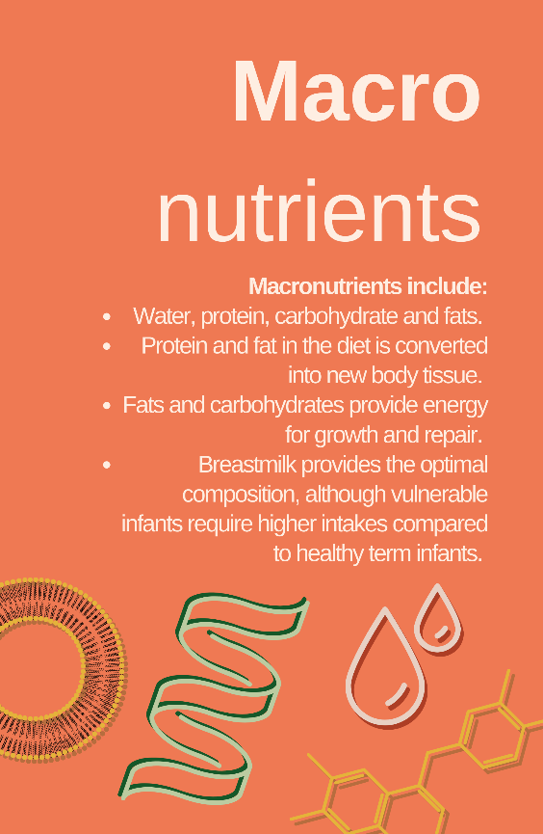
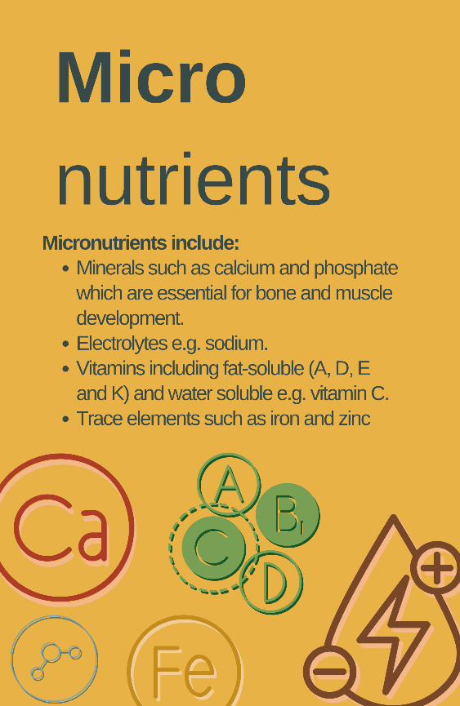
Introduction to dietary nutrient requirements
Notes:
Overview of nutrients in an infant diet
Macronutrients and micronutrients are key elements of neonatal nutrition. Examples of what is included in these two groups is provided in the two graphics on this slide.
Over the next few slides we will explore the different components of breast milk and discuss why each of these is important for the development of the infant.

Slide 22
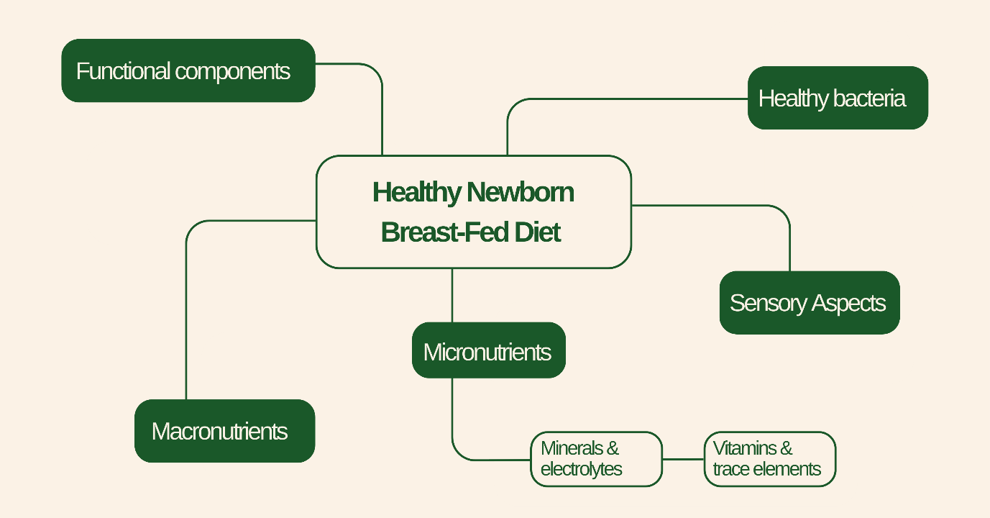
Components of a healthy newborn breast-fed diet
Functional Components - Components of a healthy newborn breast-fed diet
Macronutrients - e.g. protein and energy
Sensory aspects - Smell, touch, and taste
Minerals & electrolytes - e.g. calcium and sodium
Vitamins & trace elements - e.g. iron and zinc
Notes:
Breast milk has evolved over millennia to meet the nutrient needs of newborn infants as well as provide components that improve immunity and reduce infections, such as human milk oligosaccharides (HMOs). By providing healthy bacteria, along with other components (e.g. HMOs, enzymes), breast milk is able to promote gut health and optimal brain development. Finally, breastfeeding also promotes maternal-infant bonding, metabolic health, and sensory aspects, all of which are important elements of nutrition over the course of the infant’s life. For example, specific breast milk components can affect appetite, taste preferences, and obesity. Most of these aspects are missing when formula milk is used.
Vulnerable infants who are born preterm or LBW also require all of these components found in breast milk. However, compared to term infants they often require higher intakes on a per kilogram (kg) basis for macronutrients and many micronutrients. These higher requirements can be met by providing a higher volume of milk, or by providing supplements. You will learn more about this in module 4.

Slide 23
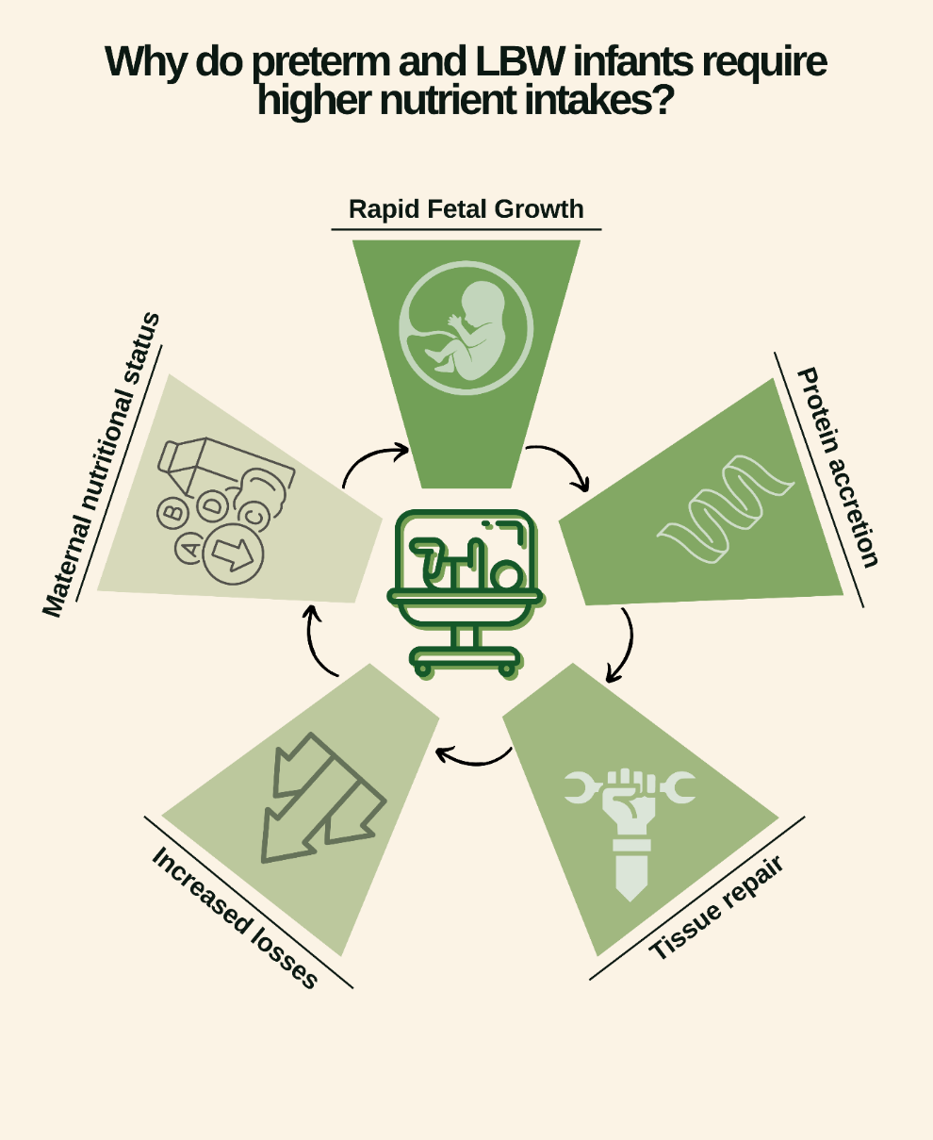
Why do preterm and LBW infants require higher nutrient intakes?
Rapid fetal growth: In-utero growth in the 3rd trimester is much greater than after 40 weeks.
Protein accretion: Higher weight gain velocity requires more nutrients (tissue substrate): more energy is needed to accrete proteins into new tissue.
Tissue repair: Preterm infants are more likely to have other problems such as lung disease: tissue repair requires additional energy.
Increased losses: Preterm infants have greater losses for example due to fat malabsorption (energy loss) or renal tubular losses (sodium loss).
Maternal nutritional status: Vulnerable infants may be born to mothers with poor nutritional status such as Vitamin D deficiency.

Slide 24




Macronutrients
Notes:
Water is essential as a ‘carrier’ of nutrients and to enable excretion of waste products, for example as urea in the urine. Preterm infants require higher water intake because they have both a higher surface area and thin skin, thereby resulting in greater water losses. Higher nutrient intake in preterm infants also requires a higher water intake.
Protein is made of long chains of amino acids. The precise combination and amounts of amino acids in body protein differ. For example, muscle cells have a different composition to immune cells. Milk protein is either casein or whey, and amino acid composition varies. Breastmilk protein is the ideal source for newborn infants as it is perfectly matched to needs and is therefore considered “high quality”. Whilst the protein is still high quality in formula milk, the composition is not as well matched to the needs of newborn humans.
Carbohydrates, also called sugars, provide energy to grow; without energy, proteins cannot be made into tissue. Energy is also needed to maintain homeostasis (e.g. breathing, heart activity, digestion) and avoid hypoglycaemia (low blood glucose). Lactose is the main carbohydrate in breast milk and plays an important role in gut health and the maintenance of a healthy gut microbiome.
Fats provide energy alongside carbohydrates, but also provide ‘building blocks’ for new tissue, especially in cell membranes and the brain. Within breast milk, there are lots of different types of fat with different roles. Long-chain fatty acids such as docosahexaenoic acid (DHA) are essential for brain development.

Slide 25




Micronutrients
Notes:
Minerals such as calcium, phosphate, and magnesium are essential for muscle function and, in combination with Vitamin D, support bone growth. Preterm infants may benefit from mineral supplements, although the availability of safe supplements might be difficult. Infants with symptomatic hypocalcaemia (e.g. tetany or convulsions) require calcium correction, but access to oral calcium and phosphate supplements is often limited.
Electrolytes: Preterm infants have much higher requirements for sodium to support growth, and have higher losses of sodium in the urine. Many very preterm infants (<32 weeks) will require supplements. However, the needs for other electrolytes such as potassium and chloride will usually be met by the mother’s own breast milk.
Vitamin D is widely available and usually given as part of a multi-vitamin supplement. All infants require supplemental Vitamin D throughout early infancy. Water soluble vitamin supplements (e.g. Vitamins B and C) are rarely required.
Trace elements refer to compounds such as iron, zinc, and selenium. All preterm and LBW infants require iron supplementation. Iron is present in breast milk at low concentrations and, whilst this perfectly meets the needs of full-term babies, it is insufficient for preterm babies. Zinc is important for tissue repair, growth, and enzyme function. Routine zinc supplementation is not necessary, but some vulnerable infants, e.g. those with diarrhoea or intestinal stoma, may benefit from supplements.
We will discuss macro- and micronutrients in more detail later in the course, including common symptoms of deficiency.

Slide 26
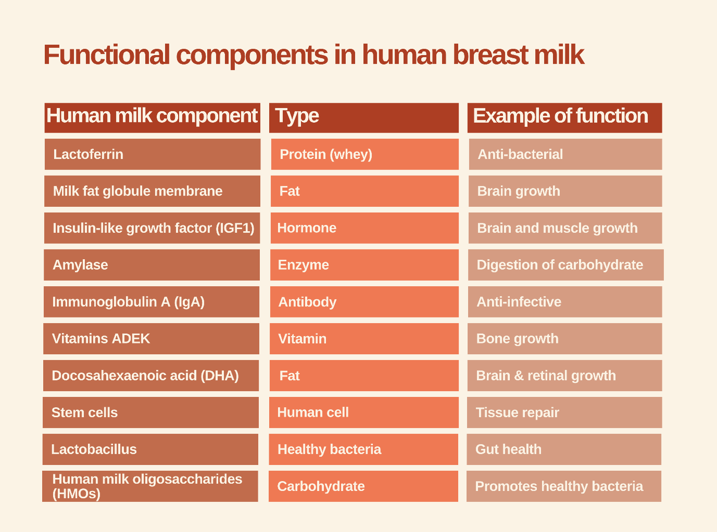
Functional components in human milk
Notes:
Functional components are also known as immunonutrients or bionutrients. Examples include specific proteins, fats, carbohydrates, hormones, enzymes, antibodies, and immune cells. They are one of the key reasons why breast milk fed infants have better outcomes compared to those fed milk formula. Most of these components are unique to human milk, and many are also present in amniotic fluid.
We will discuss breast milk composition in more detail in module 3. For now, take a look at this slide to see a few examples of these components and their likely functions.

Slide 27
End of Module 1
In this module, we introduced the key concepts of nutrition in preterm and LBW infants. We introduced the key components of a newborn diet, whilst stressing the importance of a holistic view on nutrition. Aspects such as Kangaroo Mother Care can be vital to ensuring effective nutrition and growth.
After working through each step, you should now be able to:
Define key terms including term, preterm, very preterm, LBW, VLBW, and SGA.
Understand the difference between macronutrients and micronutrients.
Understand the benefits of KMC.
List the components of a healthy newborn breastfed diet.

