Slide 1


Module 2:
Breast Milk

Slide 2

Introduction to Module 2
The key learning objectives from this module include:
Describe the composition of breast milk and how it changes during breastfeeding.
Describe the benefits of breast milk for preterm and LBW infants.
Review the importance of colostrum in early infancy.
Explain the differences between MOM, DHM, and formula milk, including the risks and benefits.
Describe the risks and benefits of breast milk fortifiers.
Review the importance of the sensory aspects of feeding.
Review the role of breast milk for preterm and LBW infants with HIV-positive mothers.
Notes:
Welcome to Module 2: Breast milk.
In this module, we will cover the composition and benefits of mother's own breast milk and colostrum. We will cover the sensory aspects of feeding, which support the ideas that breast milk is more than food and nutrition is more than nutrients. We will introduce other milk types, including donor human milk (DHM), formula, and fortified breast milk, and compare them to mother's own milk (MOM).

Slide 3
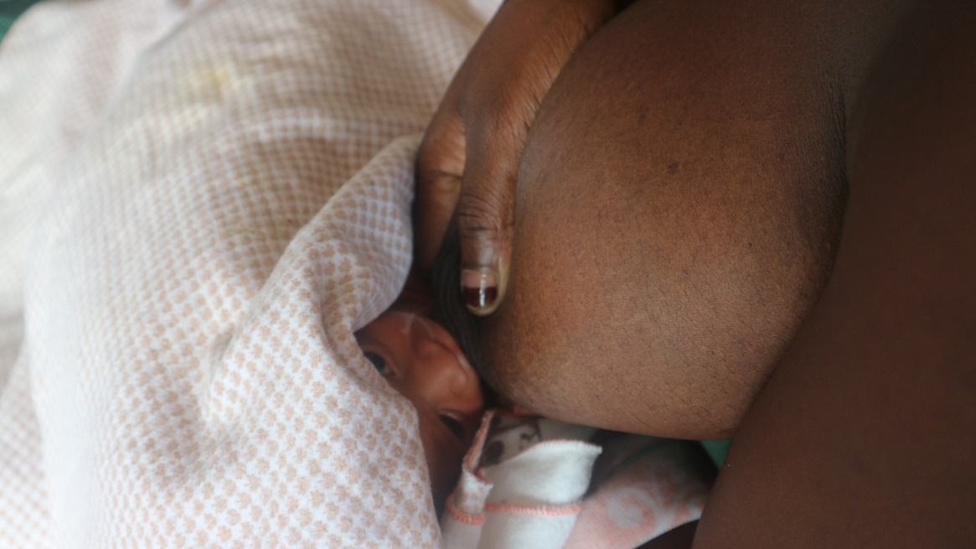
Breast Milk Composition
Overall, breast milk consists of approximately:
85-90% water
3-5% fat
0.8-0.9% protein
7% carbohydrate as lactose
0.2% minerals.
Human breast milk meets infant water requirements, and additional water is not required for stable preterm infants.
Photo provided by African Neonatal Nutrition Network partners with parental consent.
Notes:
Breast milk is the only true super-food ever consumed by humans, providing every single macro- and micronutrient required to support the rapid growth of a healthy term born infant. Human milk composition is dynamic, and varies within and between feeds, during lactation, and between mothers and populations.
The unique structures of human milk macronutrients cannot be replicated by the proteins and fats found within formula milk, meaning that functional effects differ. Furthermore, breast milk contains numerous bioactive components or 'bionutrients' including hormones, growth factors and enzymes, all of which are absent in formula. We will discuss the differences between human milk and formula milk in more detail later in this module.
In the next few slides we will discuss the components of breast milk in more detail, including how they can change during expression of breast milk and throughout the course of lactation.

Slide 4
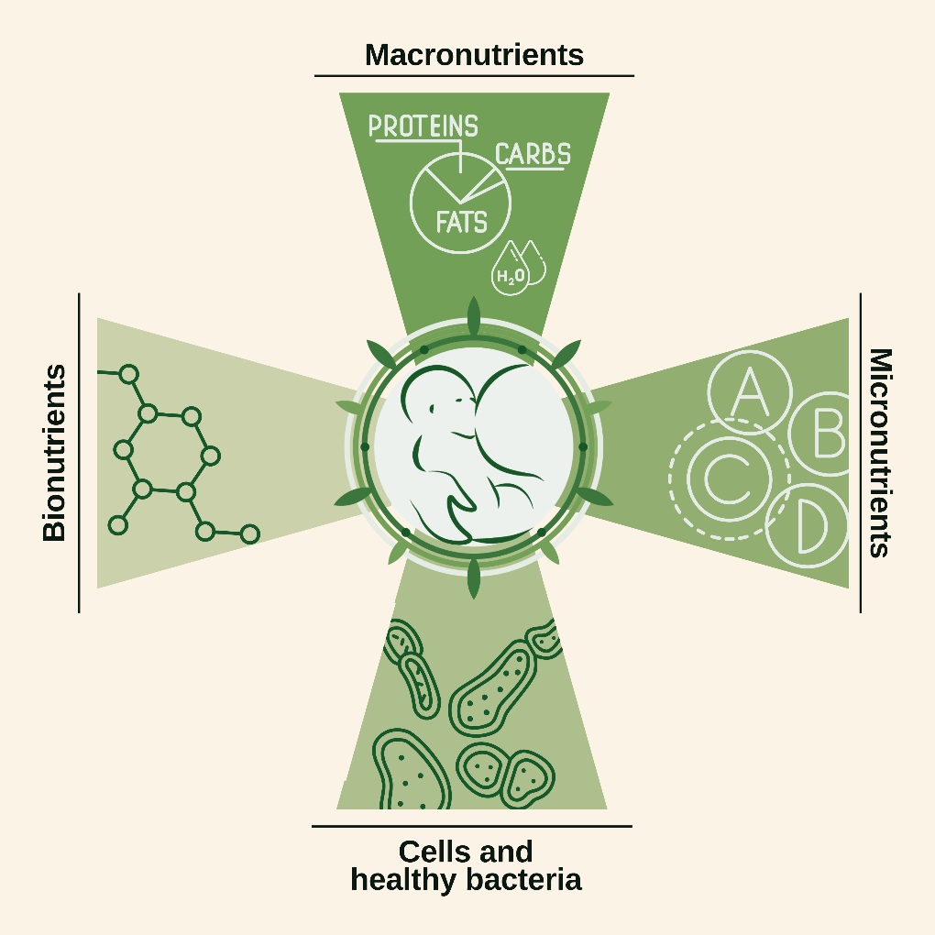
Breast milk components

Slide 5



Macronutrients
Notes:
Macronutrients include proteins, fats, carbohydrates, and water. Protein provides the building blocks for tissue growth and repair. Fats and carbohydrates each contribute about 50% of the non-protein energy in milk. Certain proteins, fats and carbohydrates also have special functions, for example in immunity and inflammation. Macronutrient quantity (concentration) and quality (types of proteins or fats) differ between human milk and milk from cows or other animals.
Proteins
Human milk contains several different proteins which are broadly classified as either casein or whey proteins. Human milk also contains small amounts of mucin proteins in the milk fat globule membrane (discussed later in this step) and some free amino acids such as taurine which may have important functions.
Fats
98% of the fats in human milk are triglycerides. These fats consist of 3 (“tri-”) fatty acids with a glycerol (“glyceride”) backbone.
Human milk also contains essential fatty acids (alpha-linolenic acid and linoleic acid) and additional long chain fatty acids such as DHA and arachidonic acid (ARA). DHA is critical for brain development and ARA is involved in controlling inflammation. The fatty acid composition in breast milk changes during a breastfeed with hind-milk having a higher fat content. Unlike protein and carbohydrates, which are relatively constant in individual mothers, the fatty composition reflects maternal diet.
Carbohydrates
Lactose is a disaccharide (two sugars) and is digested by the enzyme lactase into two monosaccharides (singular sugars) - glucose and galactose - which are then absorbed. Lactose and galactose are important for healthy gut bacteria health and function of the gut lining (epithelium).
HMOs are also carbohydrates. HMOs are short-chain sugars consisting of 3-8 individual sugars including fucose, glucose and galactose. They promote the growth of healthy bacteria in the infant gut and reduce the risk of necrotising enterocolitis (NEC).

Slide 6
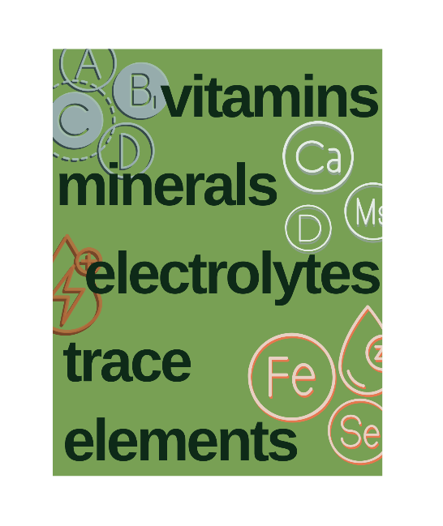


Micronutrients and functional components
Notes:
Human breast milk provides all the micronutrients needed by healthy term infants.
Vitamins provided by breast milk include water soluble vitamins B and C, and fat soluble vitamins A, D, and E. Breast milk is relatively low in vitamin K and intramuscular vitamin K is widely given at birth.
Minerals provided by breast milk include calcium, phosphorus, and magnesium. Iron is an important mineral for red cell production and essential for brain development. Breast milk has relatively low concentrations of iron, but these are sufficient for term infants. Preterm and LBW infants who are exclusively breastfed need supplemental iron.
Other micronutrients provided by breast milk include electrolytes (e.g. sodium, potassium) and trace elements (e.g. zinc, selenium).
Bionutrients
Bionutrients or immunonutrients are ‘functional’ components of breast milk that perform important physiological functions, such as protecting against infection. Many bionutrients are also present in amniotic fluid.
In human breast milk, hundreds of bionutrients have been identified - more than have been found in any other mammal.
Examples of bionutrients in breast milk include:
Growth factors, e.g. Insulin-like growth Factor-1 (IGF-1), Vascular endothelial growth factor (VEGF)
Hormones, e.g. erythropoietin, somatostatin
Specialised fats, e.g. phospholipids, DHA
Immunoglobulins, e.g. secretory immunoglobin A (sIgA)
HMOs
Interestingly, HMOs cannot be digested by humans, but are present solely to promote the growth of healthy bacteria, such as Bifidobacteria. There are around 200 different HMOs in breast milk. In human milk, by weight there are more HMOs than protein (the key to life itself)! This emphasises how important breast milk is to reducing infections and promoting gut health.
Cells and Healthy Bacteria
Breast milk contains live maternal cells, including immune cells such as macrophages, and stem cells which are involved in tissue repair and can migrate to the brain.
It is normal for breast milk to contain healthy bacteria that support development of the gastrointestinal tract. These healthy bacteria can help prevent growth of dangerous bacteria and infections. Breast milk can also transfer healthy viruses called bacteriophages.

Slide 7
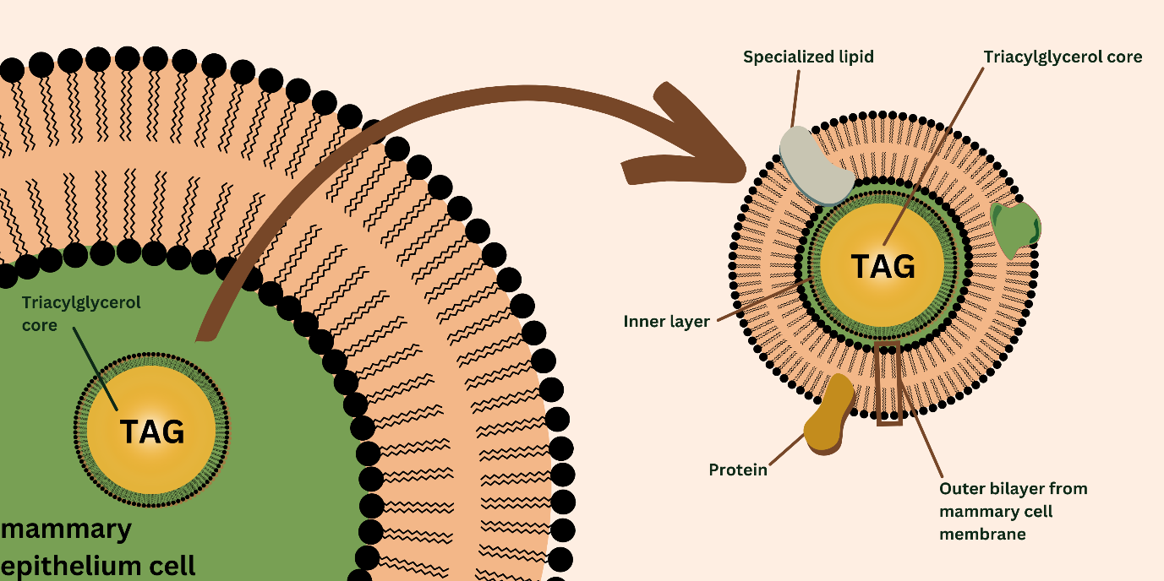
Milk Fat Globule Membrane (MFGM)
Notes:
You have learned that most of the fats in breast milk are triglycerides. These are produced inside the mammary cell with a single membrane layer. When the fat globule is exocytosed (passed out) into the milk ducts in the breast, it ‘picks up’ the bi-layer of the mammary cell itself. This results in a fat globule with 3 layers (tri-layer structure) which is fairly unique in biology. Embedded into this trilayer structure are specialized lipids, such as sphingomyelin, and proteins involved in immune function and brain growth.
You may recognise this unique tri-layer structure from the logo of the African Neonatal Nutrition Network, shown in the top left of this slide!
The ANNN logo carries a double meaning. The colour and shape use themes from the flags of African countries. Meanwhile the three concentric circles represent the triple-layered MFGM found in breast milk. The leaf-shaped structures represent the proteins and enzymes found in this membrane.

Slide 8

Changes in breast milk composition
Whilst composition of breast milk changes over the course of weeks, there are also significant changes in composition over the course of a single feed.
Notes:
Changes over the course of lactation
Breast milk produced in the later stages of a feed (or expression) is termed 'hind-milk' and has higher concentrations of fat, and therefore is more energy dense. This is why it is important to empty the breast when feeding before transferring to the other breast.
Effect of maternal diet on breast milk composition
Maternal diet has little effect on the composition of breast milk except for the types of fat. For example, higher concentrations of DHA are found in milk from meat and fish eaters. The amount of protein, iron, and carbohydrate that a mother eats has little effect on breast milk composition. However, mothers must eat a healthy diet and drink plenty of water in order to produce breast milk in sufficient quantities.

Slide 9
Breast milk composition summary
The macronutrient and micronutrient composition of breast milk is unique to humans and has evolved to provide immune protection and promote brain growth.
Bionutrients support unique physiological processes. Human milk also contains healthy bacteria and live maternal stem cells which may repair damaged tissue.
The unique composition of breast milk cannot be replicated by artificial formula, emphasising the importance of supporting mothers to provide their own milk to their babies.
The types of fats and proteins (the macronutrient ‘quality’) differ to cow milk.
Most bionutrients are not present in formula and often have much lower concentrations in donated human milk.
We will discuss donor and formula milk in more detail later in this module.

Slide 10
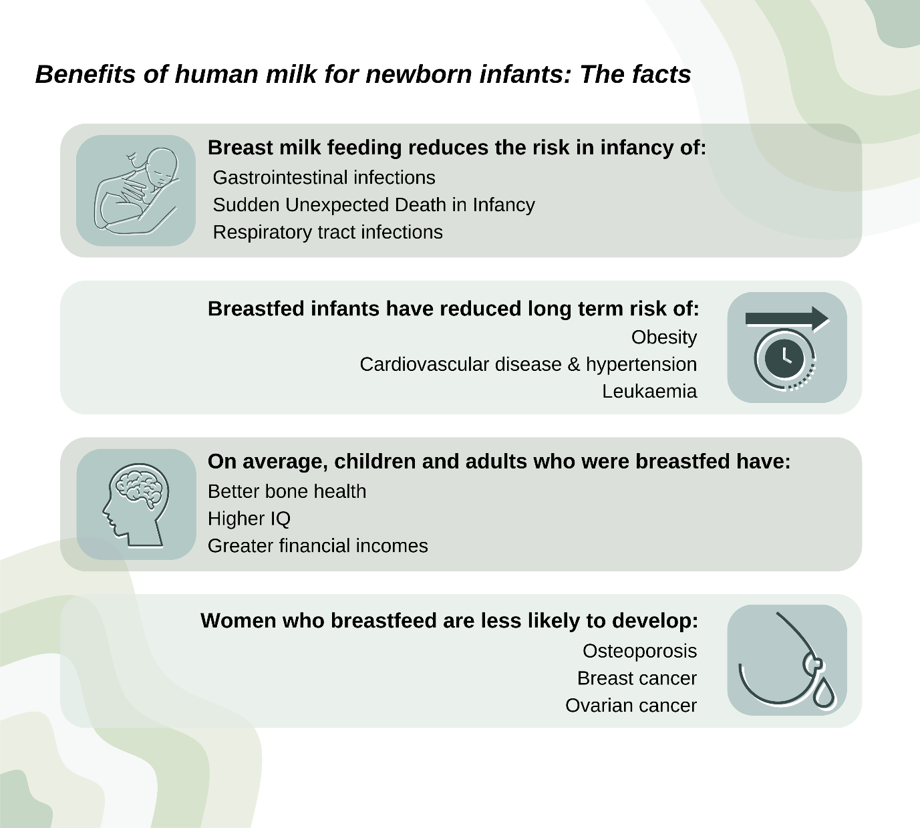
Benefits of breast milk
Notes:
Breastfeeding is one of the foundations of child health, development, and survival, especially where diarrhoea, pneumonia, and undernutrition are common causes of mortality among children younger than five years. For these reasons, exclusive breastfeeding for the first six months of life is the recommended way of feeding infants, followed by continued breastfeeding with appropriate complementary foods for up to two years or beyond.
The benefits of breast milk
The benefits of human breast milk for newborn infants are undisputed, and the scientific literature on this topic is vast. Some of the key facts are shown on this slide.

Slide 11
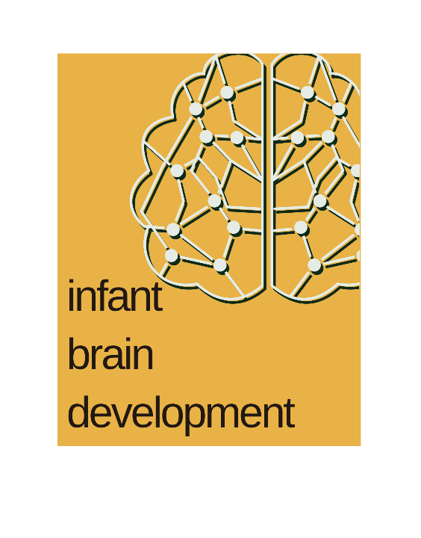

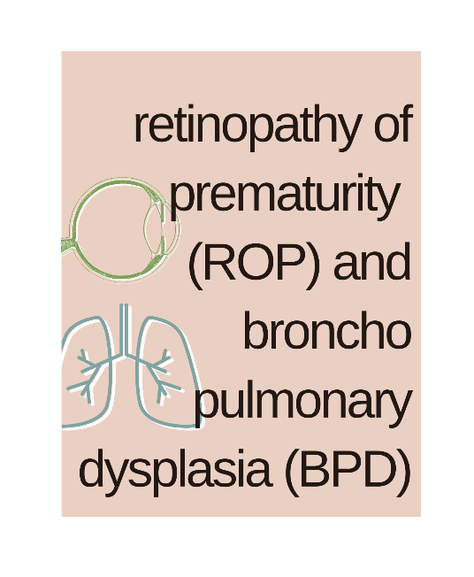
Benefits of breast milk for preterm and LBW infants
Notes:
The benefits shown on the last slide apply to all newborns, including preterm and LBW infants. Observational studies, including randomised controlled trials (RCTs), have shown key benefits for LBW infants who receive human milk compared to formula. In almost all studies there is a dose-response effect, meaning the more human breast milk received the greater the benefit. RCTs comparing MOM to formula would be unethical, but RCTs have compared DHM to formula.
Some key areas where breast milk can provide benefits to preterm and LBW infants are shown in the cards on this slide and described in more detail below.
Necrotising enterocolitis (NEC) and sepsis
RCTs show that infants who receive DHM to make up for any shortfall in MOM have a lower rate of NEC (Quigley et al., 2019). This may be due to several mechanisms including greater intake of beneficial human milk components, or lower intake of cow milk proteins. Observational studies confirm that infants receiving MOM compared to formula have lower rates of NEC and late onset sepsis. The benefits are greatest in those receiving the most MOM – there is a dose-response effect.
Retinopathy of Prematurity (ROP) and Bronchopulmonary Dysplasia (BPD)
Several observational studies suggest that rates of ROP and BPD are lower in infants receiving MOM. Although these are only observational studies, the data are fairly consistent and yet again stress the importance of maximising MOM intakes (Bharwani et al., 2016).
Infant brain development
Numerous observational studies show that infants fed with MOM have better neurodevelopmental outcomes even after adjusting for variables such as maternal educational attainment and socioeconomic aspects. The benefits may be related to mother-baby closeness during breastfeeding, or related to specific functional components of breast milk (bionutrients). This emphasises how holistic nutrition relates to both social and cellular behaviour.

Slide 12
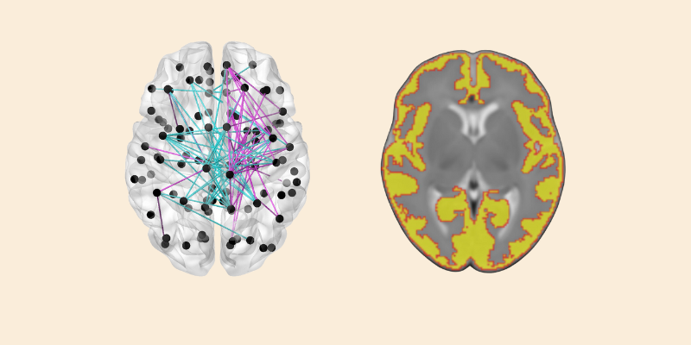
Relevant studies
Image provided by Professor James Boardman.
Notes:
Left: Glass brain diagram showing inter-hemispheric (blue) and intra-hemispheric (magenta) brain connections in white matter that are strengthened in preterm infants who receive human milk.
Right: The cerebral cortex is better developed in preterm infants who receive high versus low volumes of human milk.
A large French study of >2,900 premature infants showed that developmental outcomes were better in MOM fed infants despite slower growth when compared to infants who were formula fed. The developmental benefits continued to be associated with duration of breastfeeding even after hospital discharge (Roze et al., 2012).
More recent studies have used Magnetic Resonance Imaging (MRI) to examine brain connectivity and development of specific brain structures in preterm infants. These show that MOM promotes the growth of specific brain regions, especially the white matter (e.g. the corpus callosum), and results in improved brain connectivity (Blesa et al., 2019).

Slide 13
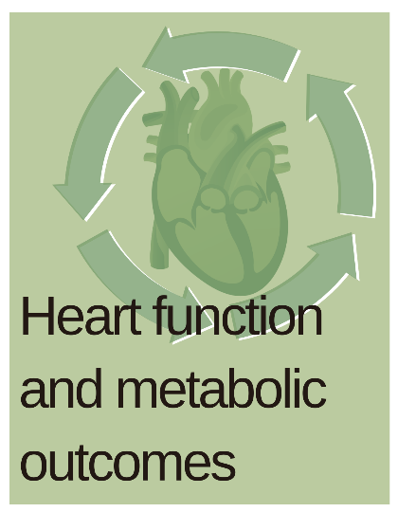

Benefits of breast milk for preterm and LBW infants
Notes:
Social, emotional and communication development in infancy
Most studies exploring the relationship between breast milk intake and brain outcomes in preterm infants have been conducted in high-income countries and focused on infants born very preterm (<32 weeks). However, a large study conducted in preterm infants born at 32-36 weeks showed the benefit of breast milk on social-communication development in infancy. Infants who were not breastfed on hospital discharge were more likely to show social, emotional, and behavioural impairments at age 2 years (Johnson et al., 2018).
Heart function and metabolic outcomes in adulthood
Long-term follow-up studies show that adults who were born preterm and received human milk had significantly better heart function and metabolic outcomes in adulthood compared to those who were formula-fed (Lewandoski et al., 2016; Singhal et al., 2001; Lucas et al., multiple papers).
Potential metabolic benefits of breastmilk include:
Lower blood pressure
Better heart function and shape
Improved serum lipid profiles
Improved insulin sensitivity
Greater bone mineral mass

Slide 14
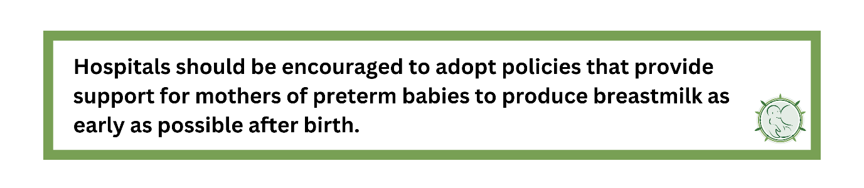
ANNN Recommendation
Notes:
References for slides 10-14
Blesa, M., Sullivan, G., Anblagan, D., Telford, E.J., Quigley, A.J., Sparrow, S.A., Serag, A., Semple, S.I., Bastin, M.E. and Boardman, J.P. (2019). Early breast milk exposure modifies brain connectivity in preterm infants. NeuroImage, 184, pp.431-439.
Lewandowski, A.J., Lamata, P., Francis, J.M., Piechnik, S.K., Ferreira, V.M., Boardman, H., Neubauer, S., Singhal, A., Leeson, P. and Lucas, A. (2016). Breast milk consumption in preterm neonates and cardiac shape in adulthood. Pediatrics, 138(1).
Johnson, S., Waheed, G., Manktelow, B.N., Field, D.J., Marlow, N., Draper, E.S. and Boyle, E.M. (2018). Differentiating the preterm phenotype: distinct profiles of cognitive and behavioral development following late and moderately preterm birth. The Journal of Pediatrics, 193, pp.85-92.
Bharwani, S.K., Green, B.F., Pezzullo, J.C., Bharwani, S.S. and Dhanireddy, R. (2016). Systematic review and meta-analysis of human milk intake and retinopathy of prematurity: a significant update. Journal of Perinatology, 36(11), pp.913-920.
Fewtrell, M.S. (2011). Does early nutrition program later bone health in preterm infants? The American Journal of Clinical Nutrition, 94(suppl_6), pp.1870S-1873S.
Singhal, A., Cole, T.J. and Lucas, A. (2001). Early nutrition in preterm infants and later blood pressure: two cohorts after randomised trials. The Lancet, 357(9254), pp.413-419.

Slide 15
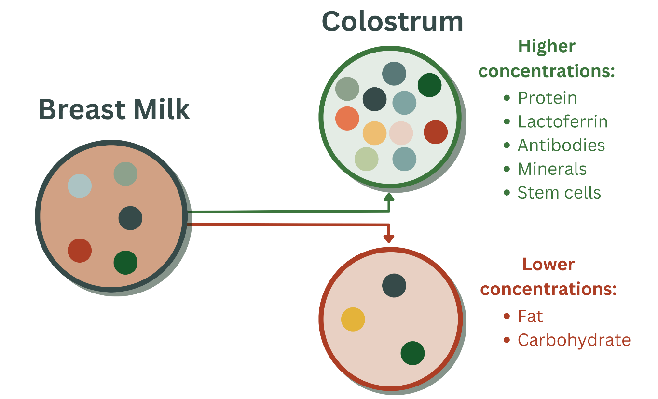
Oropharyngeal colostrum
Notes:
Colostrum is the breast milk produced in the first hours and days after birth. In this step, we discuss how the composition of colostrum differs from regular breast milk and the advantages of providing colostrum to infants.
This step will also provide an opportunity to interact with peers and share your own hospital's use of colostrum.
Composition of colostrum
The large number of immunoprotective, growth, and bioactive factors in breast milk are present in colostrum in even higher concentrations, especially in milk from mothers delivering preterm.
The graphic on this slide indicates the components of breast milk that are found in higher or lower concentrations in colostrum.
In infants who feed directly from the breast, these components come into direct contact with lymphoid tissue in the mouth and oropharynx. When breast milk is administered via a gastric tube, direct contact with the mucosa is by-passed.
In preterm or LBW infants who are too sick or small to breastfeed, 0.2-0.5ml oropharyngeal colostrum (OPC) should be provided immediately after birth and continued for several days or weeks until direct breastfeeding is established.

Slide 16
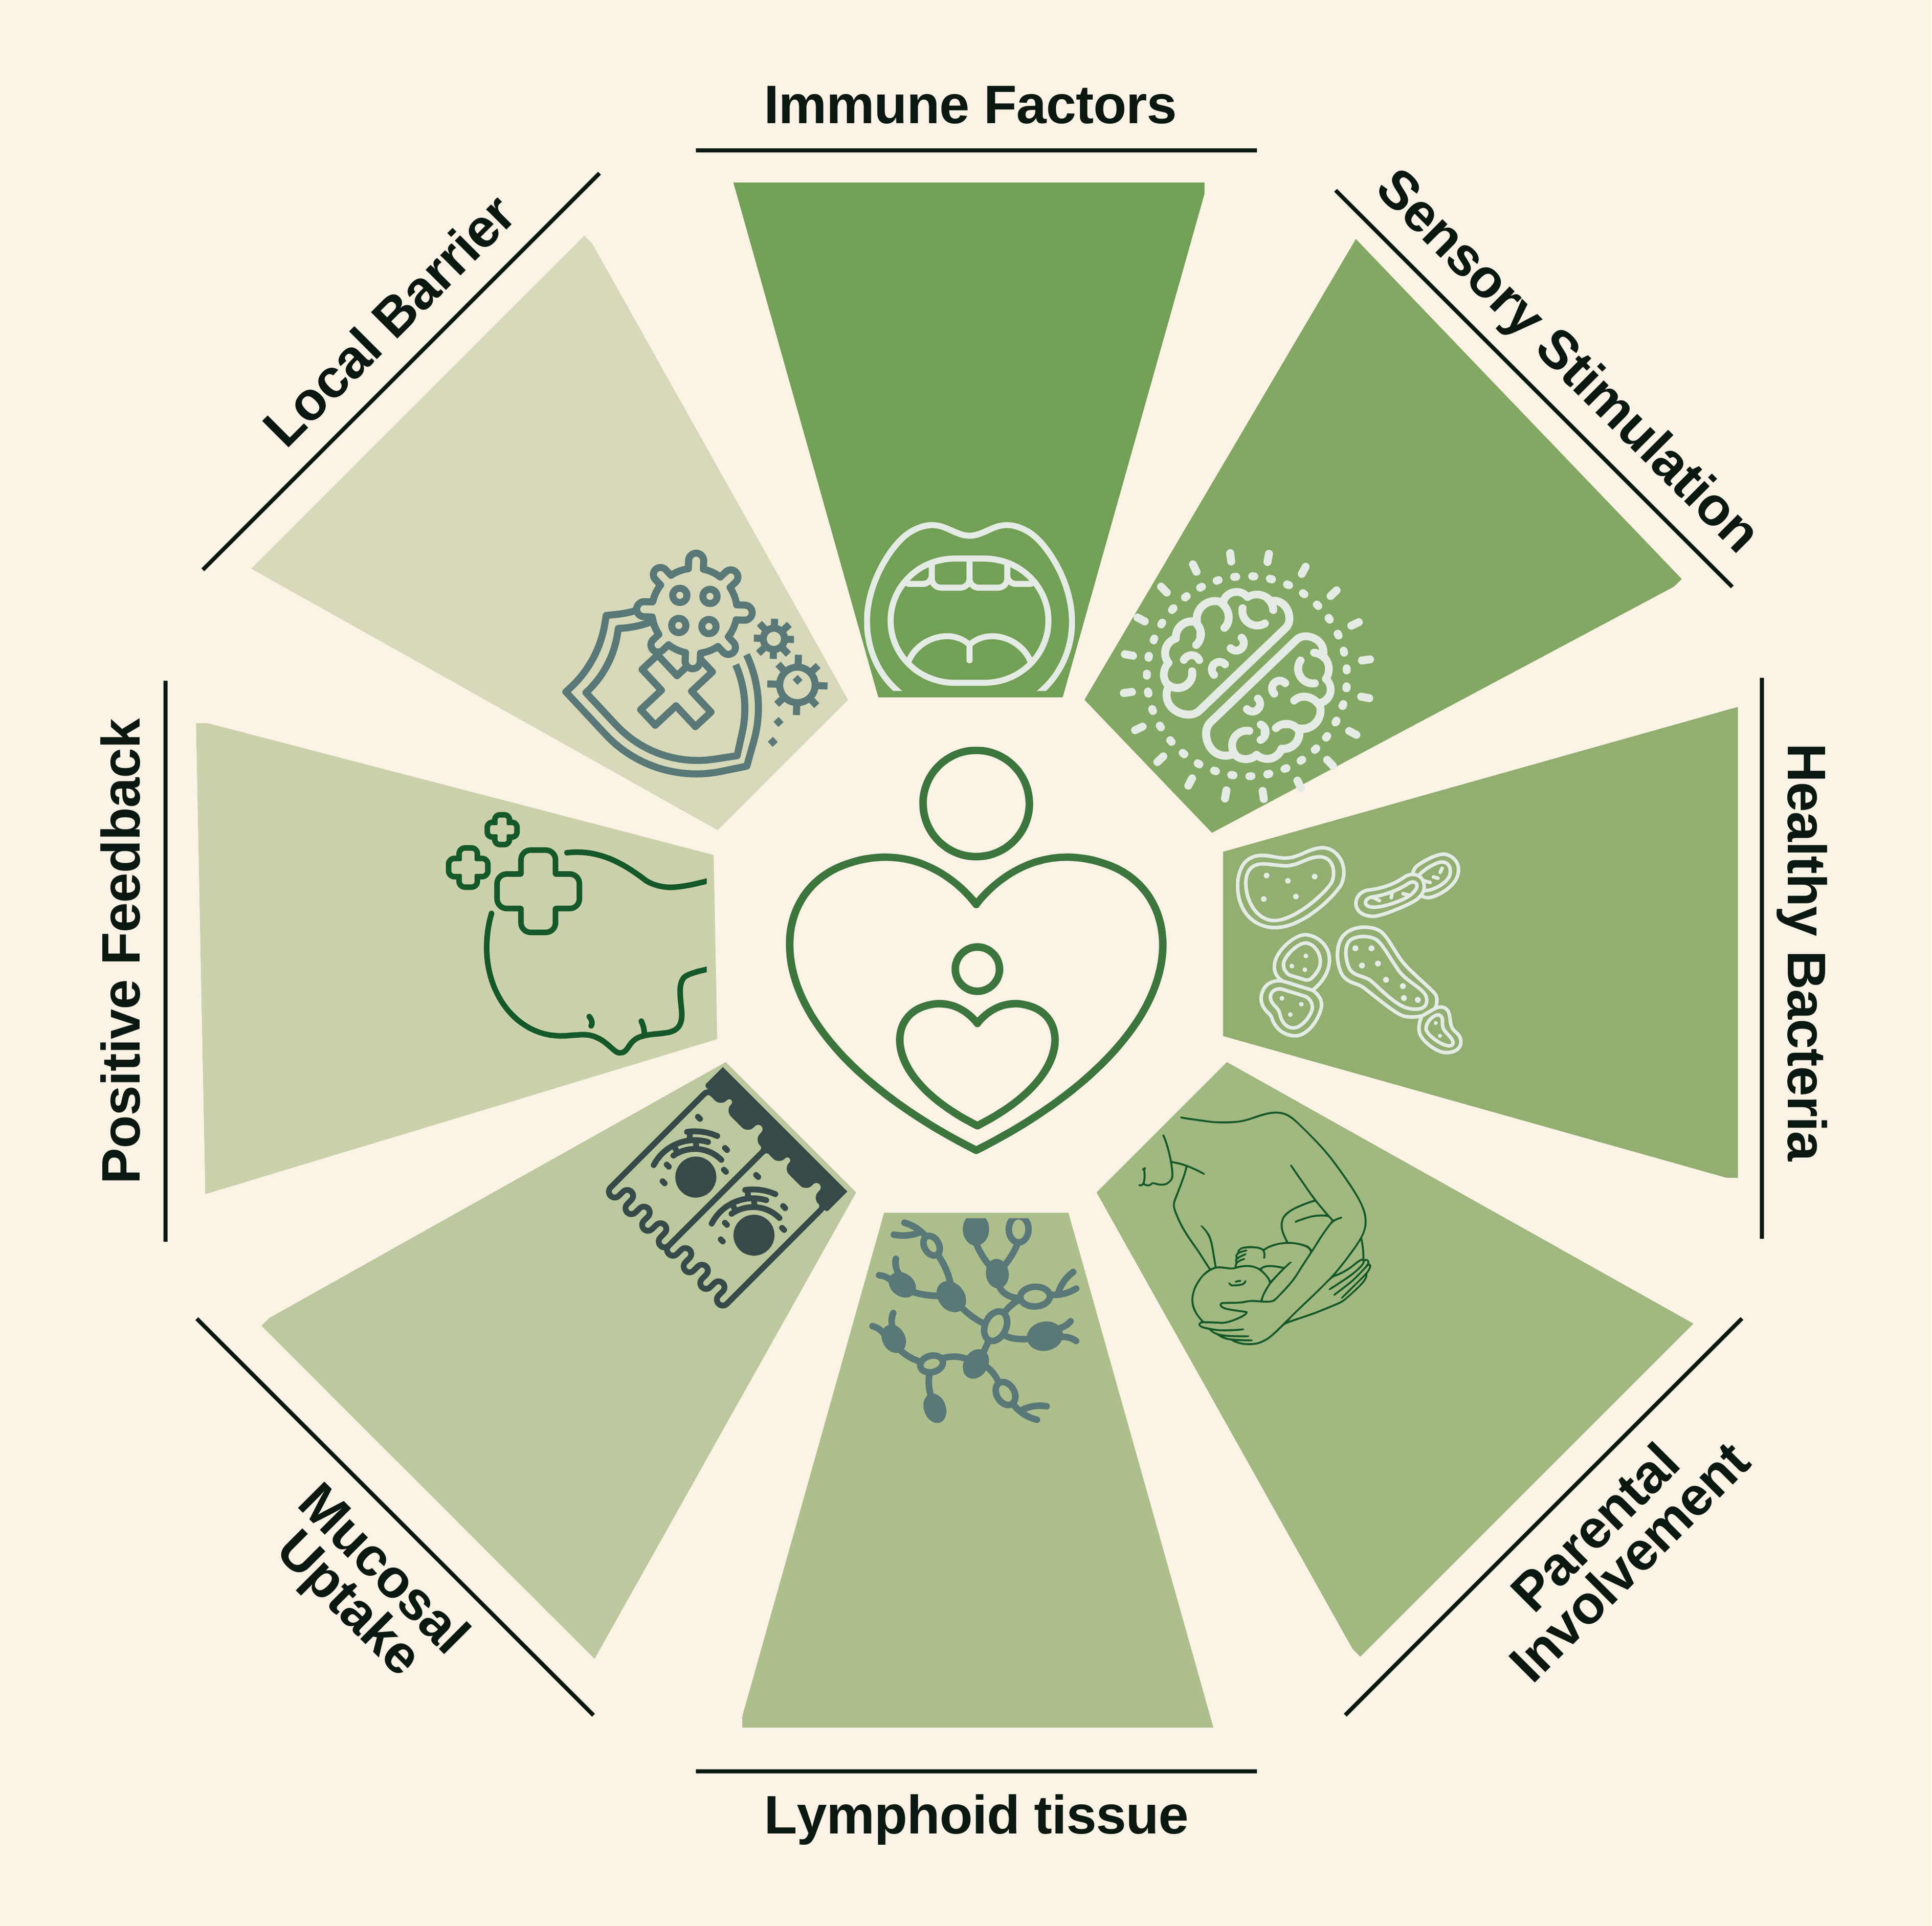
Advantages of oropharyngeal colostrum
Notes:
Immune factors - Direct contact of immune factors with oropharyngeal tissue.
Sensory stimulation - Taste and sensation may comfort the baby.
Healthy bacteria - Colonisation of the mouth with healthy bacteria.
Parental involvement - Administration by parents/carers involves them in feeding management.
Lymphoid tissue - Stimulating lymphoid tissue to enhance immune cell production.
Mucosal Uptake - Placing a small volume of colostrum directly onto the buccal mucosa of preterm infants during the early neonatal period may provide immunological and growth factors that stimulate the immune system and enhance intestinal growth.
Positive feedback - Positive feedback to mother encourages breast milk expression.
Local barrier - Acts as a form of local barrier protection against pathogens by blocking microbial adhesion to the mucosa.
In one study, OPC resulted in higher levels of beneficial antibodies, such as sIgA, in the urine, and higher levels of immune protective proteins, such as lactoferrin (Maffei et al., 2020). OPC may reduce the risk of NEC and sepsis (OuYang et al., 2021) and may also reduce the time to full feeds and improve weight gain (Huo et al., 2022). Many hospitals now provide OPC to every infant, including infants born <28 weeks gestation as well as fragile infants requiring ventilatory support and inotropes. There are no obvious contra-indications, but rapid administration of large volumes may increase the risk of aspiration.
How to collect and give oropharyngeal colostrum
Ideally, the baby can receive OPC by direct breastfeeding. When this is not possible, such as in preterm or LBW infants who are too sick or small to breastfeed, colostrum can also be collected by the mother using a small syringe as she performs hand expression. Advice and support from a nurse will help, as will information sheets, diagrams and access to videos. The mother can then give this colostrum directly to the infant if they are receiving KMC, or the mother can be enabled to give this if the infant is in an incubator or cot. Alternative methods include collecting the colostrum on a cotton bud, although some of the colostrum may be ‘lost’ as it is absorbed into the cotton bud itself. Cotton buds cannot be re-used.

Slide 17
How to collect and give oropharyngeal colostrum
Ideally, the baby can receive OPC by direct breastfeeding.
When this is not possible, such as in preterm or LBW infants who are too sick or small to breastfeed, colostrum can also be collected by the mother using a small syringe as she performs hand expression.
Advice and support from a nurse will help, as will information sheets, diagrams and access to videos.
The mother can then give this colostrum directly to the infant if they are receiving KMC, or the mother can be enabled to give this if the infant is in an incubator or cot.
Alternative methods include collecting the colostrum on a cotton bud, although some of the colostrum may be ‘lost’ as it is absorbed into the cotton bud itself.
Cotton buds cannot be re-used.
Notes:
Does your hospital use OPC? What is their approach to starting colostrum feeds, and why?
Summary
Colostrum has a different composition to mature milk and contains numerous beneficial anti-infective components. During normal breastfeeding, these components come into contact with the oropharyngeal mucosa where they interact with the immune system. Where direct breastfeeding is not possible, drops of colostrum can be collected and administered directly by the mother into the baby’s mouth.

Slide 18
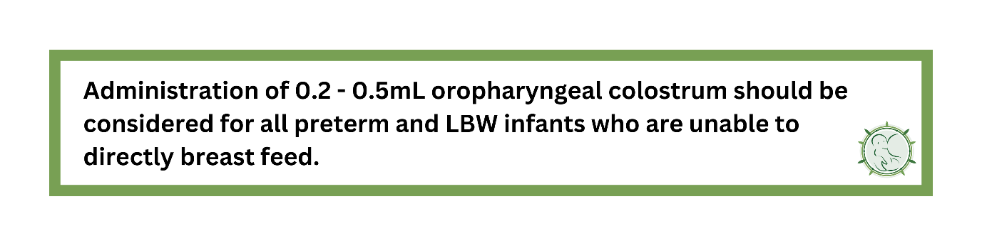
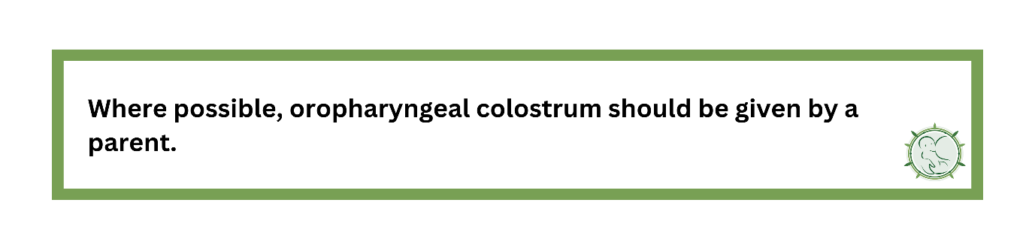
ANNN Recommendation
Notes:
References for slides 15-18
Singhal, A., Cole, T.J. and Lucas, A. (2001). Early nutrition in preterm infants and later blood pressure: two cohorts after randomised trials. The Lancet, 357(9254), pp.413-419.
Maffei, D., Brewer, M., Codipilly, C., Weinberger, B. and Schanler, R.J. (2020). Early oral colostrum administration in preterm infants. Journal of Perinatology, 40(2), pp.284-287.
OuYang, X., Yang, C.Y., Xiu, W.L., Hu, Y.H., Mei, S.S. and Lin, Q. (2021). Oropharyngeal administration of colostrum for preventing necrotizing enterocolitis and late-onset sepsis in preterm infants with gestational age≤ 32 weeks: a pilot single-center randomized controlled trial. International Breastfeeding Journal, 16(1), pp.1-15.
Huo, M., Liu, C., Mei, H., Zhang, Y., Liu, C., Song, D., Zhang, Y., Zhang, Y. and Xin, C. (2022). Intervention Effect of Oropharyngeal Administration of Colostrum in Preterm Infants: A Meta-Analysis. Frontiers in Pediatrics, 10(895375).
Embleton, N.D., Moltu, S.J., Lapillonne, A., van den Akker, C.H., Carnielli, V., Fusch, C., Gerasimidis, K., van Goudoever, J.B., Haiden, N., Iacobelli, S. and Johnson, M.J. (2022). Enteral nutrition in preterm infants (2022): a position paper from the ESPGHAN committee on nutrition and invited experts. Journal of Pediatric Gastroenterology and Nutrition, 76(2), pp.10-1097.

Slide 19
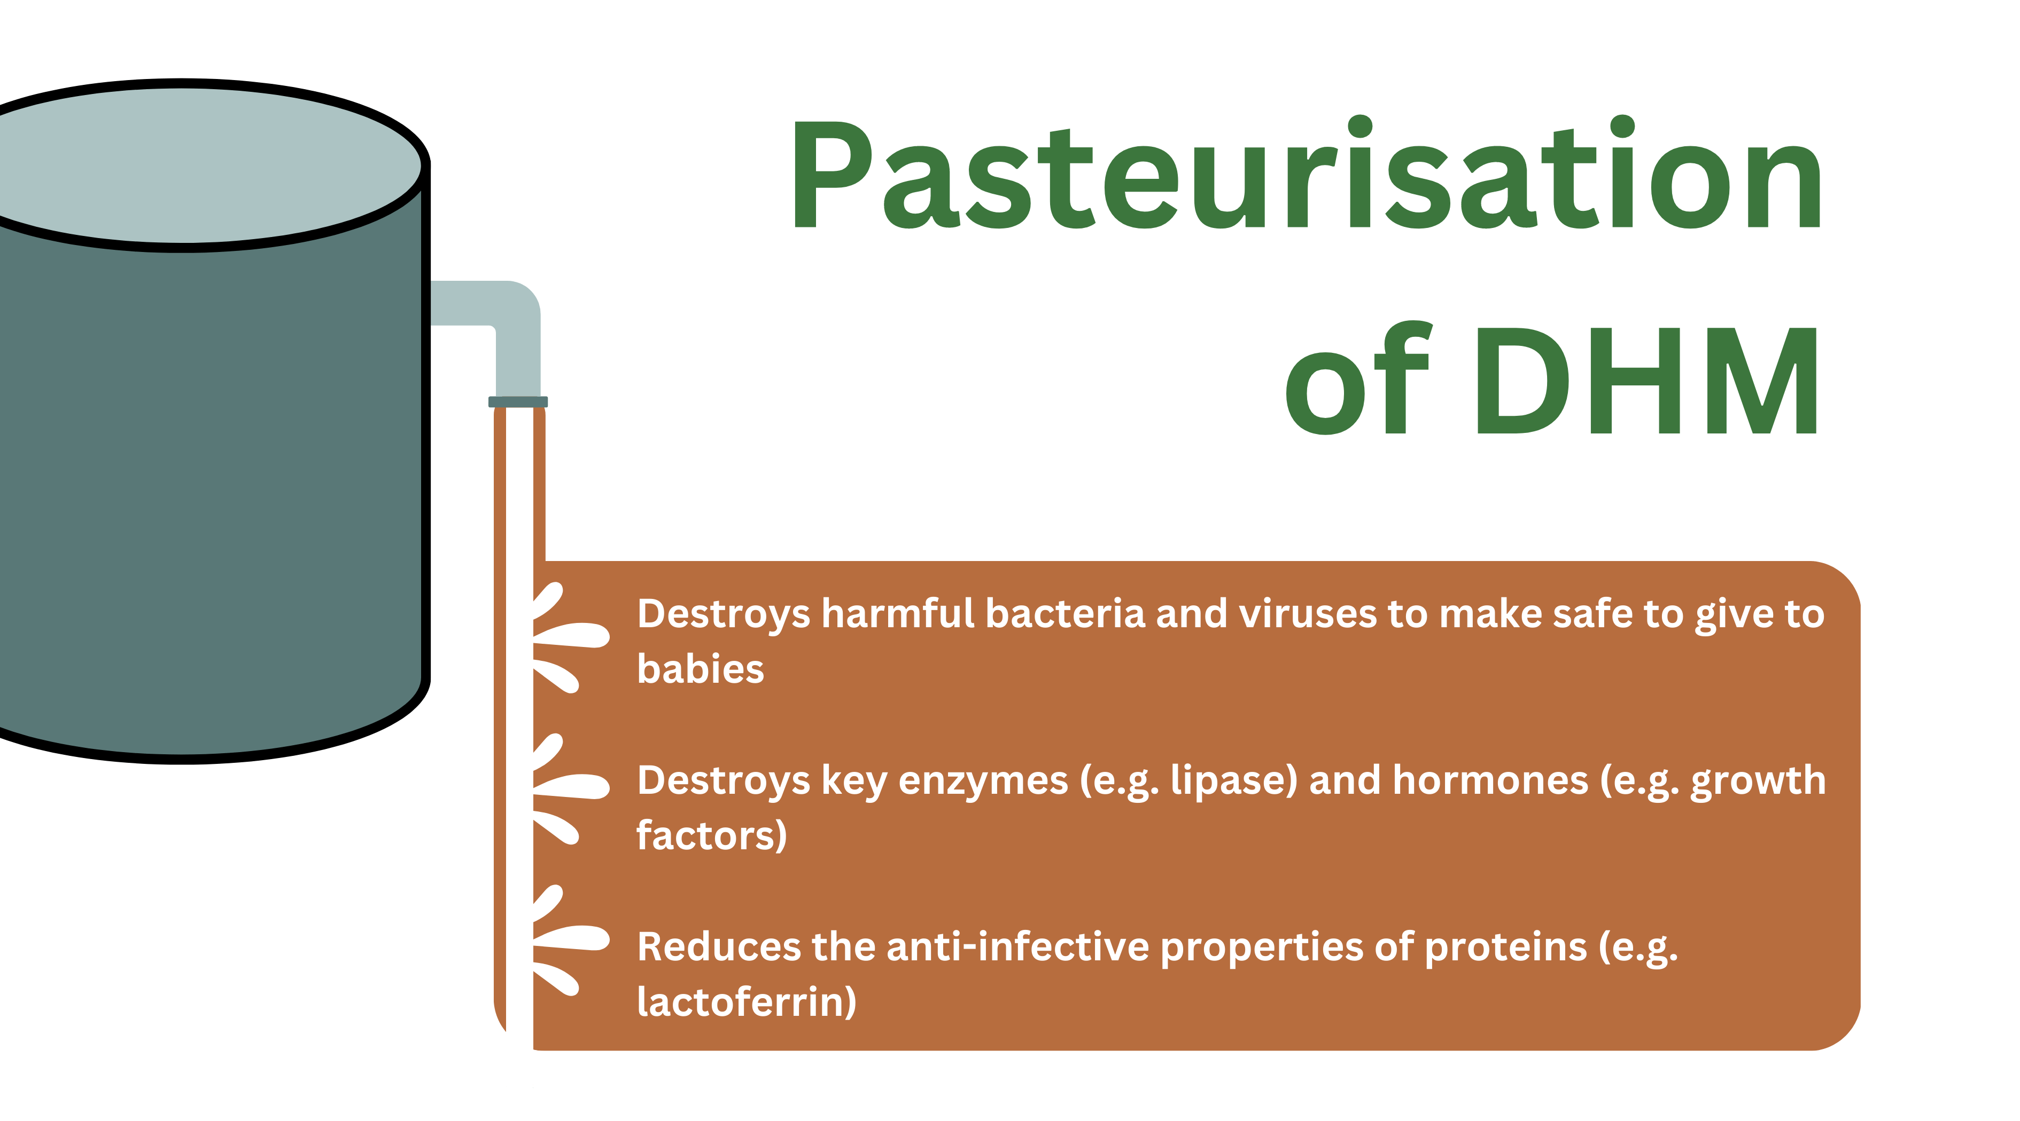
Donor milk and formula
Notes:
This step introduces donor human milk (DHM) and formula as alternatives to mother’s own milk (MOM). It concludes with a comparison between all three milk types, which once again highlights the benefits of MOM.
Donor human milk (DHM)
DHM is pasteurised human breast milk that has been donated for free to a donor milk bank. DHM is typically donated by mothers who have been breastfeeding their own infant for several weeks or months. This is then used to make up for any “shortfall” or absence of MOM supply. DHM is therefore not needed if there is a plentiful supply of MOM.
Pasteurisation of DHM
Pasteurisation is essential when DHM is used for preterm infants. The process destroys most bacteria and viruses, but some spore forming bacteria can still survive.

Slide 20
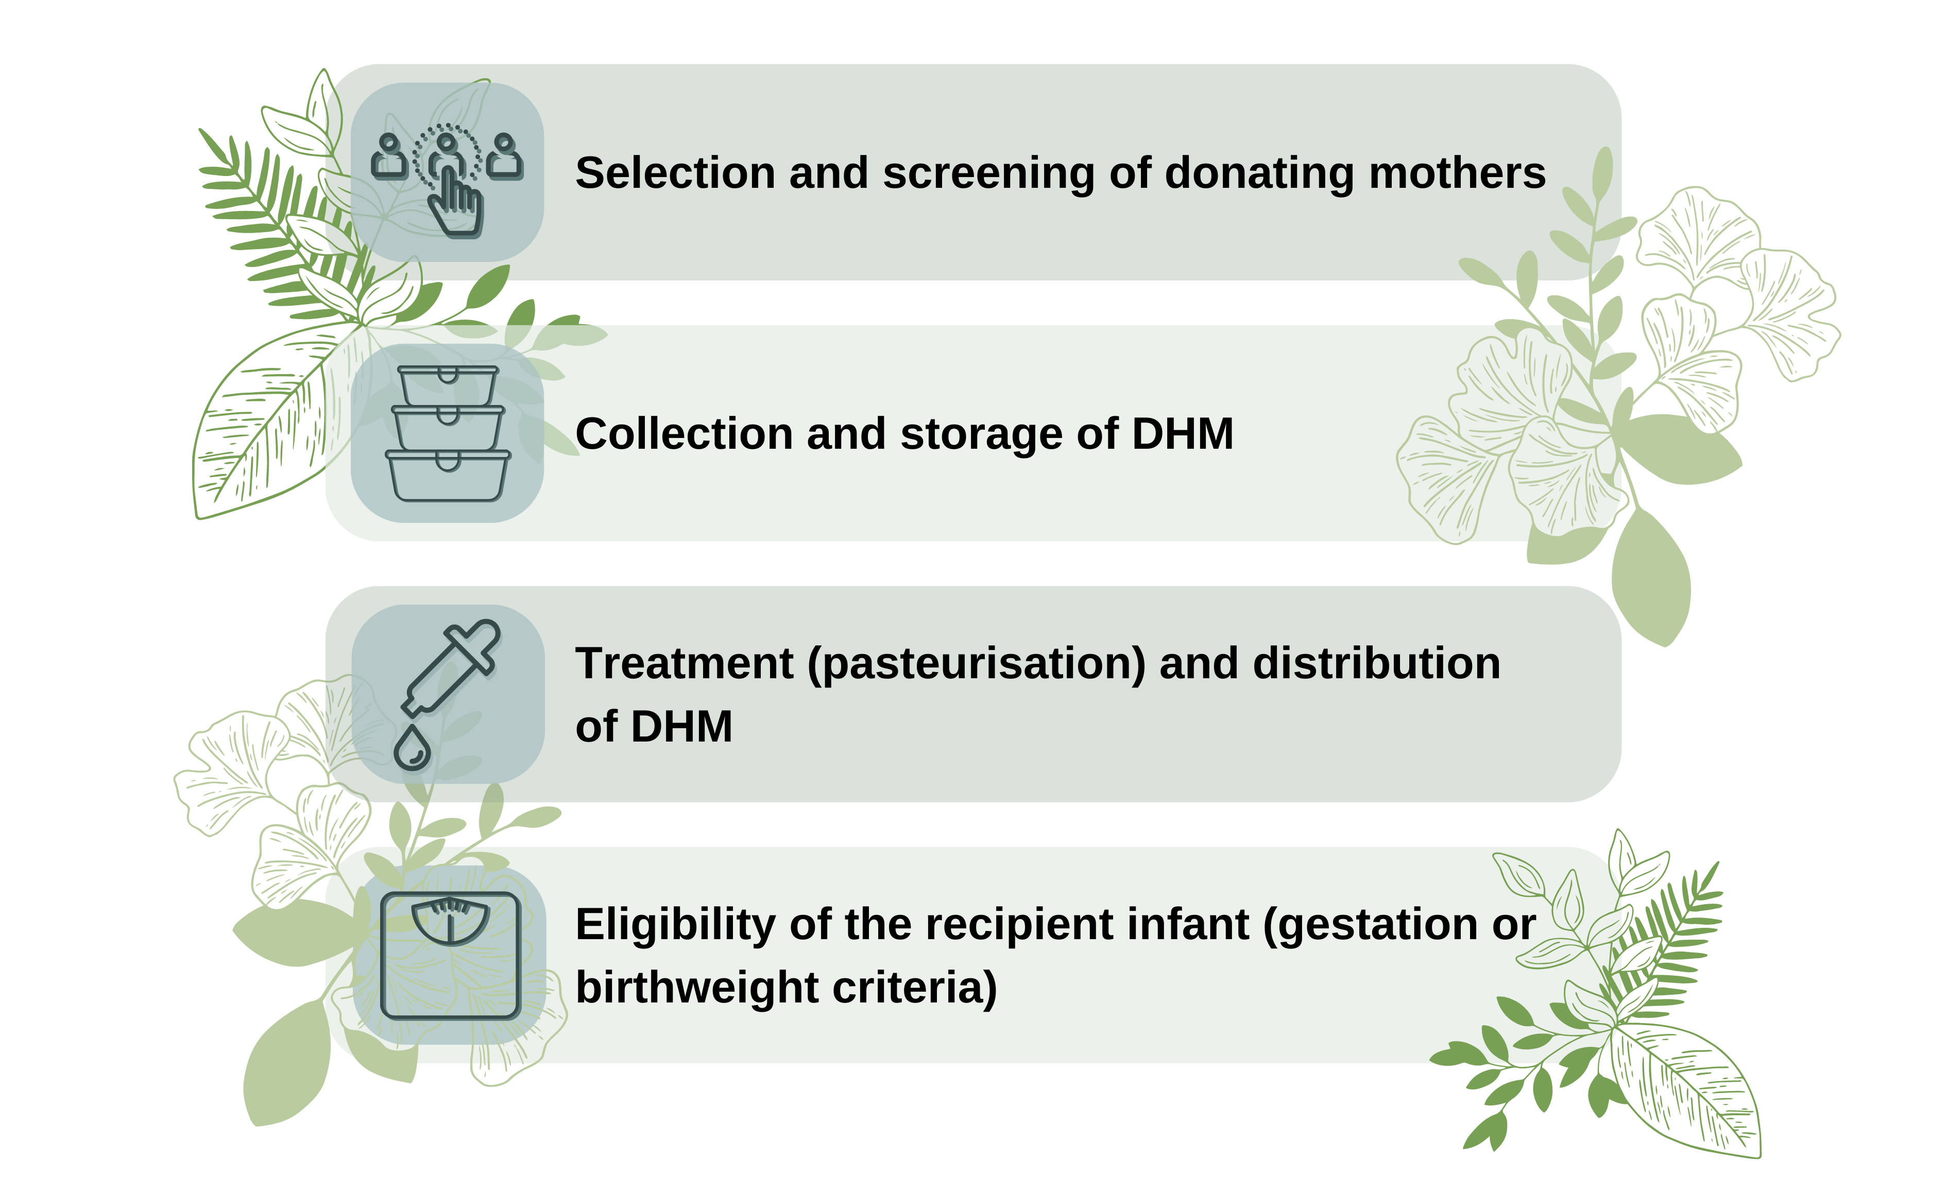
Quality controls and national policies
Notes:
DHM given to preterm or sick newborn infants must always be provided by a registered milk bank with strict quality controls and adherence to national policies that consider the measures shown on this slide.
An example of screening of donating mothers is that those who are HIV-positive should not donate milk.
We will not discuss these aspects of quality control in detail in this course, but further information can be obtained from WHO and other groups and organisations on the resources page of our website.
Sources of human breast milk
Donor human milk banks are common in many parts of the world including Brazil (>200 milk banks), Europe, and Southeast Asia.
Human breast milk (apart from MOM) can also be obtained in other ways including:
Commercial human milk banks, in which donors receive reimbursement.
Informal milk sharing, e.g. friends or family members.
Independent purchases, e.g. online sales.
We will not discuss these different methods or sources further in this eLearning course, but practitioners should be aware that all of these can be associated with significant health risks and/or costs.
Cultural and religious factors are also important. For example, wet nursing is encouraged in some communities. However, evidence is required to assess the safety, benefits, and outcomes of wet nursing. In Islamic communities, the concept of milk kinship is a belief that human milk creates a kinship between the breastfeeding woman and her non-biological nursing infant, prohibiting future marriages between "milk brothers and sisters”. This may impact acceptability and use of DHM in these communities, when considering the anonymity and multiplicity of donors.

Slide 21
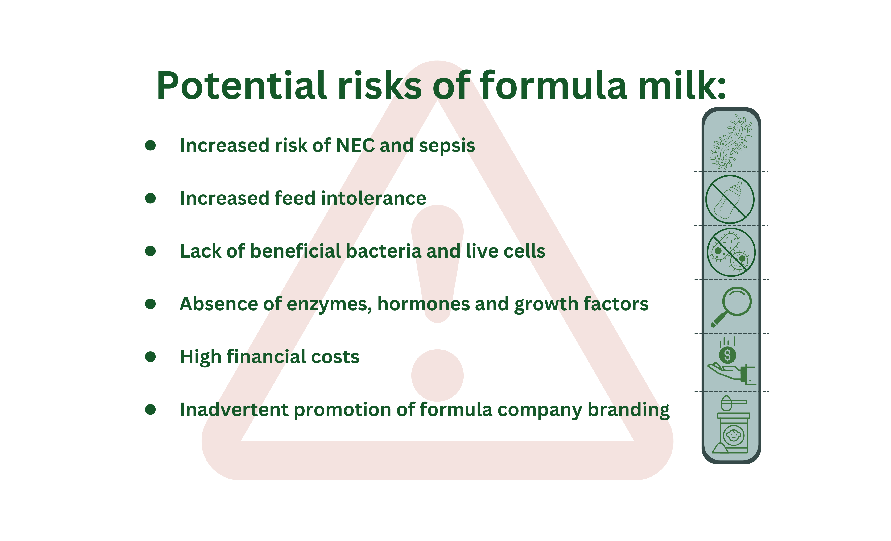
Formula Milk
Notes:
Artificial formula milk is made from cow’s milk and is available in different formulations such as term-formula, preterm-formula (higher energy and protein) or hydrolysed-formula (partially digested protein). The following risks (compared to MOM) are the same regardless of the specific formula milk used:

Slide 22
Comparing DHM, formula, and MOM
DHM vs MOM
Notes:
Due to the pasteurisation process discussed above, DHM is very different from MOM. The concentrations of bionutrients are often much lower in DHM compared to MOM. DHM is not needed if there is a plentiful supply of MOM.
Given the high costs of DHM, and the uncertain advantages, many organisations have suggested that in low-income settings, limited financial resources might be better spent on improving support for mother’s to provide their own milk. However, there are situations where access to DHM might be useful, such as for maternal orphaned infants or HIV-positive mothers who have a shortfall in supply of MOM.

Slide 23
Comparing DHM, formula, and MOM
Formula vs MOM
Notes:
Human milk composition and benefits cannot be replicated by formula milk. Some of the key differences are described below.
Proteins
Cow milk formula contains casein and whey proteins, but the proteins have a different structure to those in human breast milk. This makes formula milk unable to perfectly meet the protein requirements for a newborn infant (unlike human breast milk). To adjust for this, cow milk formula contains a higher overall concentration of protein. Whilst this solves the problem in the short term, high protein intakes in infancy may increase the risk of metabolic problems in later life.
Fats
Human milk fat also differs in composition from fat in formula milk. The structure of the triglycerides in human milk are different from cow milk fat. This affects how they are digested and how they function.
Bionutrients
Whilst human breast milk contains hundreds of bionutrients, formula milk contains almost no bionutrients, without any hormones, growth factors, or enzymes. There are around 200 different Human Milk Oligosaccharides (HMOs) in breast milk, but no HMOs in formula milk. There are also no bionutrients in parenteral nutrition or intravenous fluids.
Milk Fat Globule Membrane (MFGM)
The MFGM structure in humans is unique and not present in formula milk.

Slide 24
Comparing DHM, formula, and MOM
DHM vs Formula
Notes:
Many organisations including the WHO consider DHM to be a better milk compared to formula for preterm infants as many functional aspects are preserved.
Whilst DHM has been widely used in high-income settings for more than 30 years (and wet nursing has been practised for millennia across the world), its usage declined rapidly in the 1980s when it was shown that HIV can be transmitted via breast milk. Over the last 10 years, the use of milk banks has increased steadily.
Studies have compared DHM to formula, monitoring likelihood of NEC as a key outcome. Read below to learn more about the evidence on DHM and formula.
NEC and sepsis
A number of studies of DHM have been performed in preterm infants. In general, most studies have been individually too small (around 100-400 infants per study) to conclusively show a reduction in NEC, yet some meta-analyses suggest that the risk of NEC may be reduced by up to 50% when DHM is used compared to formula. The largest effects, however, are seen where the amount of MOM available was low, or completely unavailable.
A large Dutch study (Corpoleijn et al., 2016) comparing DHM to formula in the first 10 days of life showed no impact on rates of NEC or sepsis. This means that DHM (compared with formula) may have fewer advantages where the use of MOM is high, for example where more than 70-80% of milk volume is provided by MOM. Two recent studies in Canada and USA (O’Connor et al., 2016; Colaizy et al., 2023) showed a lower rate of NEC in infants randomised to donor milk, but in these studies, NEC was a secondary outcome.
Missing evidence
No studies have shown that rates of mortality are reduced by using DHM compared to formula. Furthermore, there is no data showing that DHM compared to formula improves brain (neuro-developmental) outcomes.
Unfortunately, the strict quality control and the needs of pasteurisation, storage and transport result in DHM costing about 10-20 times as much as infant milk formula.

Slide 25
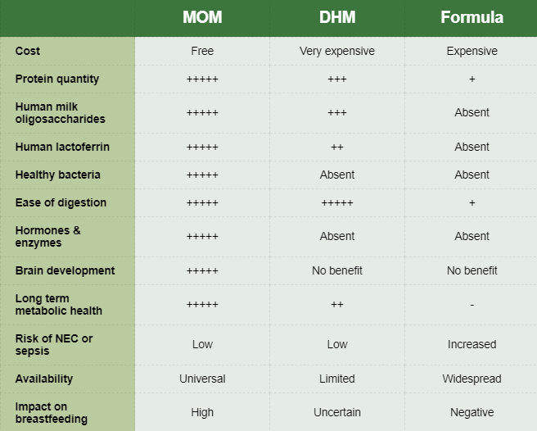
Comparing DHM, formula, and MOM
Notes:
The table on this slide compares the benefits of DHM, formula, and MOM.
Summary
Mother’s own milk (MOM) is the optimal milk for preterm and LBW infants, and support for mothers to express and breast feed is a key component of good nutritional care. Where there is insufficient MOM, then donor human milk (DHM) can be used. DHM may have important advantages compared to formula milk, but these are less important when there is a good intake of MOM. DHM does not have the same short and long-term advantages of MOM and is also relatively expensive.

Slide 26
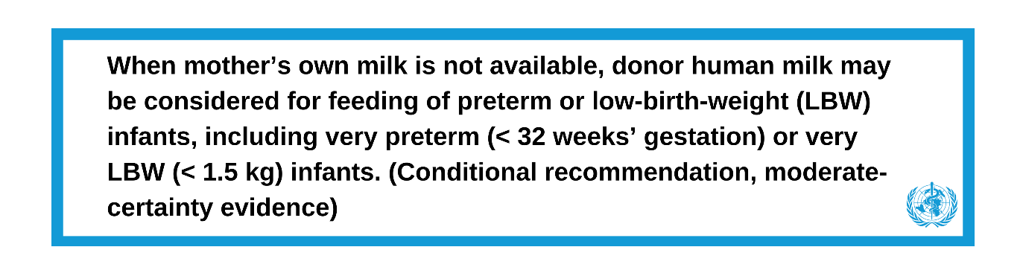
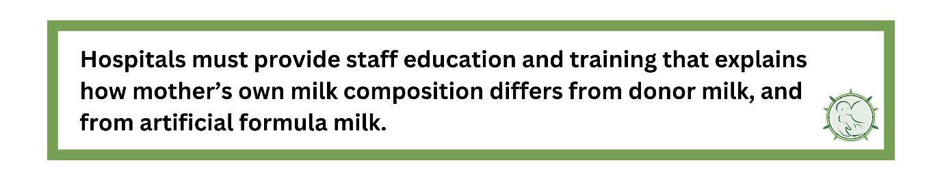
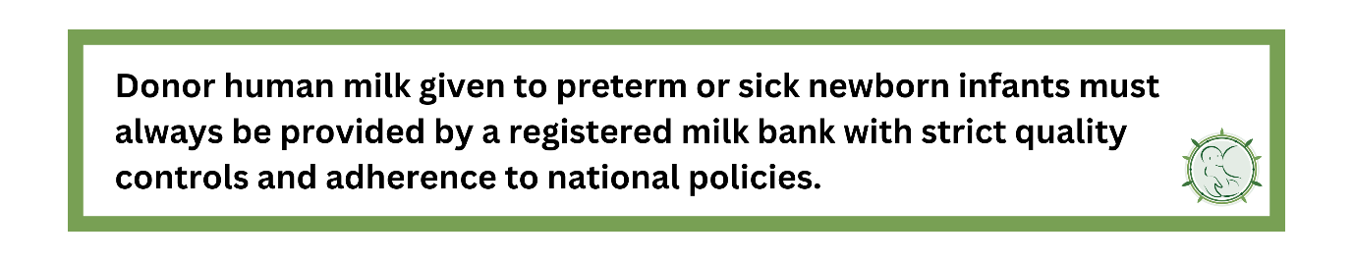
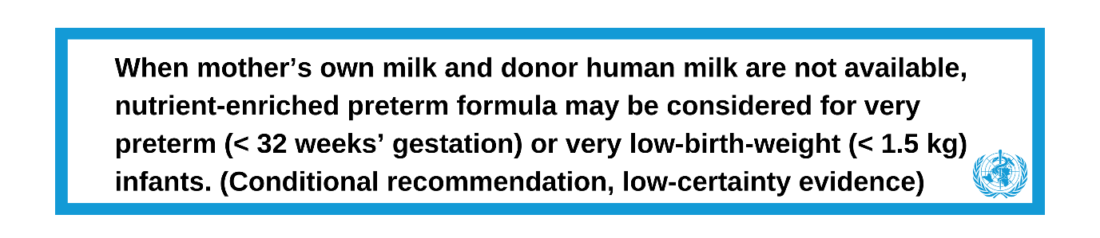
WHO/ANNN Recommendations
WHO Recommendations
ANNN Recommendations
Notes:
References for slides 19-25
Quigley, M., Embleton, N.D. and McGuire, W., Cochrane Neonatal Group. (2019). Formula versus donor breast milk for feeding preterm or low birth weight infants. Cochrane Database of Systematic Reviews, 170(7).
Corpeleijn, W.E., De Waard, M., Christmann, V., van Goudoever, J.B., Jansen-van der Weide, M.C., Kooi, E.M., Koper, J.F., Kouwenhoven, S.M., Lafeber, H.N., Mank, E. and van Toledo, L. (2016). Effect of donor milk on severe infections and mortality in very low-birth-weight infants: the early nutrition study randomized clinical trial. JAMA Pediatrics, 170(7), pp.654-661.
O'Connor, D.L., Gibbins, S., Kiss, A., Bando, N., Brennan-Donnan, J., Ng, E., Campbell, D.M., Vaz, S., Fusch, C., Asztalos, E. and Church, P. (2016). GTA DoMINO Feeding Group. Effect of supplemental donor human milk compared with preterm formula on neurodevelopment of very low-birth-weight infants at 18 months: a randomized clinical trial. JAMA, 316(18), pp.1897-1905.
Embleton, N.D., Moltu, S.J., Lapillonne, A., van den Akker, C.H., Carnielli, V., Fusch, C., Gerasimidis, K., van Goudoever, J.B., Haiden, N., Iacobelli, S. and Johnson, M.J. (2022). Enteral nutrition in preterm infants (2022): a position paper from the ESPGHAN committee on nutrition and invited experts. Journal of Pediatric Gastroenterology and Nutrition, 76(2), pp.10-1097.
WHO (2022). WHO recommendations for care of the preterm or low-birth-weight infant. World Health Organization. Available at: https://www.who.int/publications/i/item/9789240058262

Slide 27
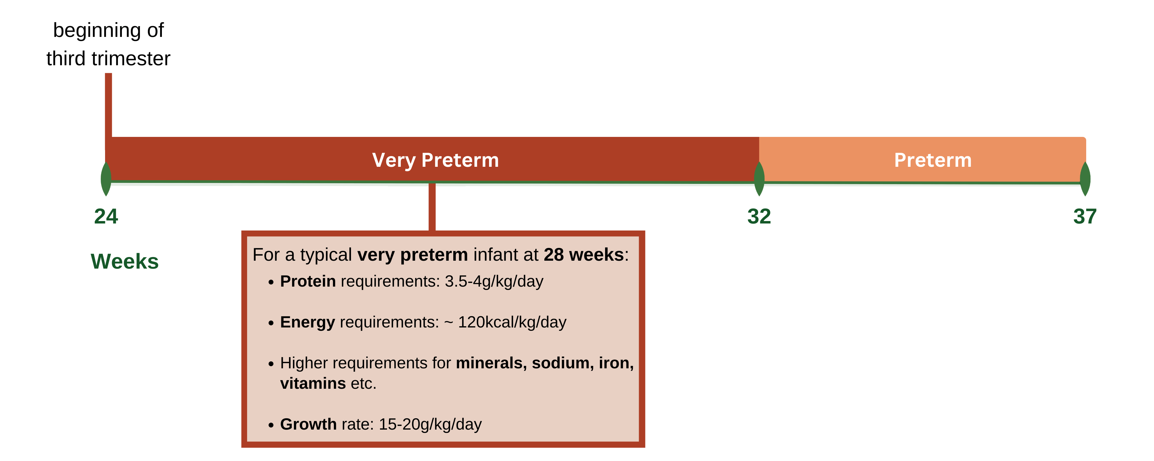
Fortification of breast milk
Nutrient needs in preterm infants
Very preterm - Growth of the fetus at the beginning of the 3rd trimester of pregnancy (24 weeks onwards) is very rapid, around 20g/kg/day.
Preterm - The growth rate slows in the last few weeks of pregnancy to around 10g/kg/day. This means that very preterm infants have higher nutrient requirements than an infant born full term.
Notes:
Very preterm infants have higher nutrient requirements than an infant born full term. Breast milk fortifiers (BMF) are widely used in high-income settings as a relatively simple method to increase macro- and micronutrient intakes. However, the evidence of their long-term benefit is uncertain, and there are several associated risks. In this step, we discuss the nutrient needs of preterm infants and the use of BMF.
Routine supplementation with iron and Vitamin D is recommended, but it is difficult to increase the amount of protein and energy in the diet without additional supplements. Breast milk has the perfect amount of nutrients for full-term babies and contains:
1-1.5g/100ml protein.
60-70kcal/100ml energy.
Feeding expressed breast milk at 180ml/kg/day will provide around 2-2.5g/kg/day of protein and 100kcal/kg/day energy. However, these intakes are lower than those required for some very preterm infants to gain weight at the same rate as a fetus, or follow the centile lines on a typical preterm infant growth chart. Weight gain slower than the centile lines on a growth chart is therefore common in extremely preterm infants in resource limited settings.

Slide 28
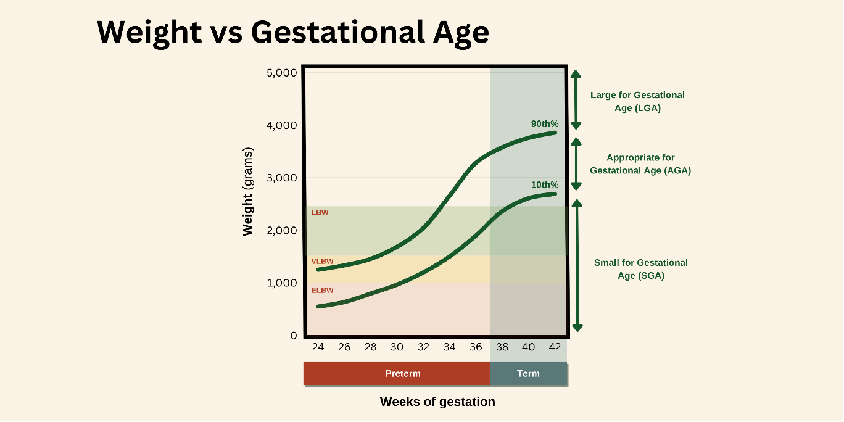
RECAP: What is a growth chart?

Slide 29
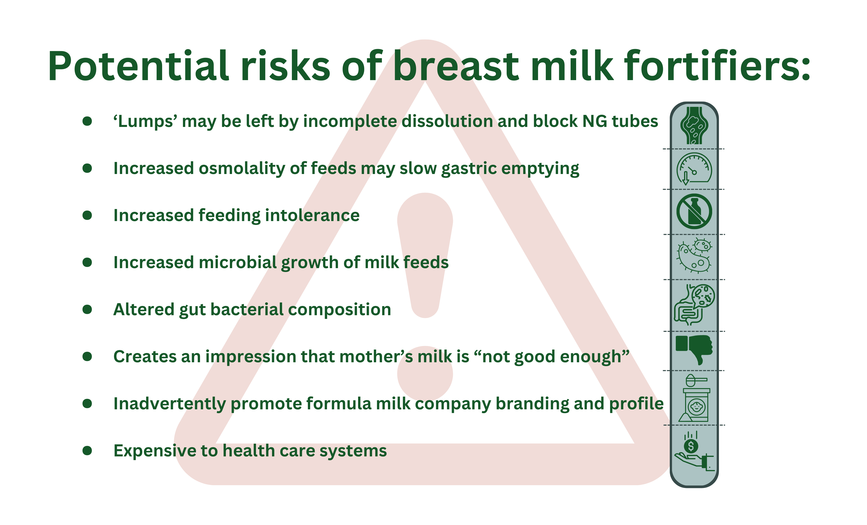
Breast milk fortifiers (BMF)
Notes:
Several studies, and a Cochrane meta-analysis (Brown et al., 2020), have shown that fortification of human breast milk with multi-component BMF has small positive effects on growth prior to hospital discharge. These studies were mainly in high income countries.
Powdered fortifiers are made from cow’s milk and are available as sachets or tins with a scoop. They are mixed with breast milk at the cot side or in a ‘milk kitchen’. Multicomponent BMF powder contains protein and energy (macronutrients), as well as extra vitamins, minerals, and electrolytes (micronutrients). BMF therefore provides a relatively simple method of meeting nutrient requirements whilst continuing to provide all milk volume as mother’s own breast milk (or occasionally donor breast milk).
Risks and benefits of BMF
Despite the apparent benefits of fortifiers, no studies have shown improved longer term outcomes in important areas such as brain development in infancy. There are also potential risks and complications (see slide).
It is therefore uncertain whether all preterm infants should receive breast milk fortification. Commercial human milk derived fortifiers are now available in the USA but are very expensive (over US$100 per day). Despite these potential concerns, fortifiers are widely used in high-income settings as a relatively simple method to increase macro- and micronutrient intakes, and are recommended by ESPGHAN. WHO does not recommend routine use but says it may be considered.

Slide 30
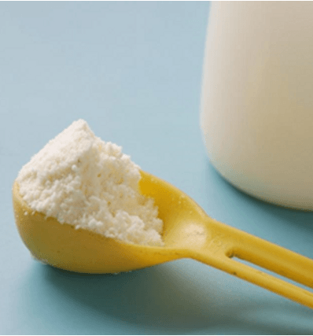

How else can extra macronutrients be provided?
Photo provided by African Neonatal Nutrition Network partners with parental consent.
Notes:
Some hospitals use infant formula (either term or preterm formulations) and add this to breast milk. Studies have shown that with careful training, unit guidelines, and strict attention to hand washing (and infection control), this may be an effective strategy to improve weight gain. However, there have been few large studies to date. Furthermore, the amounts of protein and energy provided are not ‘balanced’, meaning that this method typically provides too little protein, and too much energy. Some hospitals may decide to replace some of the mother’s milk volume with formula, but in cases where there is sufficient mother’s milk, this is not recommended as it increases the risks of complications.
Another way of providing additional nutrients is to increase the volume of breast milk that is given. Most hospitals feed milk at 150-180ml/kg/day, but several hospitals regularly use higher intakes - up to 200-220ml/kg/day. Small studies have shown that feeding at higher volumes appears safe (Travers et al., 2020). Despite this, some infants may experience increased gastric residuals, abdominal distension, or feeding intolerance as a result of these higher volumes. Once full feeds of around 180ml/kg/day has been achieved, one strategy is to gradually increase the milk feeds further by 10ml/kg/day every 1-2 days and observe how the baby tolerates these increases.
As discussed earlier in this course, hind-milk has a higher fat content than foremilk. Limited data show that preferentially feeding hind-milk may be an effective strategy to improve weight gain in some preterm infants. However, there is currently no evidence to show that this improves long term brain outcomes.
In resource-limited settings, it may be difficult to ensure that the weight gain of very preterm infants follows their centile lines. However, it is important to remember that mother’s own breast milk has the largest positive impact on infant health and survival. Furthermore, mother’s own breast milk has major effects on cognition in infancy, childhood, and adult life. Breast milk feeding plays a much more important role than simply weight gain. In addition to the nutrients provided, breast milk also provides healthy bacteria and other bioactive components that improve brain function.

Slide 31
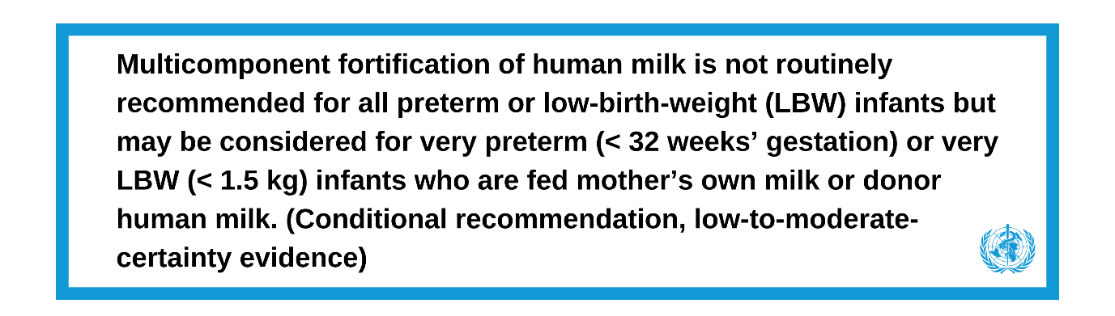
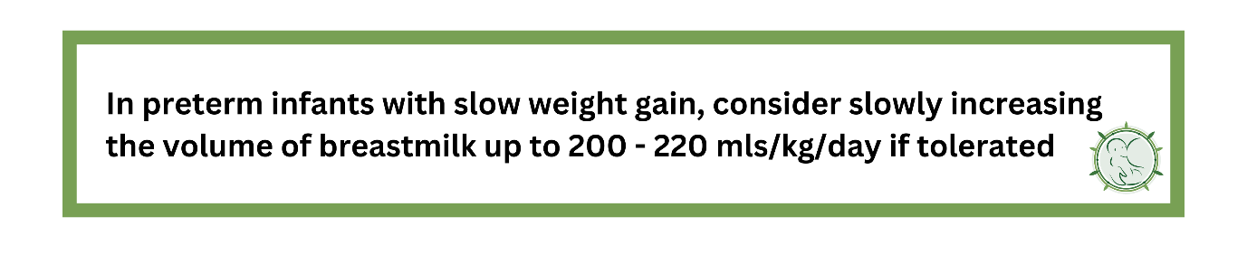
WHO/ANNN Recommendations
WHO Recommendations
ANNN Recommendations
Notes:
References for slides 27-31
Embleton, N.D., Moltu, S.J., Lapillonne, A., van den Akker, C.H., Carnielli, V., Fusch, C., Gerasimidis, K., van Goudoever, J.B., Haiden, N., Iacobelli, S. and Johnson, M.J. (2022). Enteral nutrition in preterm infants (2022): a position paper from the ESPGHAN committee on nutrition and invited experts. Journal of Pediatric Gastroenterology and Nutrition, 76(2), pp.10-1097.
Travers, C.P., Wang, T., Salas, A.A., Schofield, E., Dills, M., Laney, D., Yee, A., Bhatia, A., Winter, L., Ambalavanan, N. and Carlo, W.A. (2020). Higher-or usual-volume feedings in infants born very preterm: a randomized clinical trial. The Journal of Pediatrics, 224, pp.66-71.
Cochrane Neonatal Group, Brown, J.V.E., Lin, L., Embleton, N.D., Harding, J.E. and McGuire, W. (1996). Multi‐nutrient fortification of human milk for preterm infants. Cochrane Database of Systematic Reviews 2020, 6.
WHO (2022). WHO recommendations for care of the preterm or low-birth-weight infant. World Health Organization. Available at: https://www.who.int/publications/i/item/9789240058262

Slide 32
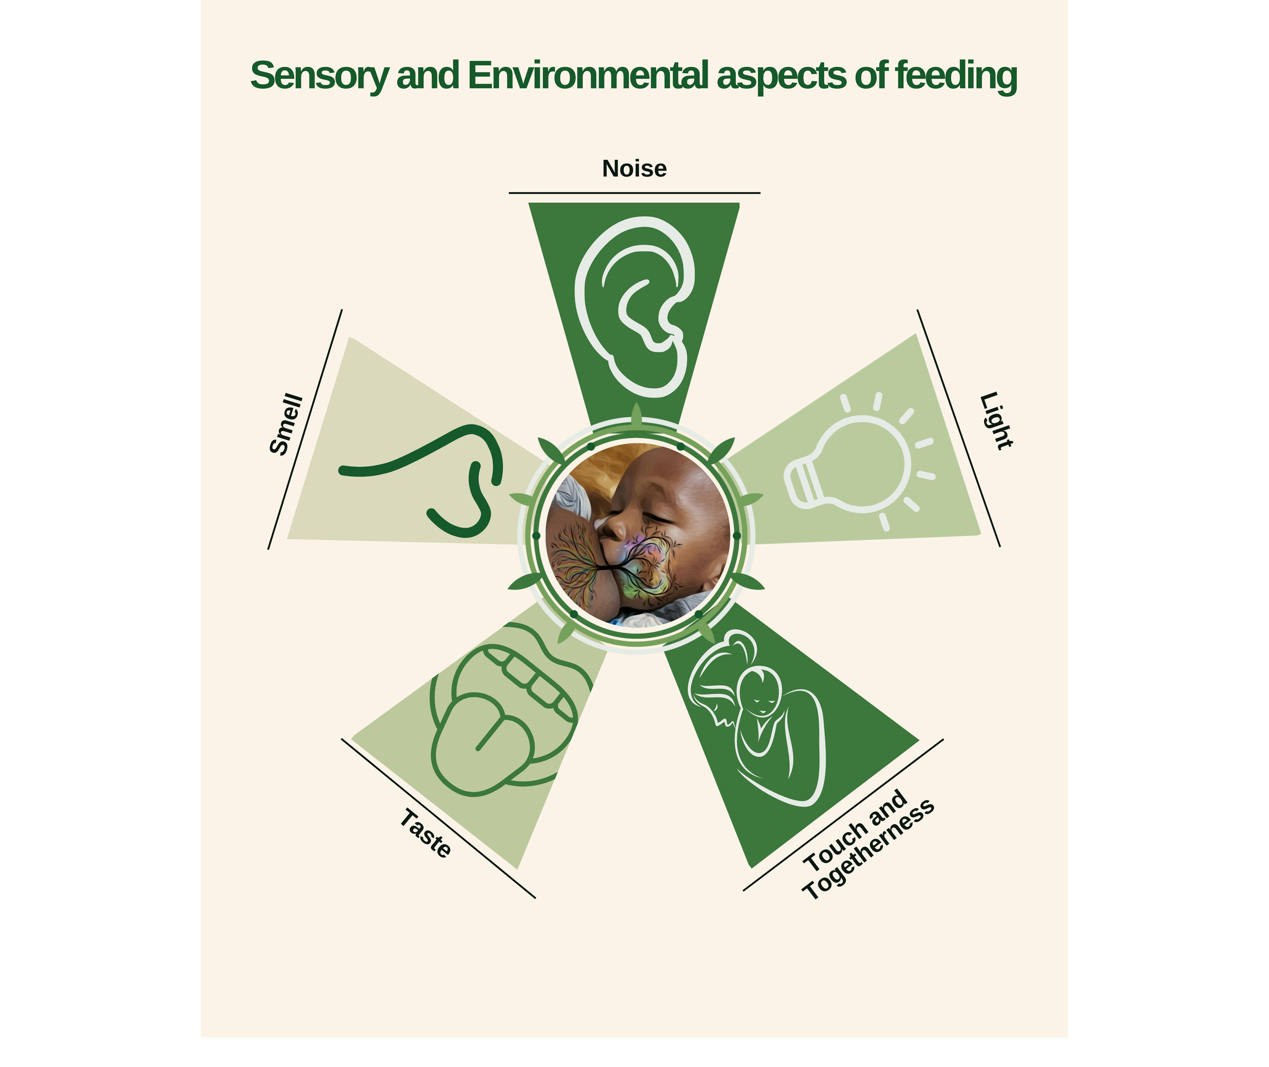
Sensory aspects of feeding
Central photo provided by African Neonatal Nutrition Network partners with parental consent.
Notes:
In this step, we will consider the importance of sensory aspects of feeding including touch, smell, and taste, and the importance of the hospital environment such as the presence of light and noise. We will discuss how sensory aspects impact on physiological stability, weight gain, and feed tolerance, and how relatively simple actions in the hospital can improve breastfeeding success.

Slide 33


Sensory aspects of feeding
Notes:
Taste and Smell
Smell and taste starts to develop in the third trimester. This means that newborn babies, including those born preterm, can smell and taste immediately after they are born (Cakirli et al., 2021). Studies show babies can distinguish the smell of their own mother’s breast milk from another mother’s milk, and that newborn babies will attempt to crawl towards the smell of their own mother’s milk (Varendi et al., 2001).
There are also studies showing that the flavours and tastes that a newborn baby is exposed to impact on their feeding behaviors when they are older (Mennella et al., 2011). Breast milk has the smell of the mother, along with the food she eats. This may be an important mechanism that explains why children who were breastfed (rather than formula milk fed) tolerate a wider variety of dietary flavors and tastes when they are older.
These ‘sensory’ aspects must therefore be considered an essential component of nutritional management for preterm infants. Data show that exposing preterm infants to the smell of their mother’s milk may accelerate feed tolerance and advancement (Muelbert et al., 2018), and possibly even head growth (Beker et al., 2021).
Touch and Togetherness
Touch is a critical element promoted by KMC and emphasises the importance of togetherness and non-separation as elements of holistic nutritional management. Studies show that cardiorespiratory stability is improved when babies are receiving KMC compared to incubator care. KMC infants have fewer bradycardic and apneic episodes (Mitchell et al., 2013). This may also result in better feed tolerance and motility. KMC also improves breast milk production and decreases maternal stress levels (Coşkun et al., 2019), meaning the mother is better able to provide nurturing support and milk.
Caring for preterm and LBW infants can involve painful procedures such as blood tests, heel prick tests, or eye examinations. Increasing evidence shows that breastfeeding, providing expressed breast milk into the mouth, or even simply exposing the infant to the smell of their mother’s milk reduces pain responses during painful stimuli (Shah et al., 2012; Velumela et al., 2022). The benefits of breast milk smell and taste, and pain reduction emphasise that “Breast milk is more than food”.

Slide 34


Sensory aspects of feeding
Notes:
Noise
Sound perception develops in the fetus from 18 weeks gestation, and by 28 weeks a fetus can hear sounds outside the uterus. Preterm and LBW infants are often exposed to loud noise in the hospital environment which may result in apnea, heart rate instability, and changes in oxygenation. Sources of noise included monitors and alarms, conversations/speaking, closing of doors and bin lids, and movement of equipment. Prolonged exposure to noise increases the risk of hearing loss, abnormal brain and sensory development, and problems with speech and language development. Reducing noise levels to a minimum will promote sleep cycles, physiological stability, feed tolerance and result in faster attainment of full feeds and successful breastfeeding.
Light
The retina starts to develop in the first trimester; eye movements are detected at the beginning of the second trimester, and eyelid opening occurs around 24-26 weeks gestation. The fetus in the third trimester develops in a relatively dark environment, but many babies will demonstrate ‘fixing’ from around 32 weeks gestation.
Exposure to bright light damages the developing retina. However, preterm infants should not be cared for continually in a completely dark environment, and gentle light-dark cycling may be considered physiological. A recent RCT of 294 preterm infants showed that light-dark cycles on the neonatal unit improved feed tolerance and weight gain, and reduced length of stay (Sanchez-Sanches et al., 2022).
Summary
A holistic approach to nutritional management involves consideration of sensory aspects. Healthcare practitioners must appreciate that growth and development of preterm and LBW infants can be improved by considering these relatively cheap and simple interventions on a daily basis. Education of healthcare staff and parents must emphasise these sensory aspects. Neonatal unit guidelines and policies should address how best to promote KMC and holistic nutrition. Regular audit should ensure standards are being met, and emphasise the importance of Quality Improvement (QI).

Slide 35
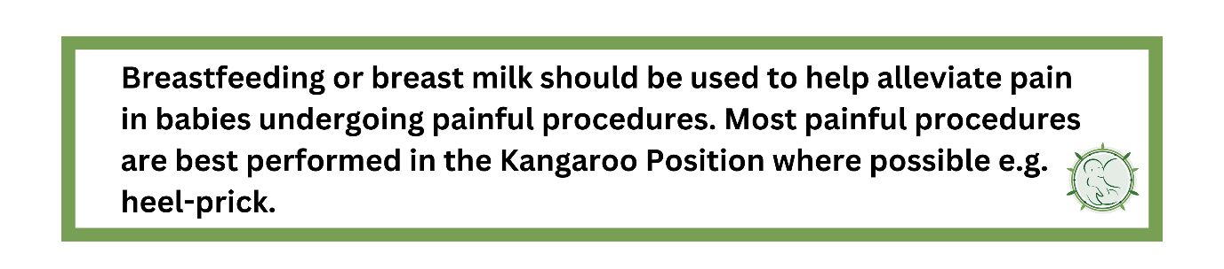
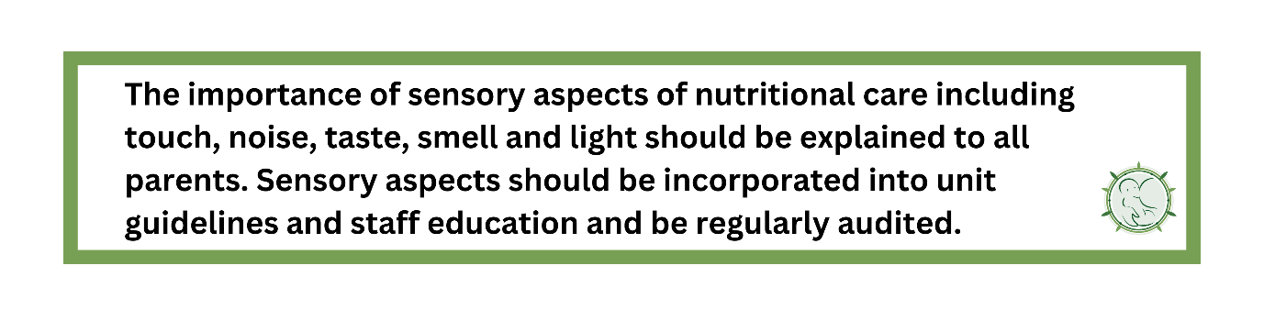
ANNN Recommendations
Notes:
References slides 32-35
Cakirli, M. and Acikgoz, A. (2021). A randomized controlled trial: The effect of own mother's breast milk odor and another mother's breast milk odor on pain level of newborn infants. Breastfeeding Medicine, 16(1), pp.75-81.
Varendi, H. and Porter, R.H. (2001). Breast odour as the only maternal stimulus elicits crawling towards the odour source. Acta Paediatrica, 90(4), pp.372-375.
Mennella, J.A., Lukasewycz, L.D., Castor, S.M. and Beauchamp, G.K. (2011). The timing and duration of a sensitive period in human flavor learning: a randomized trial. The American Journal of Clinical Nutrition, 93(5), pp.1019-1024.
Muelbert, M., Lin, L., Bloomfield, F.H. and Harding, J.E. (2019). Exposure to the smell and taste of milk to accelerate feeding in preterm infants. Cochrane Database of Systematic Reviews 2019, 7.
Beker, F., Liley, H.G., Hughes, I.P., Jacobs, S.E., Macey, J., Twitchell, E. and Davis, P.G. (2021). Effects on growth of smell and taste of milk during tube feeding of preterm infants: A randomized clinical trial. JAMA Pediatrics, 175(11), pp.1115-1123.
Mitchell, A.J., Yates, C., Williams, K. and Hall, R.W. (2013). Effects of daily kangaroo care on cardiorespiratory parameters in preterm infants. Journal of Neonatal-Perinatal Medicine, 6(3), pp.243-249.
Coşkun, D. and Günay, U. (2020). The effects of kangaroo care applied by Turkish mothers who have premature babies and cannot breastfeed on their stress levels and amount of milk production. Journal of Pediatric Nursing, 50, pp.e26-e32.
Velumula, P.K., Elbakoush, F., Tabb, C., Farooqi, A., Lulic-Botica, M., Jani, S., Natarajan, G. and Bajaj, M. (2022). Breast milk vs 24% sucrose for procedural pain relief in preterm neonates: a non-inferiority randomized controlled trial. Journal of Perinatology, 42(7), pp.914-919.
Shah, P.S., Herbozo, C., Aliwalas, L.L. and Shah, V.S. (2012). Breastfeeding or breast milk for procedural pain in neonates. Cochrane Database of Systematic Reviews 2012, 12.
Sánchez-Sánchez, M., García, T.L., Heredia, D., Reséndiz, I., Cruz, L., Santiago, J., Rojas-Granados, A., Ubaldo-Reyes, L., Pérez-Campos-Mayoral, L., Pérez-Campos, E. and Vásquez, G.S. (2022). Effect of a light-darkness cycle on the body weight gain of preterm infants admitted to the neonatal intensive care unit. Scientific Reports, 12(1), p.17569.

Slide 36
HIV-positive mothers
The evidence gap
WHO guidelines aim to improve the HIV-free survival of HIV-exposed infants by providing guidance on appropriate infant feeding practices. However, there are no good RCTs conducted in preterm and LBW infants and specific challenges may arise, including:
Feeding practice where there is a delay in initiating lactation, i.e. how long to wait for milk to become available in a very preterm infant.
Optimal practice if there is a shortfall in maternal MOM supply.
Accessibility and role of DHM.
Optimal practice in a woman recently diagnosed with HIV, or who may not have been compliant with highly active antiretroviral therapy (HAART).
Notes:
In southern and eastern Africa, where child mortality rates are among the highest in the world, HIV infection is common and a leading cause of death. There is an important evidence gap in the feeding of preterm and LBW infants born to HIV-positive mothers.
The 2016 WHO recommendations on HIV and infant feeding
This WHO document focuses on evidence-based guidelines on HIV-exposed infants who are born at term. You can access in the downloadable resources for optional reading.
The guidance suggests that HIV-positive mothers may consider expressing and heat-treating breast milk as an interim feeding strategy in special circumstances, for example, when an infant is LBW or ill in the neonatal period and unable to breastfeed.
However, we have not been able to identify any longer-term studies assessing such an intervention, and it does not seem to be a widely practised strategy. There may also be practical limitations to the implementation of this process in Africa.

Slide 37



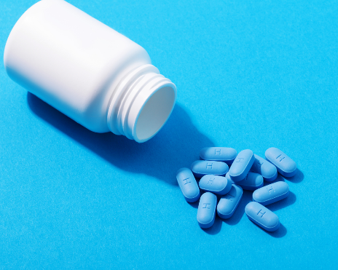
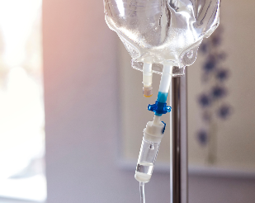

HIV-positive mothers of preterm and LBW infants in Africa
Plan with parents
Breastfeeding
Discuss with family
HAART and prophylaxis
Supplementary milk
Counsel on discharge
Notes:
Plan with parents
Arrange to meet and discuss with both parents prior to delivery and make a plan.
Breastfeeding
Strongly recommend sole breastfeeding and emphasise the risks of mixed feeding.
Discuss with family
With parents permission, consider discussion with wider family members, e.g. grandparents.
HAART and prophylaxis
Emphasise the importance of HAART and prophylaxis for the infant.
Supplementary milK
Where resources allow, consider the limited use of DHM, parenteral nutrition or IV dextrose where MOM is not available.
Counsel on discharge
Counsel the parents again on hospital discharge and consider providing written information.
During Antenatal Counseling or at the point of contact with an HIV-positive mother, it is good practice to educate the mother on the available feeding options subject to AFASS (Acceptable, Feasible, Affordable, Sustainable, and Safe) and the dangers of mixed feeding.

Slide 38
End of Module Two
From completing this step, you should now be able to:
Describe the composition of breast milk and how it changes during breastfeeding.
Describe the benefits of breast milk for preterm and LBW infants.
Review the importance of colostrum in early infancy.
Explain the differences between MOM, DHM, and formula milk, including risks and benefits.
Describe the risks and benefits of breast milk fortifiers.
Review the importance of the sensory aspects of feeding.
Notes:
In this module, we introduced the composition, benefits, and sensory aspects of breastfeeding, concluding that breast milk is more than food and nutrition is more than nutrients. We discussed the benefits of providing breast milk instead of donor human milk and formula, whenever possible.
If you are unsure about any of these goals, make sure to go back through the previous steps and refresh your learning.

