Slide 1


Module 3: Feeding Methods

Slide 2
Introduction to Module 3
The key learning objectives from this module include:
Describe the different approaches to feeding preterm and LBW infants.
Explain the benefits and potential complications of cup feeding.
Explain the uses and risks of gastric tube feeding.
Apply your knowledge of nasogastric and orogastric tube feeding.
Explain how to start and increase milk feeds.
Review the effectiveness of monitoring gastric residuals.
Explain breast milk expression techniques and how expression can be improved.
Notes:
Welcome to Module 3: Feeding methods
In this module, we will cover various feeding methods, including cup and spoon, gastric tubes, and breastfeeding. Whilst module 2 focused on the importance of breast milk, the breastfeeding content in this module will focus on milk expression techniques and direct breastfeeding challenges in preterm and LBW infants (infants born weighing less than 2.5kg).

Slide 3
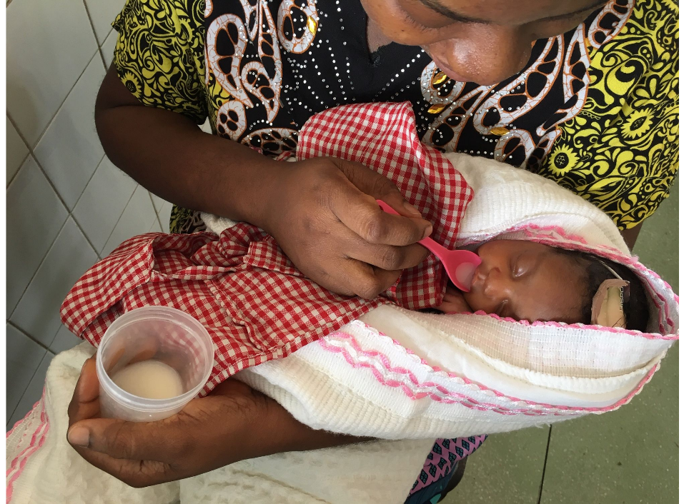
Cup and spoon feeding
In 2023, the WHO and UNICEF recommend cup feeding especially in low-resource settings with poor water quality and unreliable electricity, as cups are easier to clean than bottles.
Photo provided by African Neonatal Nutrition Network partners with parental consent.
Notes:
We will explore the use of cup and spoon feeding in vulnerable infants. We will learn about the benefits of cup feeding, and some of the common risks when feeding by cup.
When is cup feeding used?
Various methods are used to provide milk to vulnerable infants when breastfeeding is not possible.
These include:
• Spoon or Cup feeding
• Nasogastric (NG) tube feeding
• Orogastric (OG) tube feeding
Cup feeding is a feeding method whereby the baby laps milk from a cup. This technique is often used alongside other feeding methods. For example, it can complement breastfeeding, and reduce time using gastric tubes. Cup feeding can also function as a long-term feeding solution for those unable to breastfeed. However, the baby must coordinate lapping, swallowing, and breathing, so cup feeding is typically not used before 30 weeks corrected gestation. Typically cup and spoon is used from 32-34 weeks. It is important to note that cup feeding is different to cup and spoon feeding.
Benefits of cup feeding
Some of the benefits of cup feeding are shown below:
• Cup feeding is safe and widely accessible.
• Encourages eye contact between mother and baby.
• Involvement of the sensory system compared to tube feeding, as the baby’s taste and smell is incorporated.
• Less stressful than bottle feeding & permits rest periods from feeding and improves breathing and oxygenation.
• Baby can take the amount of milk they want, at their own pace.
• Heart rate, respiration, and oxygen requirements are better maintained in contrast to bottle feeding.
• Requires less effort to cup feed than to breastfeed.
• A cup is an ordinary type of device that is easily washed and cleaned. There is less chance of contamination compared to bottles.
• The baby is prepared for breastfeeding by exercising the back of the tongue and stretching forward when lapping milk from the cup.
• Widely affordable.

Slide 4
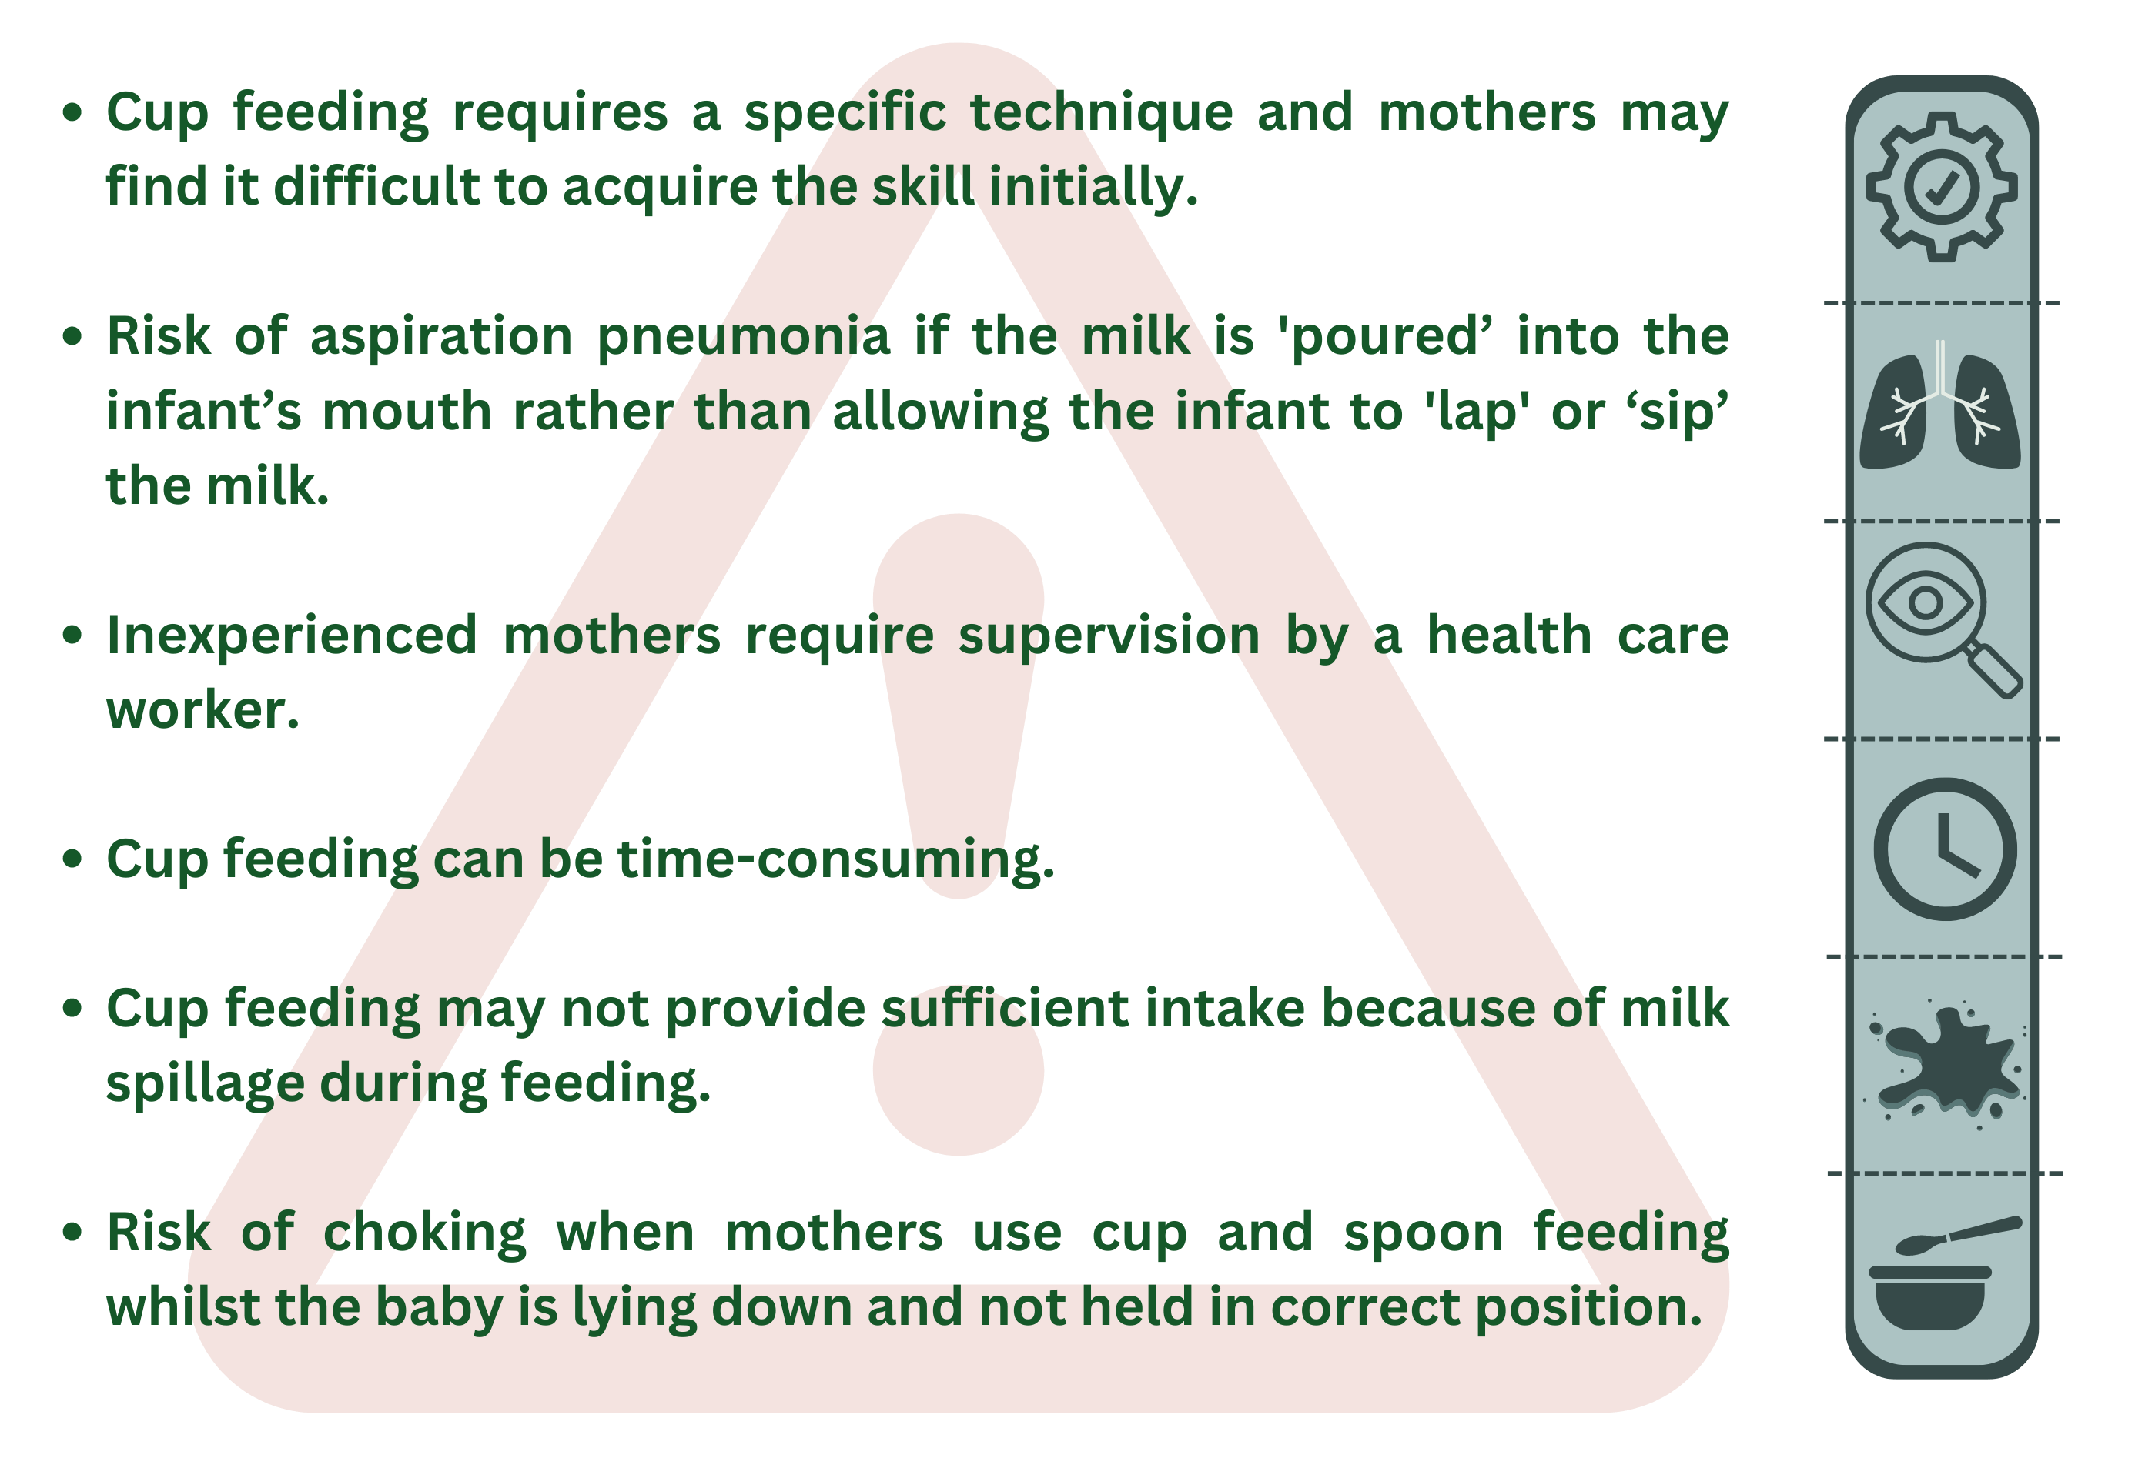
Potential challenges of cup feeding
Notes:
Cup feeding provides many benefits for newborn infants. However, this method can also present a number of complications.

Slide 5

Similar feeding methods
Photo provided by African Neonatal Nutrition Network partners with parental consent.
Notes:
Paladai (or palady) feeding is also used in certain settings, especially in India. This is a device similar to a cup but with a narrow beak. Spoon feeding is also widely used and as with cups, spoons are widely available and can be easily cleaned. Careful technique is still needed to avoid tipping the milk into the mouth of the baby too quickly. Where possible, it seems better to offer cup, paladai or spoon feeding rather than bottle or tube, as these methods may be associated with less risk and cost. The use of fewer utensils for feeding may also lower the risk of contamination. Currently however there are no good comparisons between cup, spoon, and paladai feeding.
Bottle/tube feeding
There are also currently no conclusive studies comparing cup, spoon or paladai feeding with bottle or tube feeding. Where possible, it seems better to offer cup, paladai or spoon feeding as these methods may be associated with less risk and cost. However, the technique requires more skill and supervision.
Overall, there is good evidence to advise against the use of bottles and teats, except where there is no alternative. The key factors are:
• Infant safety (aspiration etc.) • Feed effectiveness (amount of milk transfer)
• Infection control (equipment cleaning)
• Cost
• Local skills and expertise

Slide 6
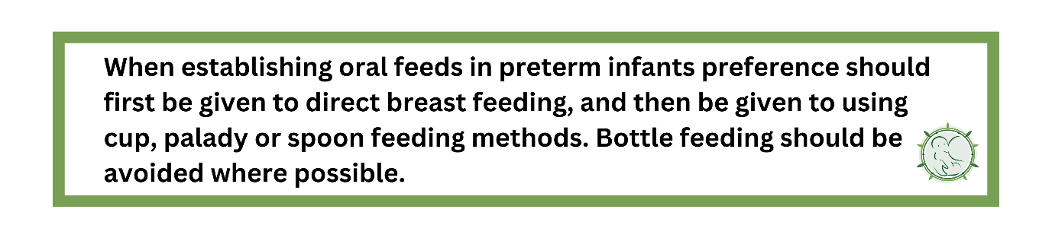
ANNN Recommendations
Notes:
References (slides 3-6)
Marofi, M., Abedini, F., Mohammadizadeh, M. and Talakoub, S. (2016). Effect of palady and cup feeding on premature neonates’ weight gain and reaching full oral feeding time interval. Iranian Journal of Nursing and Midwifery Research, 21(2), p.202.
Alinezhad Shebilouysofla, P., Mostafa Gharebaghi, M., Sattarzadeh Jahdi, N., Abdoli Najmi, L. and Hakimi, S. (2022). Effect of cup, syringe, and finger feeding on time of oral feeding of preterm neonate’s: a randomized controlled clinical trial. Journal of Health, Population and Nutrition, 41(1), p.52.
Shaki, F., Aziznejadroshan, P., Rad, Z.A., Chehrazi, M. and Arzani, A. (2022). Comparison of the effect of two methods of sucking on pacifier and mother's finger on oral feeding behavior in preterm infants: a randomized clinical trial. BMC Pediatrics, 22(1), p.292.
Flint, A., New, K. and Davies, M.W. (2016). Cup feeding versus other forms of supplemental enteral feeding for newborn infants unable to fully breastfeed. Cochrane Database of Systematic Reviews 2016, 8.
Dunn, P.M. (2002). Stéphane Tarnier (1828–1897), the architect of perinatology in France. Archives of Disease in Childhood-Fetal and Neonatal Edition, 86(2), pp.F137-F139. 6. Comprehensive Newborn Care Protocols. (2022). Republic of Kenya Ministry of Health, p.142.

Slide 7
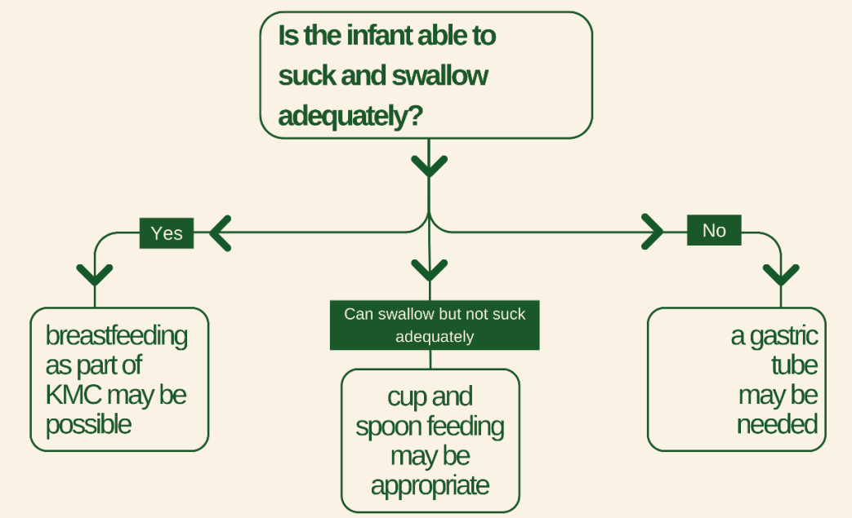
Gastric tube feeding
Notes:
We will explore the risks and benefits of gastric tube feeding, including the two types:
• Nasogastric (NG) tubes
• Orogastric (OG) tubes
When are gastric tubes used?
Gastric tubes are widely used in neonatal practice and therefore health care practitioners must understand the risks and benefits. The first question to consider is whether the baby really needs a gastric tube. This flowchart may be able to help with this decision.
The WHO considers that initiation of enteral feeding in unstable babies should be based on clinical judgment. Where possible, the infant’s clinical condition including heart rate, breathing, colour, temperature, and oxygen saturation must all be monitored.

Slide 8

Risks of gastric tube feeding
Notes:
Oesophageal perforation is very rare but can occur in extremely LBW or preterm infants. Careful training is required to ensure the tip of the gastric tube is located in the stomach. Routine checking of tip position by aspirating stomach contents is essential, but confirmatory X-rays are rarely required. Tubes that are too short (tip in the oesophagus) may increase the risk of reflux and choking. Tubes that are too long (duodenum or jejunum) may prevent proper digestion or absorption of foods or medicines.

Slide 9


Nasogastric vs orogastric tube feeding
Notes:
All gastric tubes have some associated risks, such as those described above. There are also more specific complications associated with either NG or OG tubes.
Potential complications of NG tubes
Nasal damage on insertion, and/or bleeding
NG tubes partially occlude the nasal passages
Airway occlusion may increase the work of breathing and worsen respiratory status.
Although some infants experience vagal symptoms on NG insertion, these are temporary.
Potential complications of OG tubes
Whilst OG tubes may avoid the ‘airway’ complications associated with NG tubes, they still come with a number of their own considerations when deciding on the most appropriate treatment strategy.
For example:
• OG tubes are more difficult to secure.
• OG tubes may ‘move’ more in the hypo-pharynx which may provoke vagally induced bradycardia.
• OG tubes may interfere with oral or direct breastfeeding.
Studies have compared the risks and benefits of NG versus OG tubes, but there is no consistent evidence-based data to recommend one method (Watson et al., 2013), and recommendations generally follow local preferences. Where mothers are giving the tube feeds themselves (independently) then a nasal rather than oral might be preferential as nasogastric tubes may have a lower chance of being dislodged.
Some neonatal units will use an OG tube in the smallest infants where respiratory complications are greatest, for example on CPAP, and then convert to an NG tube when the babies are bigger.

Slide 10

How to insert an NG tube
Notes:
Please note, it is not possible to safely teach the necessary skills for inserting a gastric tube, or tube feeding itself, within the confines of a presentation, so the following information is provided as a guide. Individual hospitals should develop their own teaching packs, policies, procedures and guidelines, and audit their techniques and outcomes.
Ensure careful infection control procedures including use of gloves according to local policies.
Measure insertion length following local procedures. Generally this calculates length by measuring from the nose (or mouth) to the ear and then to mid-point between xiphoid process and umbilicus. Check length against a weight based calculator if available to ensure length is not obviously too long or short.
Collect equipment and choose the correct size gastric tube for the infant.
Speak to the parents and carers and explain the procedure, including why it is needed, and for how long it is likely to be needed. Reassure the parents that it will not hurt the baby.
Advance tube gently to desired length, stopping if there is any resistance. Marking the tube at the point of insertion allows easier monitoring of tube position.
Check tip position by aspirating stomach contents and/or use of a pH strip according to local policies.
Secure in place according to local guidelines.

Slide 11
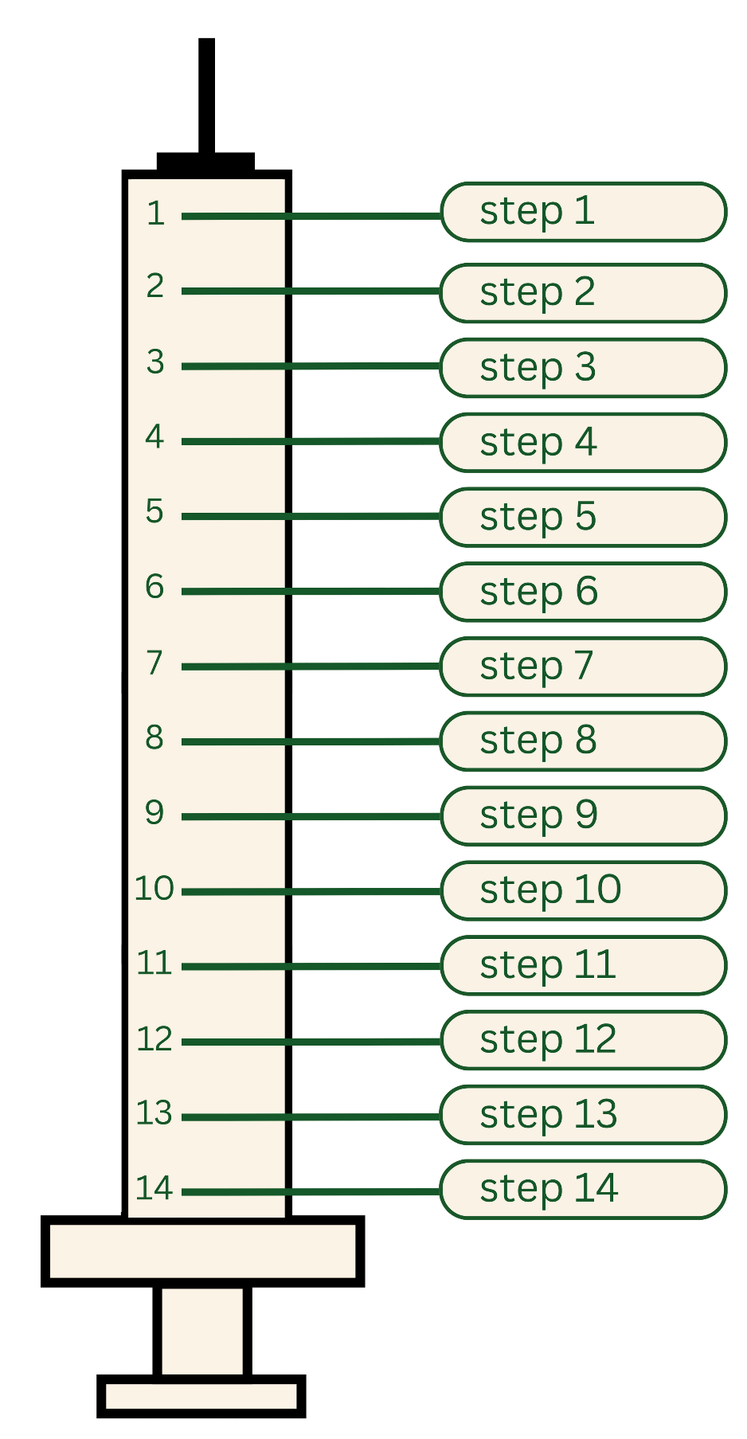

How to give an NG feed
Photo provided by African Neonatal Nutrition Network partners with parental consent.
Notes:
How to give an NG feed
Step 1: Ask mother to wash the cup with soap and water, and allow to dry.
Step 2: When the cup is clean and dry, the mother should wash her hands with soap and water.
Step 3: Ask anyone assisting (e.g. father, other family member) to wash their hands.
Step 4: Express breast milk into cup.
Step 5: Use a new syringe every day.
Step 6: Draw up the amount of milk required.
Step 7: Fold the NGT in half and open the top.
Step 8: Attach the syringe to the end of the NGT.
Step 9: Remove plunger from the syringe.
Step 10: Hold the syringe above the baby and allow the milk to flow in. Do not push with the plunger. If the milk does not flow under gravity seek extra advice. Gentle pressure on the top of the syringe may help but carefully check the insertion mark first.
Step 11: When the milk has flowed in, remove the syringe.
Step 12: Replace the top of the NGT.
Step 13: Wash all equipment.
Step 14: Discard any un-used milk.
References (slides 7 -12)
Embleton, N.D., Moltu, S.J., Lapillonne, A., van den Akker, C.H., Carnielli, V., Fusch, C., Gerasimidis, K., van Goudoever, J.B., Haiden, N., Iacobelli, S. and Johnson, M.J. (2022). Enteral nutrition in preterm infants (2022): a position paper from the ESPGHAN committee on nutrition and invited experts. Journal of Pediatric Gastroenterology and Nutrition, 76(2), pp.10-1097.
Hawes, J., McEwan, P. and McGuire, W. (2004). Nasal versus oral route for placing feeding tubes in preterm or low birth weight infants. Cochrane Database of Systematic Reviews 2004, 3.

Slide 12
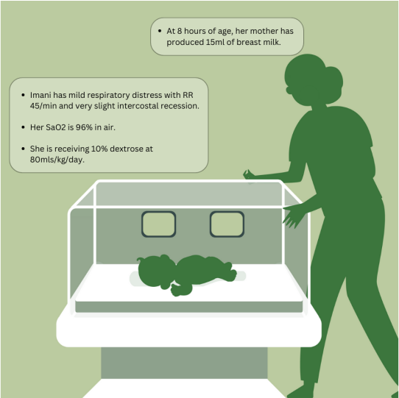
Case study
How would you supply this milk to Imani at 12 hours of age,
and what volume would you give for the first feed?
NG feed, 7.5ml
NG feed 10ml
NG feed 15ml
OG feed 7.5ml
OG feed 10ml
OG feed 15ml
Notes:
Introduction
Imani is born at 30 weeks weighing 1000g. Her mother had a C-section and Imani is receiving care in an incubator. Read through the graphic below to learn more
Initial care
How would you supply this milk to Imani at 12 hours of age, and what volume would you give for the first feed?
Discussion
Shortly after giving the 10ml feed Imani had a small vomit of undigested milk with no blood or bile.
What would you do next?
Expert opinion
Now, we will look at an expert opinion of how to treat the infant in this particular case study. Listen and consider similarities and differences to your own patient management.
“Firstly, examine Imani carefully, observing respiratory status and vital signs (heart rate (RR), temperature etc.)
If Imani appeared well, then waiting a few hours and repeating the milk feed of 10mls might be appropriate. Some clinicians might give a smaller feed volume, for example, 7.5mls every 3 hours. A feed volume of 15mls every 3 hours would be a larger amount then many clinicians would commence. There are no good data to say what starting feed volume is optimal. A volume of 25- 50mls per kg per day might be appropriate.
If Imani’s RR had increased dramatically, then waiting for it to settle before giving a further milk feed might be considered. If there is a raised RR then feeds should not be advanced too quickly. Giving a few drops of the breast milk into the mouth (oropharyngeal colostrum) in addition to the milk via the gastric tube might improve the care.
Measuring blood glucose is important. Preterm babies are at risk of hypoglycemia, but IV 10% Dextrose at 80-100mls/kg/day will supply sufficient calories for most babies in the first 24-48 hours.
Speak to the mother and reassure her that Imani is well, that small vomits are common, and acknowledge (congratulate!) the importance of providing breast milk. Ensure she is adequately supported to keep increasing her lactation, and that she has access to food and drink. If possible, see if her mother can come to the neonatal ward and give Imani skin-skin or KMC as this may aid lactation even if Imani is receiving IV fluids.”

Slide 13

Starting and increasing milk feeds
Benefits of early initiation of feeding:
Quicker attainment of full enteral feeding.
Faster transit time.
Improved gut epithelial health and endocrine activity.
Improved gut motility.
Notes:
We will learn about how to start and increase milk feeds in preterm and LBW infants, including the benefits and complications commonly associated with each.
Starting milk feeds
Traditionally, many hospitals did not provide preterm or LBW infants with milk feeds in the first few days of life. This increases the risk of malnutrition and could potentially lead to increased risks of gut complications due to a lack of nourishment for the gut.
However, it is now accepted that early milk feeding is appropriate, with the exception of the very sickest infants, such as those requiring cardio-respiratory support. Many hospitals now provide buccal colostrum (see module 2) within the first few hours after birth even in preterm infants as small as 500g. Remember that many preterm infants can be tried immediately at the breast as part of immediate KMC, although additional milk feeds via a cup or gastric tube may still be required.
‘Minimal enteral feeding’ is the same term as ‘trophic feeding’ and refers to the provision of small amounts of milk up to 10-20ml/kg/day over the first few days. The main aim of trophic feeding is to provide nourishment to the gut and limit starvation, rather than to promote growth itself. There is no good evidence that using trophic feeds without increases (e.g. maintaining intake volumes at <20ml/kg/d for several days) is more effective than slowly increasing the milk volume each day based on the time taken to achieve full feeds.
Due to the benefits above, we recommend starting small volumes of milk feeds as soon after birth as possible and increasing as clinically tolerated.

Slide 14
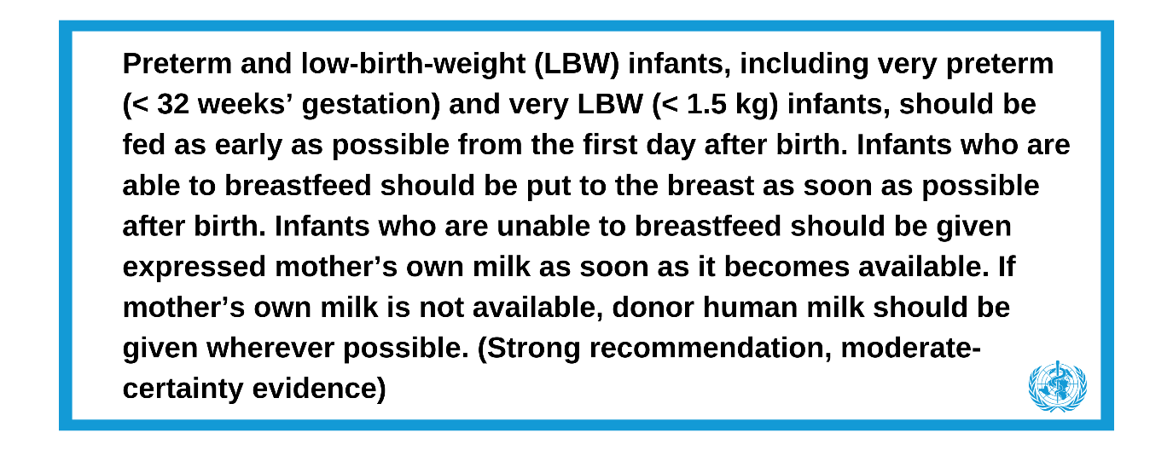
WHO recommendation
Notes:
According to WHO, early initiation of feeding appears to decrease length of hospital stay and may reduce mortality, though this benefit was not noted in the Cochrane review (Young et al., 2022). Some studies show decreased rates of sepsis, but again the effects are not consistent across studies. Where parenteral nutrition (PN) is used, earlier feed advancement results in a shorter duration of PN, thereby saving costs. There appears to be little or no effect on NEC, feed tolerance, and growth.

Slide 15
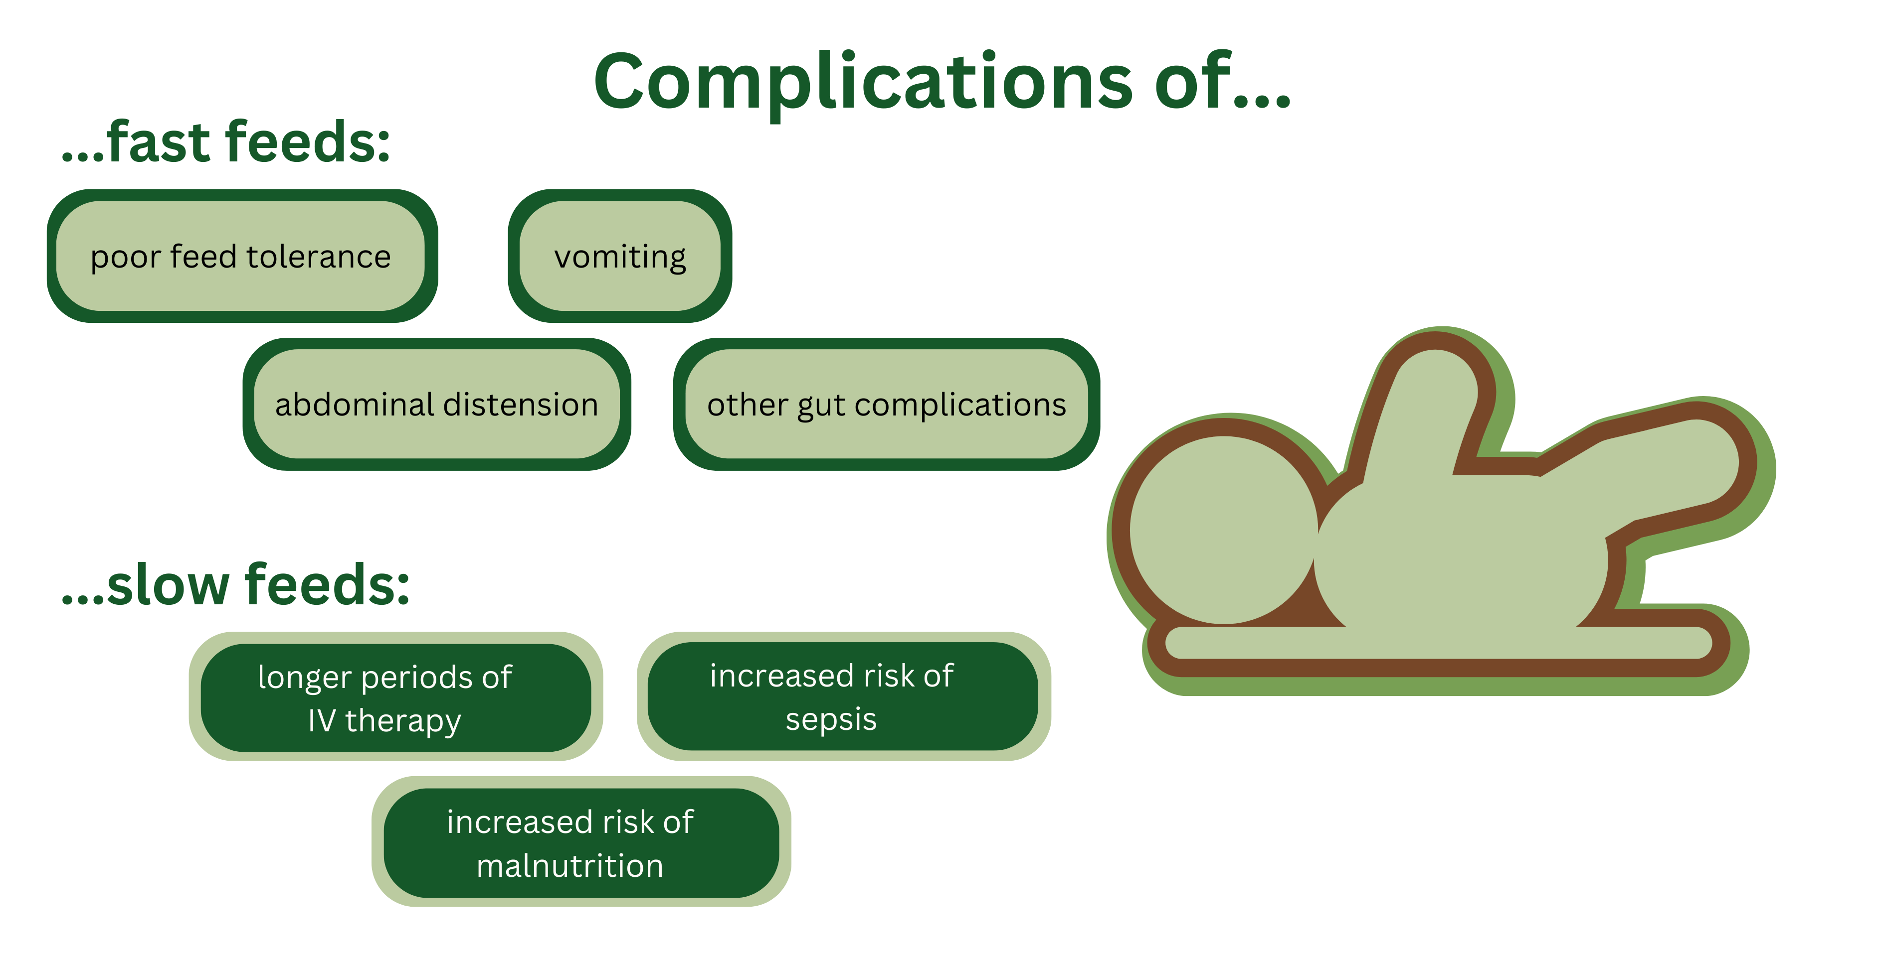
Increasing milk feeds
Notes:
Increasing milk feeds
Controlling the speed of milk feeds is very important in newborn infants. Some of the issues commonly associated with fast and slow feeds are shown in the graphic on the screen.
Several trials and systematic reviews have been conducted in this area over the last few years. There is no evidence that complications such as sepsis or NEC are more common with faster feed increases (around 30ml/kg/day) than with slower feed increases (15-20ml/kg/day). There is also no strong data to show that SGA babies or those with IUGR require different policies.
These rates of milk feed increases are relevant if the baby is receiving tube or cup feeds. Remember, if a newborn baby is able to safely breastfeed directly there is no need to restrict the baby from feeding on demand.
It is also important to note that complications are much more likely to occur when formula milk is used instead of breast milk.

Slide 16
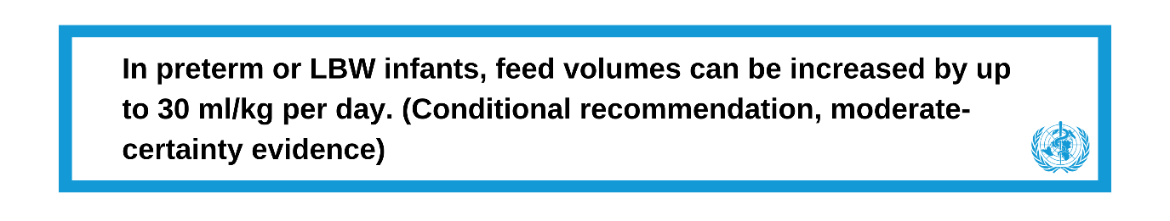
Recommendations
WHO Recommendation
Notes:
WHO Recommendation
See on screen
Kenyan Paediatric Association recommendation
Other professional organisations, such as the Kenyan Paediatric Association, recommend that infants

Slide 17
Maximum feed volumes for LBW or preterm infants
Feed volumes of 150ml/kg/day of mother’s own breast milk are unlikely to meet nutrient requirements for most LBW or preterm infants unless extra nutrients are provided. It is therefore common for these infants to be fed milk volumes of around 180ml/kg/day.
There is also some data to show that intakes as high as 200ml/kg/day improve growth in LBW infants (Travers et al., 2020).
Feed volumes greater than this have also been used.

Slide 18
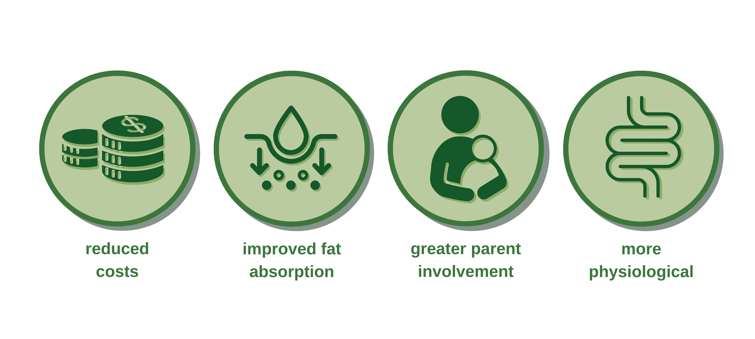
Continuous vs bolus feeding
Notes:
Continuous vs bolus feeding
Finally, it is important to consider whether milk from gastric tubes is given by bolus (intermittently, e.g. every 2-3 hours) or continuously. Systematic reviews have concluded that whilst there are no major differences in outcomes, bolus feeding has several potential advantages, some of which are shown in the graphic on screen.
Reduced cost - Continuous gastric feeds can be more costly as they require expensive electric pumps. However, there may be occasional very small infants who are struggling to tolerate milk feeds where continuous feeds or giving more regular bolus feeds, e.g. every 1-2 hours, may help.
Improved fat absorption - Continuous feeds can result in the human milk fat ‘settling’ in the upper portion of the syringe, and more fat may adhere to the inside of the syringe or tube. This means fat absorption is lower with continuous feeds.
Greater parent involvement - Unlike in continuous feeds, parents can help hold the syringe when giving a bolus feed, enabling them to feel more involved in the nutritional care of their baby. Bolus feeds can also be administered whilst the baby is maintained in the ‘Kangaroo position’.
More physiological - Bolus feeding is more similar to breastfeeding and may improve gastric emptying and intestinal motility.

Slide 19

ANNN recommendation
Notes:
References (slide 13–20)
Embleton, N.D., Moltu, S.J., Lapillonne, A., van den Akker, C.H., Carnielli, V., Fusch, C., Gerasimidis, K., van Goudoever, J.B., Haiden, N., Iacobelli, S. and Johnson, M.J. (2022). Enteral nutrition in preterm infants (2022): a position paper from the ESPGHAN committee on nutrition and invited experts. Journal of Pediatric Gastroenterology and Nutrition, 76(2), pp.10-1097.
Young, L., Oddie, S.J. and McGuire, W. (2022). Delayed introduction of progressive enteral feeds to prevent necrotising enterocolitis in very low birth weight infants. Cochrane Database of Systematic Reviews 2022, 1.
Morgan, J., Bombell, S., McGuire, W. and Cochrane Neonatal Group (1996). Early trophic feeding versus enteral fasting for very preterm or very low birth weight infants. Cochrane Database of Systematic Reviews 2013, 3.
Cochrane Neonatal Group, Oddie, S.J., Young, L. and McGuire, W. (1996). Slow advancement of enteral feed volumes to prevent necrotising enterocolitis in very low birth weight infants. Cochrane Database of Systematic Reviews 2021, 8.
Dorling, J., Hewer, O., Hurd, M., Bari, V., Bosiak, B., Bowler, U., King, A., Linsell, L., Murray, D., Omar, O. and Partlett, C. (2020). Two speeds of increasing milk feeds for very preterm or very low-birthweight infants: the SIFT RCT. Health Technology Assessment (Winchester, England), 24(18), p.1.
Premji, S.S. and Chessell, L. (2011). Continuous nasogastric milk feeding versus intermittent bolus milk feeding for premature infants less than 1500 grams. Cochrane Database of Systematic Reviews 2011, 11.
Comprehensive Newborn Care Protocols (2022). Integrating Technologies with Clinical Pathways. Republic of Kenya Ministry of Health.
WHO (2022). WHO recommendations for care of the preterm or low-birth-weight infant. World Health Organization. Available at: https://www.who.int/publications/i/item/9789240058262

Slide 20
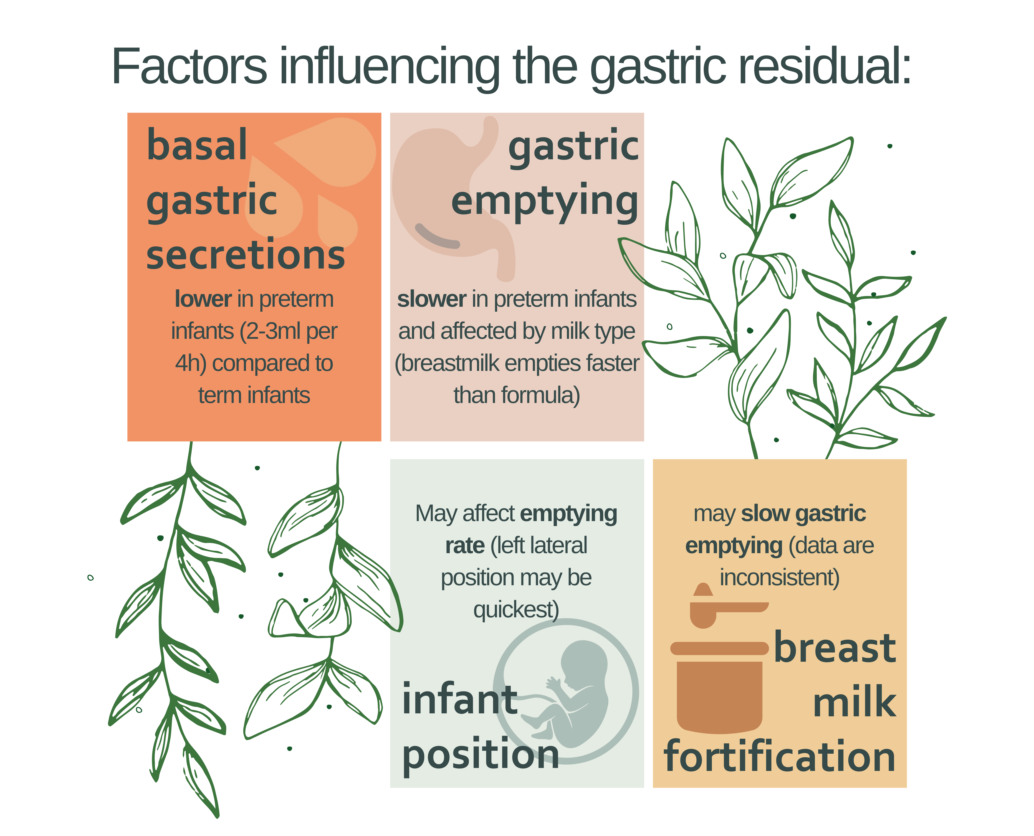
Gastric residuals
Notes:
We will discuss ‘gastric residuals’ and the problems commonly associated with their use when feeding preterm and LBW infants.
What is a gastric residual?
The ‘gastric residual’ is the fluid remaining in the stomach prior to the next enteral feeding. Gastric residuals are sometimes used to predict feeding tolerance and NEC, although there is no good data on the significance of its volume and colour.
Gastric residuals are a normal finding in preterm infants who have immature gastric motility and low average basal gastric secretions of around 2-3ml every 4 hours.
The factors influencing gastric residuals are described in the graphic on the screen.

Slide 21
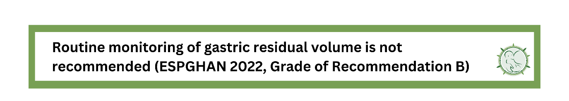
Management of gastric risiduals
ANNN Recommendation
Notes:
Management of gastric residuals
Studies on the effectiveness of monitoring gastric residuals are currently inconclusive. There are no conclusive studies showing that routinely measuring gastric residuals can predict feed tolerance or NEC. Definitions of ‘clinically significant’ residuals vary – for example, some studies use 33%-50% of the previous feed, whilst others use 2-5ml/kg. There is no agreement on whether the colour of aspirate is helpful.
There is also no consensus on whether to re-feed or discard the aspirated residual. Refeeding gastric residuals may replace partially digested milk, gastrointestinal enzymes, bile acids, hormones, and trophic substances that support digestion and promote gastrointestinal motility and maturation. However, they may also result in further feed intolerance.
A retrospective study of >600 preterm infants (Mangapally et al., 2023) concluded that routine pre-feed gastric residual monitoring in the absence of concerning clinical exam findings does not reduce the incidence of NEC, but instead may delay important nutritional outcomes such as starting feeds and achieving full feeds.
In summary, routine monitoring of residuals is not recommended, however health care practitioners will still want to aspirate the gastric tube periodically to check the tip position is in the stomach.
ANNN Recommendation
On screen
References (slide 21–22)
Embleton, N.D., Moltu, S.J., Lapillonne, A., van den Akker, C.H., Carnielli, V., Fusch, C., Gerasimidis, K., van Goudoever, J.B., Haiden, N., Iacobelli, S. and Johnson, M.J. (2022). Enteral nutrition in preterm infants (2022): a position paper from the ESPGHAN committee on nutrition and invited experts. Journal of Pediatric Gastroenterology and Nutrition, 76(2), pp.10-1097.
Abiramalatha, T., Thanigainathan, S. and Ninan, B. (2019). Routine monitoring of gastric residual for prevention of necrotising enterocolitis in preterm infants. Cochrane Database of Systematic Reviews 2019, 7.
Mangalapally, N., Patel, S., Schofield, E.M., Capriolo, C. and Davis, N.L. (2023). Impact of Routine Gastric Aspirate Monitoring on Very Low Birth Weight Early Preterm Infants. Journal of Pediatric Gastroenterology and Nutrition, 76(4), pp.517-522.

Slide 22
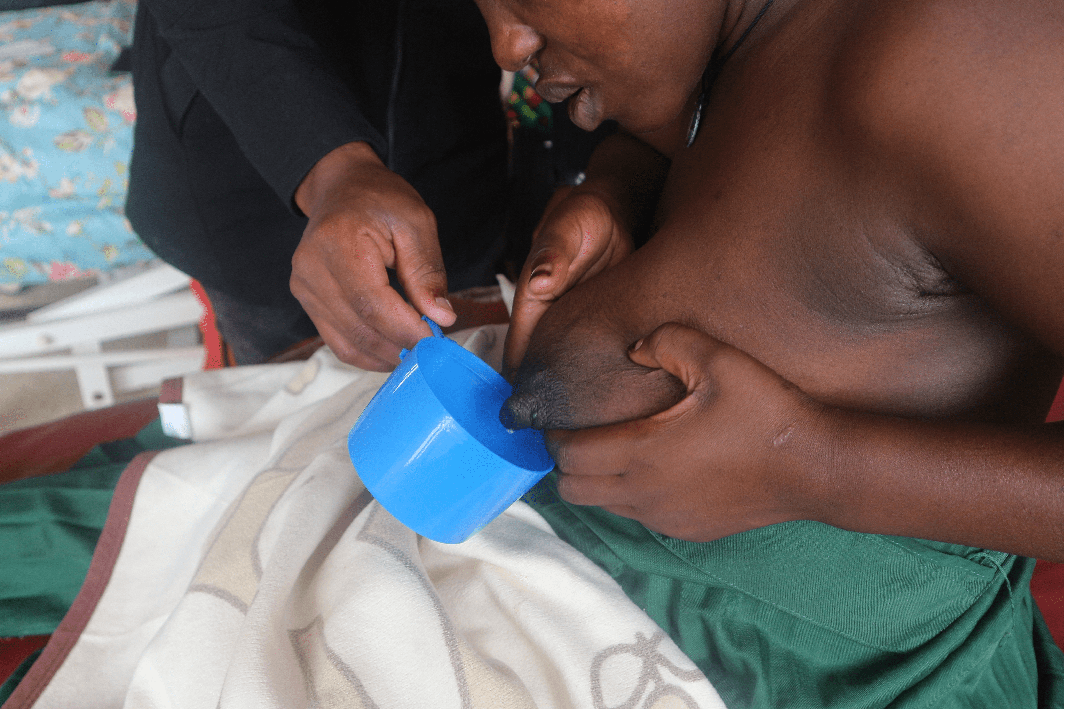
Expression of breast milk
Photo provided by African Neonatal Nutrition Network partners with parental consent.
Notes:
Expression of breast milk
In this step, you will learn about the expression of breast milk in new mothers. You will explore different techniques for the expression of mother's own milk (MOM), common risks, and strategies to increase milk expression through holistic techniques.
Techniques for milk expression
Whilst many preterm and LBW infants will be able to breastfeed from birth, many will require expressed MOM. There are many methods and techniques that are used to express the milk, including hand expression and electric pumps. A Cochrane review (Becker et al., 2016) identified over 40 trials, many of which compared different techniques, and concluded that there is no clear preference for one type of milk pump or technique.
Many hospitals only ever use hand expression. Electric pumps are expensive and use by multiple mothers raises significant infection control issues. In Becker’s review, there were no clear differences in infection control aspects or breast/nipple soreness when the techniques were used with training and high quality control. However, with poor technique and especially with multiple users, there is a risk of microbial transmission, especially HIV.
Furthermore, the studies highlight that different settings may impact on success, for example in terms of population, culture, resources, and equipment. An optimal technique in one setting may not be the optimal technique for a different resource setting.

Slide 23
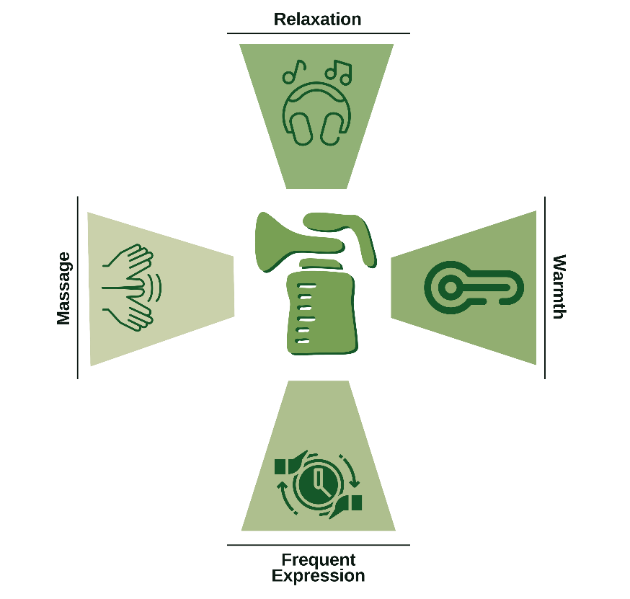
Techniques for increasing milk expression
Notes:
Relaxation: More milk is expressed when mothers are relaxed, for example when listening to music or other techniques.
Warmth: More milk is expressed when the breast is warmed, for example using a warm towel.
Frequent expression: Initiating expression soon after birth is more successful than delaying the start. Many hospitals recommend expression at least every 3 hours initially, using a suitable breast shield.
Massage: More milk is expressed by gently massaging the breast between the forefinger and thumb.
There is some evidence that hand expression or larger electrical pumps produced milk with a slightly higher protein content. Hand expression produced milk with more sodium than pumps, and fat content was higher with breast massage during expression. Many of the studies comparing different mechanical pumps received commercial support. Few studies provided data on other aspects such as resources for mothers including food and drink, places to rest, and environmental aspects e.g. noise (Becker et al., 2016).

Slide 24

Factors improving provisions of mother’s own milk
Notes:
Parent communication and support
The available evidence strongly suggests that direct and careful support of parents has a major impact on the success of milk expression. The hospital environment (e.g. noise, food and fluid access, rest areas) and the ability to express milk privately, or whilst sitting next to the infants’ incubator, can be important to mothers. Cultural aspects should also be considered.
KMC promotes mother-infant togetherness and is optimal for expression. In other settings, providing mothers with a photo of their baby may help. Multiple other healthcare interventions and processes are likely to impact on successful and continued MOM expression, some of which are shown here.
Factors improving provision of mother's own milk
Positive attitudes amongst healthcare staff.
Involvement of doctors in speaking with parents about the importance of MOM.
Antenatal education and/or consultations.
Promotion of KMC or skin-to-skin care. If skin-to-skin / KMC is not possible, mothers usually express more milk if they are in the presence of their baby.
Availability of lactation consultants or healthcare workers.
Physical resources, e.g. space for a mother to express, including at the cotside.
Staff training and education.
Adoption of the UNICEF Baby Friendly Initiative.
Hospitals that conduct regular audit and QI.
Talking about the gift of 'liquid gold' on ward rounds.

Slide 25
Storage, labelling and usage of expressed human milk
Given the risk of inadvertent HIV transmission through poor infection control,
the importance of audit and QI should be given high priority.
Notes:
A detailed discussion of the storage, labelling and usage of expressed human milk is not possible in this presentation.
Careful labelling of any stored breast milk is vital, especially in settings where HIV-positive infection is a possibility. Storage facilities such as freezers and fridges need careful policies and procedures, and regular maintenance. Breast milk cannot be stored at room temperature. If breast milk is stored frozen, guidelines need to describe how this is defrosted and where this takes place.
Summary
Multiple factors impact on the success of breast milk expression. Careful policies, procedures, and guidelines are needed. Given the potential for MOM to stop infants from dying, for example from NEC, but also the risk of inadvertent HIV transmission through poor infection control, the importance of audit and QI should be given high priority.
References (slide 23-26)
Becker, G.E., Smith, H.A. and Cooney, F. (2016). Methods of milk expression for lactating women. Cochrane database of systematic reviews 2016, 9.
Alibhai, K.M., Murphy, M.S., Dunn, S., Keely, E., O’Meara, P., Anderson, J. and El-Chaâr, D. (2022). Evaluation of a breastmilk hand expression toolkit: the MILK survey study. International Breastfeeding Journal, 17(1), p.8.
Friedman, S., Flidel‐Rimon, O., Lavie, E. and Shinwell, E.S. (2004). The effect of prenatal consultation with a neonatologist on human milk feeding in preterm infants. Acta Paediatrica, 93(6), pp.775-778.

Slide 26
Challenges of direct breast feeding for preterm and LBW infants
Sucking
Swallowing
Oesophageal transport
Breathing
Notes:
Challenges of direct breast feeding for preterm and LBW infants
One of the most challenging tasks for preterm infants is learning to feed directly from the breast whilst they coordinate breathing. Whilst many preterm infants born at 35 weeks or more will breastfeed from birth, this is less common in newborn infants at 32-34 weeks. Very preterm infants (less than 32 weeks) are rarely able to feed directly from the breast, although many will demonstrate suck and swallow. The key challenge for most very preterm infants is coordinating safe breathing alongside the suck/swallow. Establishing oral feeding requires the coordination of:
Sucking
Swallowing
Oesophageal transport
Breathing

Slide 27

Factors affecting feeding success
Notes:
Factors affecting feeding success include:
Milk availability.
NICU environment, e.g. sound.
Caregiver feeding approach.
History of non-nutritive sucking.
Sensorimotor interventions.
Bottle vs breastfeeding.
Neonatal morbidities, e.g. BPD.

Slide 28
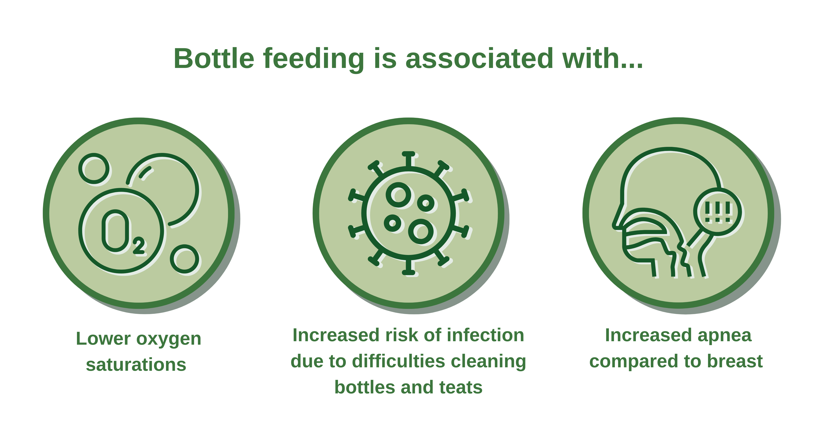
Initiating direct breastfeeding
Notes:
Initiating direct breastfeeding
Whilst many tools have been developed to help assess feed readiness, few are widely used, and the decision to start direct breastfeeding is best taken by experienced neonatal nurses and lactation consultants (Crowe et al., 2016). If babies develop apnea, raised respiratory rate, or signs of aspiration, then direct breastfeeding should be halted.
In recent years, there has been increasing recognition that preterm infants can latch to the breast, suck and swallow, and attain full breastfeeding at earlier gestational ages than previously believed (Nykvist, 2008).
Prior to establishment of full breastfeeding, the use of gastric tube and cup or spoon feeds are preferred to the use of bottles or teats. This graphic shows some of the contraindications commonly associated with the use of bottle feeding.
Non-nutritive sucking with a clean finger or pacifier when the mother is not available may improve feeding success, and may have stress relieving effects. Pacifiers must be kept clean.

Slide 29
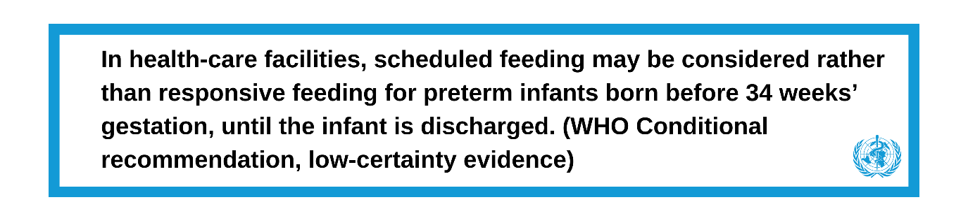
Transitioning to direct breastfeeding
WHO Recommendation
Notes:
Transitioning to direct breastfeeding
There is no consensus on how best to transition a baby from tube feeding to the breast. Some will place the infant directly to the breast, and this seems most logical when KMC is being practiced. Others may have a transition phase with the mother carefully expressing the milk directly into the baby’s mouth (UNICEF, 2020). Many very preterm infants do not display feed readiness cues prior to 32-34 weeks and the WHO considers that scheduled feeding (e.g. feeding the baby every 2-3 hours) can be appropriate. In more mature infants, responsive feeding is generally practiced.
WHO recommendation
On screen
References (slides 27-30)
Crowe, L., Chang, A. and Wallace, K. (2016). Instruments for assessing readiness to commence suck feeds in preterm infants: effects on time to establish full oral feeding and duration of hospitalisation. Cochrane Database of Systematic Reviews 2016, 8.
Allen, E., Rumbold, A.R., Keir, A., Collins, C.T., Gillis, J. and Suganuma, H. (2021). Avoidance of bottles during the establishment of breastfeeds in preterm infants. Cochrane Database of Systematic Reviews 2021, 10.
Flint, A., New, K. and Davies, M.W. (2016). Cup feeding versus other forms of supplemental enteral feeding for newborn infants unable to fully breastfeed. Cochrane Database of Systematic Reviews 2016, 8.
World Health Organization and UNICEF. (2020). Protecting, promoting and supporting breastfeeding: the Baby-friendly Hospital Initiative for small, sick and preterm newborns.
Nyqvist, K.H. (2008). Early attainment of breastfeeding competence in very preterm infants. Acta Paediatrica, 97(6), pp.776-781.
Rocha, N.M., Martinez, F.E. and Jorge, S.M. (2002). Cup or bottle for preterm infants: effects on oxygen saturation, weight gain, and breastfeeding. Journal of Human Lactation, 18(2), pp.132-138.
Penny, F., Judge, M., Brownell, E. and McGrath, J.M. (2018). Cup feeding as a supplemental, alternative feeding method for preterm breastfed infants: an integrative review. Maternal and Child Health Journal, 22, pp.1568-1579.
WHO (2022). WHO recommendations for care of the preterm or low-birth-weight infant. World Health Organization. Available at: https://www.who.int/publications/i/item/9789240058262

Slide 30
End of Module 3
From completing this presentation, you should now be able to:
Describe the different approaches to feeding preterm and LBW infants.
Explain the benefits and potential complications of cup feeding.
Explain the uses and risks of gastric tube feeding.
Apply your knowledge of nasogastric and orogastric tube feeding.
Explain how to start and increase milk feeds.
Review the effectiveness of monitoring gastric residuals.
Explain breast milk expression techniques and how expression can be improved.
Notes:
In this module, we introduced the key concepts of feeding methods in preterm and LBW infants. We described the general principles of a number of different methods, learned how to implement gastric residuals, and explored techniques to increase expression of breast milk. Finally, we used what we had learned to work through a case study involving a preterm/LBW infant.
If you are unsure about any of these goals, make sure to go back through this presentation and refresh yourself.

