Slide 1


Module 4:
Growth and Nutrients

Slide 2

Introduction to Module 4
Key Learning objectives
Describe the expected growth patterns of preterm and LBW infants.
Describe the equipment and steps involved in accurately filling in a growth chart.
Explain the common causes of growth faltering, including key considerations in practice.
Explain the function of specific macro- and micronutrients in preterm and LBW infants.
Recall the required intakes of specific macro- and micronutrients in preterm and LBW infants.
Explain how to diagnose and manage NEC.
Review the benefits and risks of probiotics.
Photo provided by African Neonatal Nutrition Network partners with parental consent.
Notes:
Welcome to Module 4: Growth and Nutrients.
In this module, we will cover the required understanding and equipment for effective growth monitoring, and how to manage slow growth. We will look in further detail at the specific macro- and micronutrient requirements for growth in preterm and LBW infants. Finally, we will cover some broader determinants of gut health and nutrition, including NEC and probiotics.
This module will include another case study, where you can decide on effective treatment plans.

Slide 3
Growth monitoring and body composition
Notes:
In this step, we will learn about the importance of growth monitoring in preterm and LBW infants. We will explore growth in early life, measured through weight, length, and head circumference (HC) monitoring, and how this can affect later outcomes. Finally, we will look at growth patterns and body composition in infants, and how this can be assessed using growth charts.
We begin by introducing two key terms: growth monitoring and body composition.
What is growth monitoring?
Assessing growth is one of the most reliable methods of checking whether nutrient intakes are adequate. Growth monitoring, including weight, length, and HC monitoring, is therefore a core component of nutritional management of preterm and LBW infants.
It is important to appreciate the following points:
Length and HC measurement are important. In older infants, mid-arm circumference may also help.
Weight gain is an important marker of nutritional status. However, slow weight gain in healthy breastfed infants may be preferable to faster weight gain using artificial formula milk.
There may be substantial individual variation in what is considered appropriate weight gain.
Growth monitoring should be accompanied by a wider assessment of nutrition, for example using the holistic ABCDE approach, which we will introduce later in this step.
What is body composition?
Body composition refers to the amount of…
lean mass (e.g. muscles, organs)
fat mass
bone mineral mass
Lean mass tissue is hydrated (contains water). In very preterm infants, about 85-90% of their weight is water. When an infant gains weight, the composition of that weight should be similar to the baby’s body composition, so the baby should gain lean tissue and fat. It is impossible in clinical practice to measure the amount of fat and lean mass.
Growth in early life and later outcomes
The scientific study of the Developmental Origins of Health and Disease (DOHaD) has emphasised the importance of growth in early life. Numerous studies have investigated the specific impact of different growth rates.
Studies have shown that intra-uterine growth restriction (IUGR) is associated with increased risk of adult-onset diseases such as diabetes and hypertension.
Rapid growth in early infancy (in the first 4 months), mainly associated with formula feeding, may also increase the risk of later metabolic disease.
Very slow growth in infancy may also be harmful.
Health care workers must therefore strike an important balance, as depicted in the image on this slide.

Slide 4
Growth in preterm and LBW infants
Preterm and LBW infants often grow more slowly in the first days and weeks due to the well-recognised challenges of providing adequate nutrition. Some of these challenges are shown on the right:
Notes:
The long-term metabolic effects of slow growth in preterm and LBW infants are not clear. Preterm and LBW infants have higher rates of adult metabolic disease, but the role of poor nutrition itself is not clear. Slower growth in preterm infants is associated with worse cognitive outcomes, but some of this association may be due to other factors such as illness severity.
Overall, for preterm infants, most organisations and authorities recommend aiming to promote growth similar to the in-utero fetus. There is currently no good data to show that infants born LBW who are also SGA or IUGR should be fed in a different way.

Slide 5
Growth in preterm and LBW infants
Preterm growth in the first week
Later growth in preterm infants
Growth faltering and catch-up growth
Notes:
Preterm growth in the first week
At birth, there is a one-time only contraction of extracellular fluid (ECF) resulting in diuresis and weight loss. Lactation takes time to establish, and milk feeds may take time to be tolerated, meaning nutrient intakes are low. ECF contraction and low early nutrient intakes result in weight loss with a nadir (lowest point) at around 3-4 days of age. Early weight loss is therefore physiological and part of metabolic adaptation to ex-utero life.
Preterm infants frequently lose 5-10% of their birthweight, although early weight loss is often less in SGA/IUGR infants. Parenteral nutrition (providing nutrition through a vein), if available, may limit early weight loss. Birthweight may take up to 7-10 days to be regained.
Later growth in preterm infants
Most preterm and LBW infants grow steadily once birthweight has been regained, and follow the centile line they achieve at 7-10 days of age, which is usually lower than their birth centile. In preterms, the growth rate varies from around 20g/kg/d at 24 weeks, decreasing to 10g/kg/day close to term corrected age. However, these rates of weight gain may be difficult to achieve in very preterm infants in the absence of parenteral nutrition and breast milk fortifiers, and some recommendations aim for ~15g/kg/day. Typically, HC gain is around 0.8–1cm/week and length gain is 1.2–1.4cm/week before 30 weeks gestation. At 32-36 weeks, HC gain is around <0.8cm/week and length gain is closer to 1cm/week.
Growth faltering and catch up growth
Some infants will grow slower and may experience growth faltering. A few infants may grow much faster and exhibit catch-up growth. Growth that is too fast or too slow may sometimes be easy to identify. However, in other situations it is less clear, and there is no agreement on what is ‘too slow’, so a visual impression from a growth chart is usually needed.

Slide 6
Growth Charts
Instead of calculating weight gain in g/kg/day, it is easier to plot weight, length, and HC on a growth chart.
Notes:
Weight
Preterm babies should be weighed at least every 2-3 days, and their weights then plotted on a growth chart at least once-a-week. Remember to ‘correct’ the gestation. For example, a 28 weeks infant who is 4 weeks old must be plotted at the 32 week point on the X-axis.
Length
To aid interpretation of weight gain, a once-a-week measurement of length can be helpful. However, this requires a careful technique to produce reliable results. Plotting length alongside weight on a growth chart enables the clinician to see if growth is proportional. Weight gain without length gain may simply reflect water or fat accumulation.
Head Circumference
HC should also be measured once-a-week. HC is not a sensitive measure of nutrient intake. HC that deviates upwards or downwards across centiles may represent intra-cerebral pathology such as evolving hydrocephalus, or other forms of brain damage such as congenital viral or perinatal hypoxic damage.

Slide 7
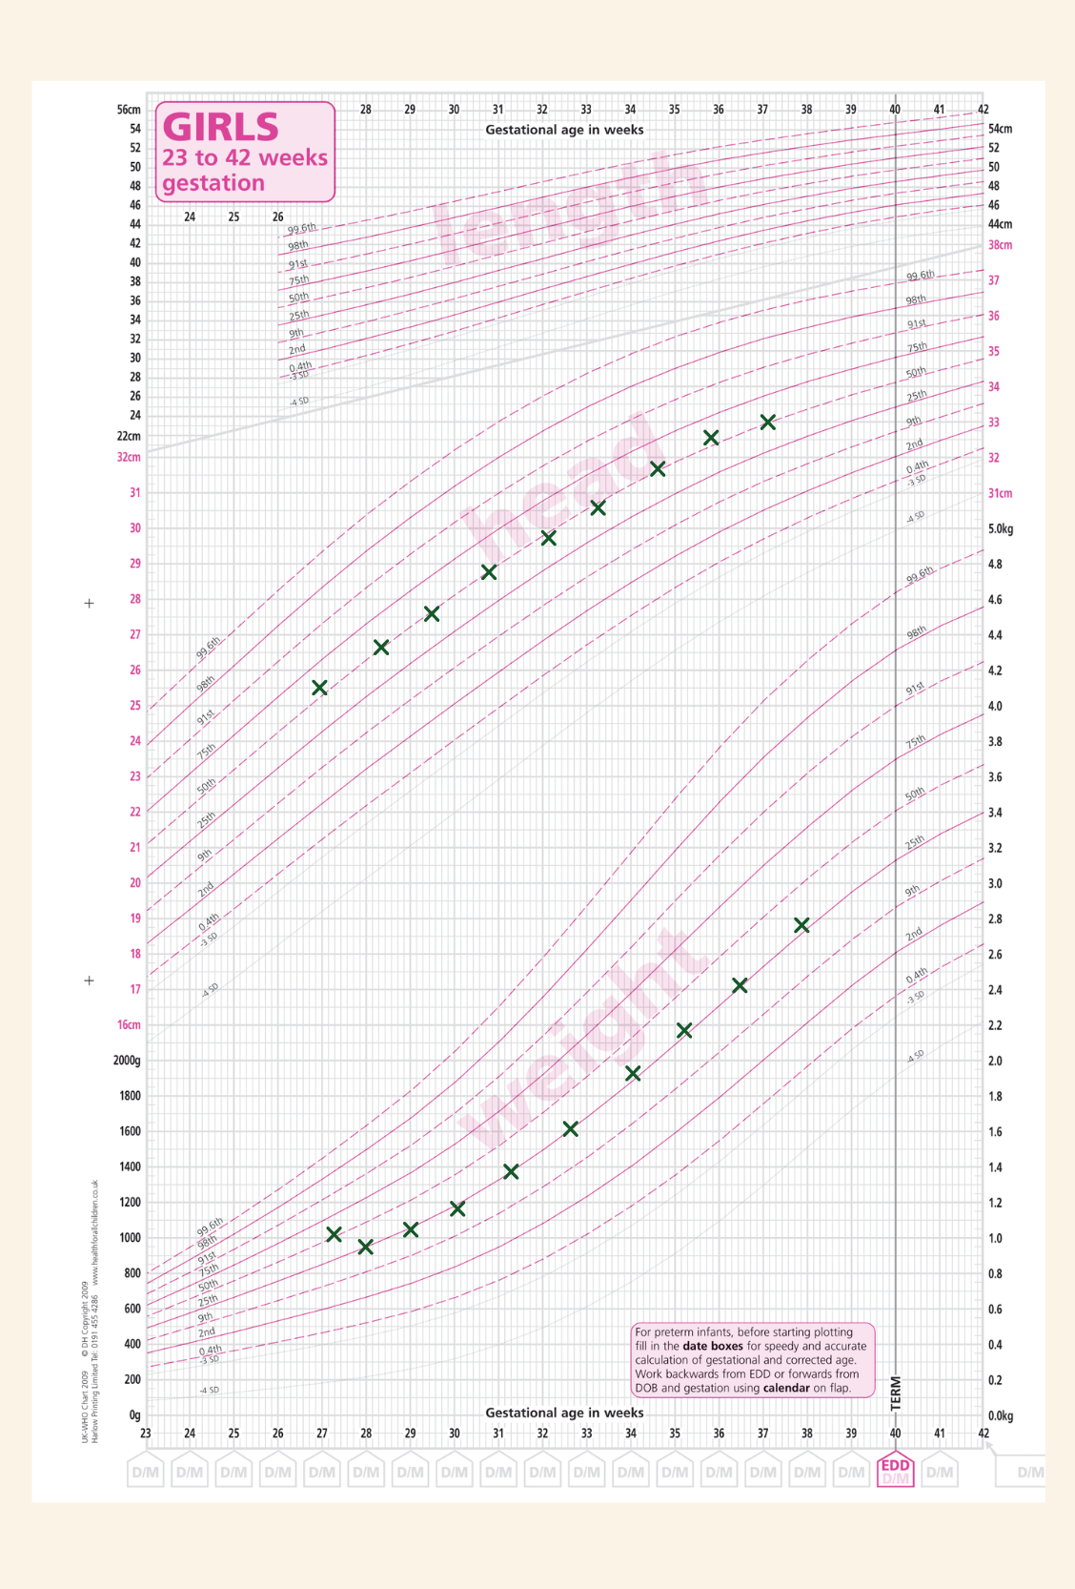
Typical preterm growth chart
This is a typical preterm growth chart. Centile lines on a growth chart represent the average growth for a population.
Explore the graph on the right and read the description in the slides to learn more about this particular growth pattern, which is felt to be acceptable.
Notes:
Weight:
The baby is born around the 50c.
The baby loses weight over the first few days.
The baby has then regained birthweight by around day 10.
After 10 days, the weight gain follows the 25c and the baby remains healthy until discharge.
Head Circumference:
Head growth tends to follow the 50c.
Length:
Unfortunately, length is not recorded.
After the first few days, recommendations aim to support growth similar to the in-utero fetus. In effect, this means that nutrition management should help maintain a preterm infant close to the weight centile line they are on towards the end of the first week. Most infants will then ‘track’ close to this centile line until discharge.

Slide 8
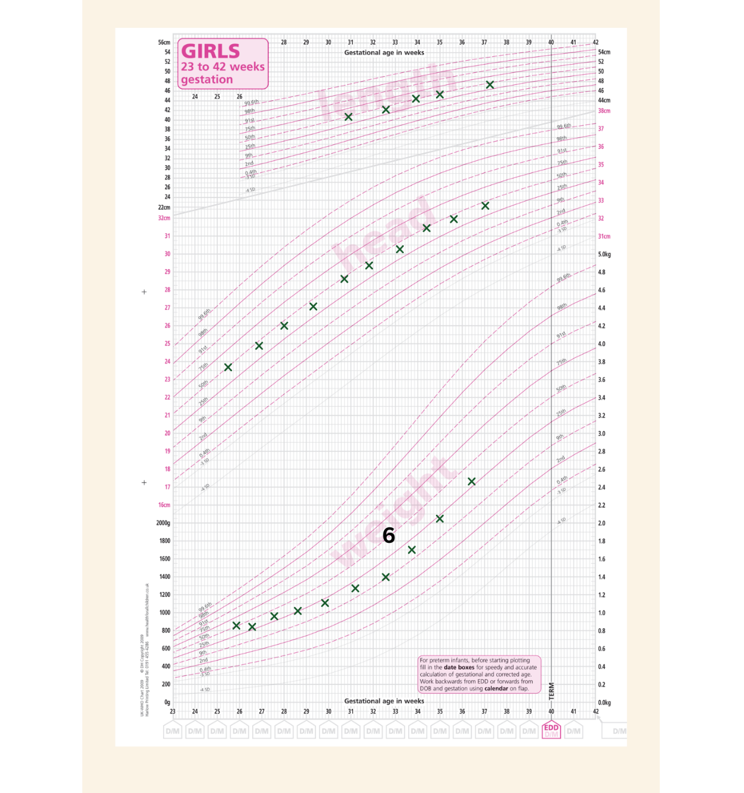
Growth charts showing growth faltering and catch-up growth
Example 1: Sodium deficiency
Notes:
This baby is born very preterm on the 50th centile, loses some initial weight and then starts to grow although the weight slowly falls to the 25th centile, and then to the 10th centile. The clinical team measure length and plot the HC, both of which seem to follow the centiles. At 6 weeks (see 6 in the graph above) of age, the baby is noted to have a sodium concentration of 128mmol/l and sodium supplements are commenced. Sufficient sodium is essential for growth. Following supplementation, growth improves.

Slide 9
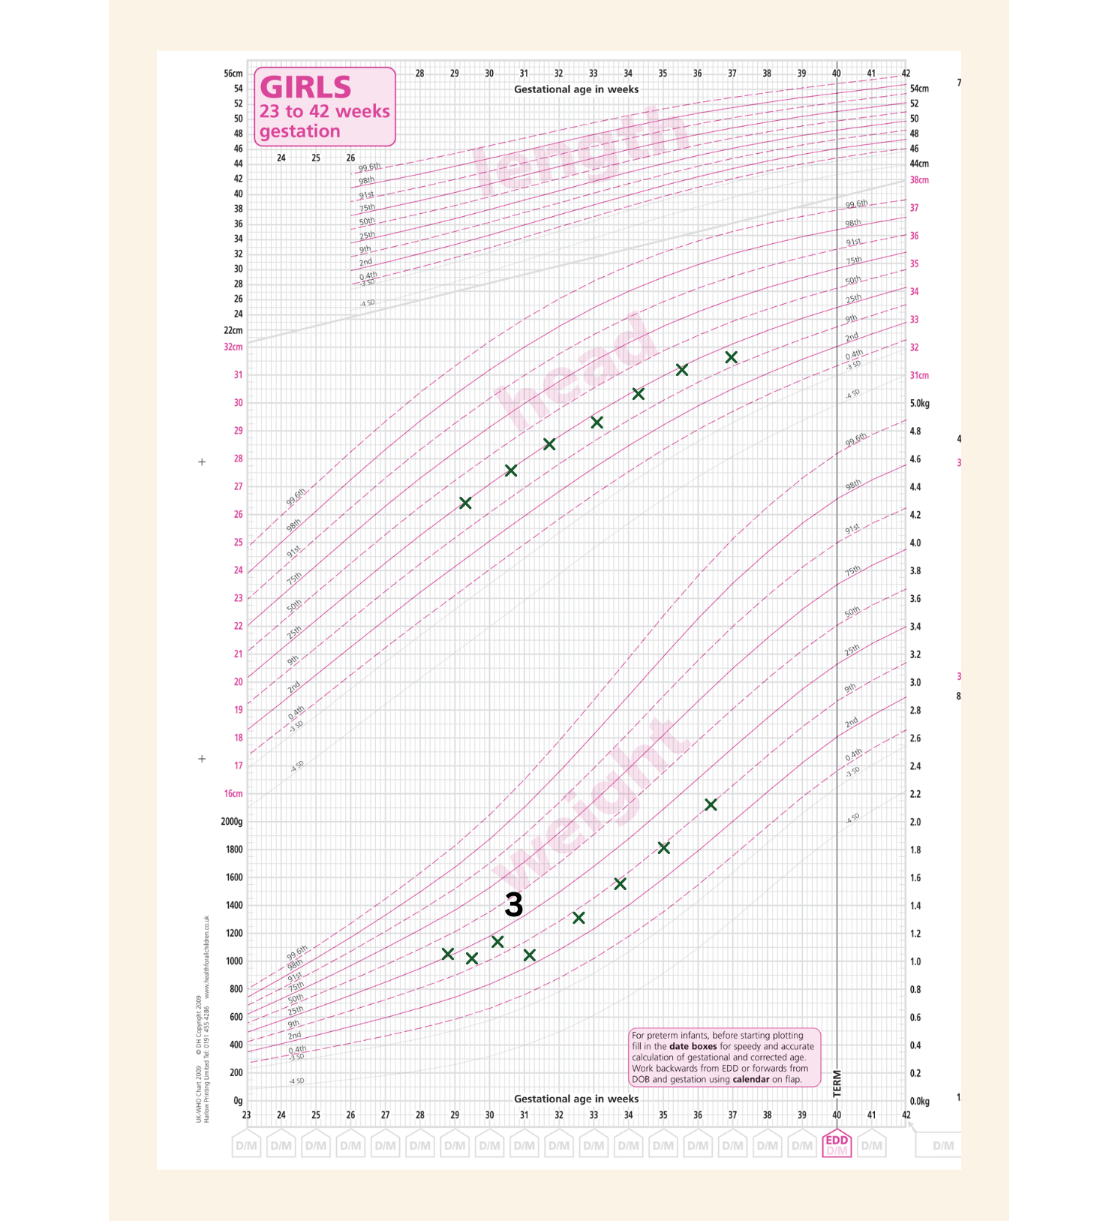
Growth charts showing growth faltering and catch-up growth
Example 2:
Severe sepsis
Notes:
This baby is born on the 25th centile, loses some initial weight and starts to grow, but at 3 weeks of age (see 3 in the graph above), develops severe sepsis. Feeds are stopped for 48 hours but after re-starting feeds the baby shows rapid catch-up growth in weight and then tracks the 10th centile.

Slide 10
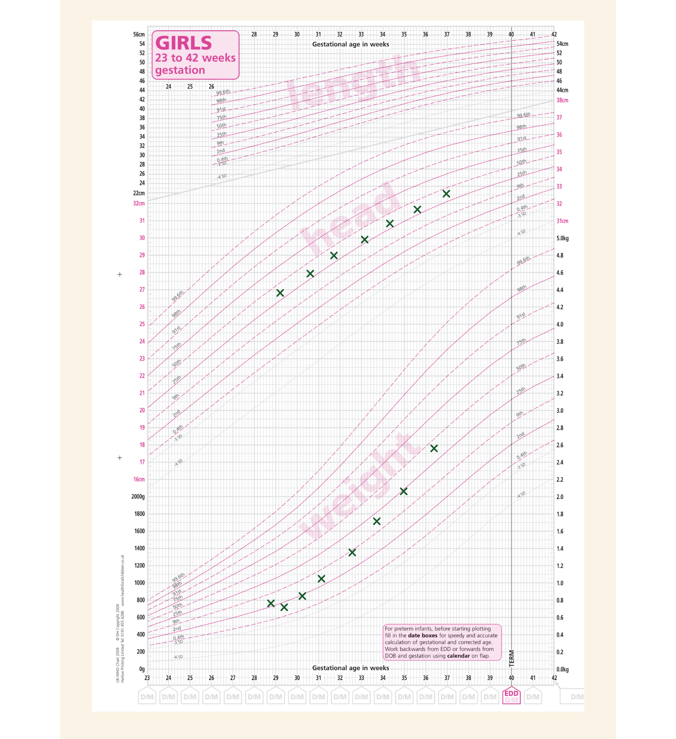
Growth charts showing growth faltering and catch-up growth
Example 3:
IUGR
Notes:
This baby is born just above the 3rd centile, loses some initial weight and then starts to gain weight. The baby’s HC is above the 25th centile suggesting the baby may be IUGR. Over the next few weeks the baby remains healthy and receives breast milk. The baby shows some catch-up growth (upwards crossing of weight centiles).

Slide 11
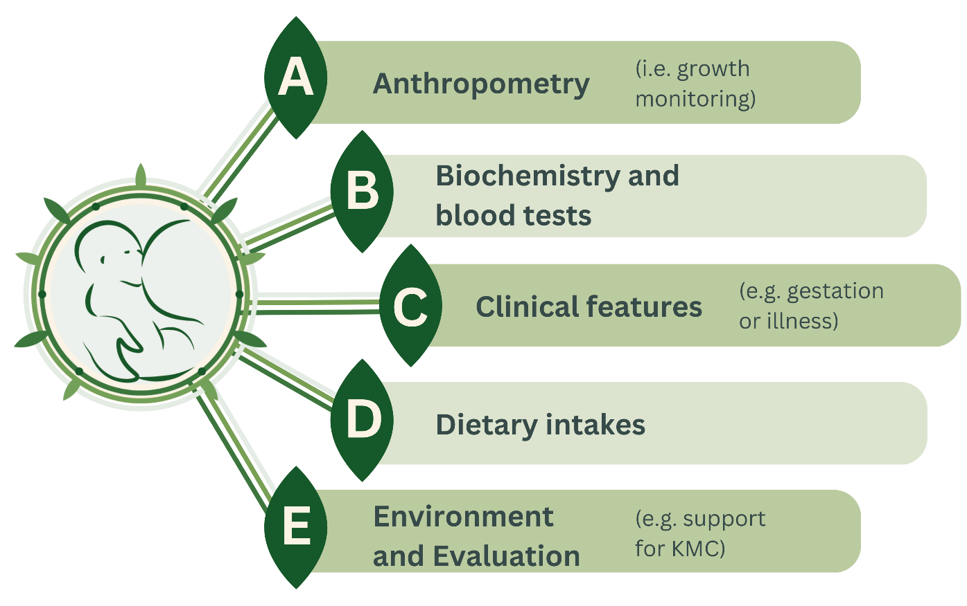
Growth monitoring, interpretation and the ABCDE approach
Notes:
Growth monitoring is a core element of nutritional care, and hospitals should develop their own guidelines and conduct regular audits on how this is implemented. However, growth is only one element of nutritional assessment, and it is important to assess wider aspects of nutrition. We call this a ‘holistic’ assessment, and use of the ABCDE approach below acts as an easy guide.
We will discuss the ABCDE approach in more detail in future steps.
Summary
Preterm infants lose weight over the first 3-4 days due to ECF contraction and delay in establishing dietary intakes. Following this, healthy preterm infants receiving appropriate nutrient intakes tend to track their weight centile until discharge. Some otherwise healthy infants grow more slowly than average, and some show catch-up after IUGR or after recovery from severe illness. Infants who are growing more slowly than acceptable should undergo careful assessment for correctable factors. All preterm infants should undergo regular growth monitoring (at least 2-3 times per week) and periodic nutritional assessment during their hospital stay.

Slide 12


ANNN Recommendations
Notes:
References for slides 2-12
Embleton, N.D., Moltu, S.J., Lapillonne, A., van den Akker, C.H., Carnielli, V., Fusch, C., Gerasimidis, K., van Goudoever, J.B., Haiden, N., Iacobelli, S. and Johnson, M.J. (2022). Enteral nutrition in preterm infants (2022): a position paper from the ESPGHAN committee on nutrition and invited experts. Journal of Pediatric Gastroenterology and Nutrition, 76(2), pp.10-1097.
Ceratto, S., Savino, F., Vannelli, S., De Sanctis, L. and Giuliani, F. (2020). Growth assessment in preterm children from birth to preschool age. Nutrients, 12(7), p.1941.
Villar, J., Giuliani, F., Barros, F., Roggero, P., Coronado Zarco, I.A., Rego, M.A.S., Ochieng, R., Gianni, M.L., Rao, S., Lambert, A. and Ryumina, I. (2018). Monitoring the postnatal growth of preterm infants: a paradigm change. Pediatrics, 141(2).
Vizzari, G., Morniroli, D., Tiraferri, V., Macchi, M., Gangi, S., Consales, A., Ceroni, F., Cerasani, J., Mosca, F. and Giannì, M.L. (2022). Postnatal growth of small for gestational age late preterm infants: determinants of catch-up growth. Pediatric Research, pp.1-6.
Ong, K.K., Kennedy, K., Castañeda‐Gutiérrez, E., Forsyth, S., Godfrey, K.M., Koletzko, B., Latulippe, M.E., Ozanne, S.E., Rueda, R., Schoemaker, M.H. and Van Der Beek, E.M. (2015). Postnatal growth in preterm infants and later health outcomes: a systematic review. Acta Paediatrica, 104(10), pp.974-986.

Slide 13
Growth resources
In this step, we will briefly describe the essential resources needed to conduct growth monitoring in preterm and LBW infants. This will include:
The use of equipment
Analysis of growth charts
Training that may be required for staff and parents.
This step provides a brief overview, and learners are directed to other resources for complete training packages, such as the INTERGROWTH-21st project.
Notes:
Equipment
Weight:
Hospitals need electronic baby weighing scales that are regularly calibrated and checked against standards. Manufacturer guidance must be followed. Scales should weigh to the nearest 5g. Infection control is important as multiple babies will be weighed on the same equipment. For growth monitoring, weighing babies every 2-3 days is probably sufficient, but for clinical purposes daily weight in a sick infant might be needed.
Head circumference (HC):
HC must be measured using non-stretchable tape. Paper tape allocated for individual baby use is ideal. Health care staff should be trained on good technique, i.e. largest occipto-frontal circumference of 3 measures.
An example video for how to measure HC is here.
Length:
Length measurement can be challenging and is usually a 2-person technique, in order to hold the head still and gently stretch the legs. A length board is needed rather than simply using tape. If length measurement can not be performed accurately and precisely then, it should not be performed.
An example video for how to measure length (as well as HC) is here.

Slide 14



Growth resources
Notes:
Growth charts
There are now several options to decide between when using growth charts to measure preterm infants. Examples include INTERGROWTH-21st, WHO, Fenton and national charts. There are complex differences between all of them in terms of population source, statistical analyses, smoothing, and use of data. Each has its own strengths and weaknesses, so these charts should be considered references (an example of how preterm infants grow) rather than standards (how babies must grow). Hospitals must decide which chart is most suitable for their setting and be consistent. Growth charts are only useful if the data is accurate, and the growth plots are made in the correct place. Remember, they must be corrected for gestation (degree of prematurity).
Staff education and training
Training is relatively simple, but is essential to ensure good technique. Hospitals should conduct periodic audits to ensure standards are maintained. See our website resources page for websites and links to help with staff education.
Parental involvement
Weight gain and plotting of measures on a growth chart holds enormous significance for parents/carers. In infancy and childhood, everyone accepts that growth is a measure of health and wellbeing. Parents/carers will want to look at the growth chart, and may want a copy for their own records. Parents/carers can help weigh their baby, and be involved in length measurement. HC should be performed or supervised by a health professional as a significant change may indicate important pathology. Informing parents/carers when the baby will be weighed or measured gives them an opportunity to ensure they are present and involved in the care. Explaining the growth pattern to parents/carers helps them better understand nutrition and growth, and gives them an opportunity to ask questions.

Slide 15
Growth Faltering
Weight gain that is slower than required to stay on the weight centile line can be quite common in preterm infants.
This is called ‘growth faltering’. In this step, we will introduce growth faltering in more detail and explain some of the common reasons for growth faltering in preterm infants.
Notes:
The importance of growth faltering
Firstly, it is important to understand what growth faltering is, and why it matters. Click the dropdown boxes below for an introduction to these key points.
Growth faltering: how slow is too slow?
There are no universally agreed definitions of growth faltering, and most extremely preterm infants will be discharged home on a weight centile lower than their birth centile. The aim of nutritional practice is to maintain weight gain on the centile achieved after the one-time-only contraction of ECF and diuresis that occurs in the first 3-4 days of life.
After the first 3-4 days, infants who cross further downwards more than 1-2 centile lines may be considered to be growth faltering. These infants should undergo a holistic evaluation of their nutritional status. Remember that weight gain is only one element of nutrition and that interventions aimed at increasing weight gain should not occur at the expense of intake of MOM.
Does growth faltering matter?
Growth faltering matters because weight gain is associated with brain growth, and infants who grow better generally have better cognitive outcomes than infants with growth faltering. However, studies of growth and outcome are all observational – infants are not ‘randomised’ in a randomised controlled trial (RCT) to either fast or slow growth. Preterm infants who are healthier tend to grow better. This may be because they are able to tolerate more nutrients, and especially because they have greater intakes of macronutrients and MOM. Infants who are sick or septic experience endocrine changes that suppress endogenous levels of growth factors such as IGF1. In this case, growth faltering is due to disturbed physiology rather than simply a lack of nutrients.
Therefore, it seems sensible to recommend meeting nutrient recommendations and maximising MOM, aiming to achieve growth along the weight centiles. However, some infants growing slowly but still tolerating good intakes of MOM may have normal cognitive outcomes.

Slide 16






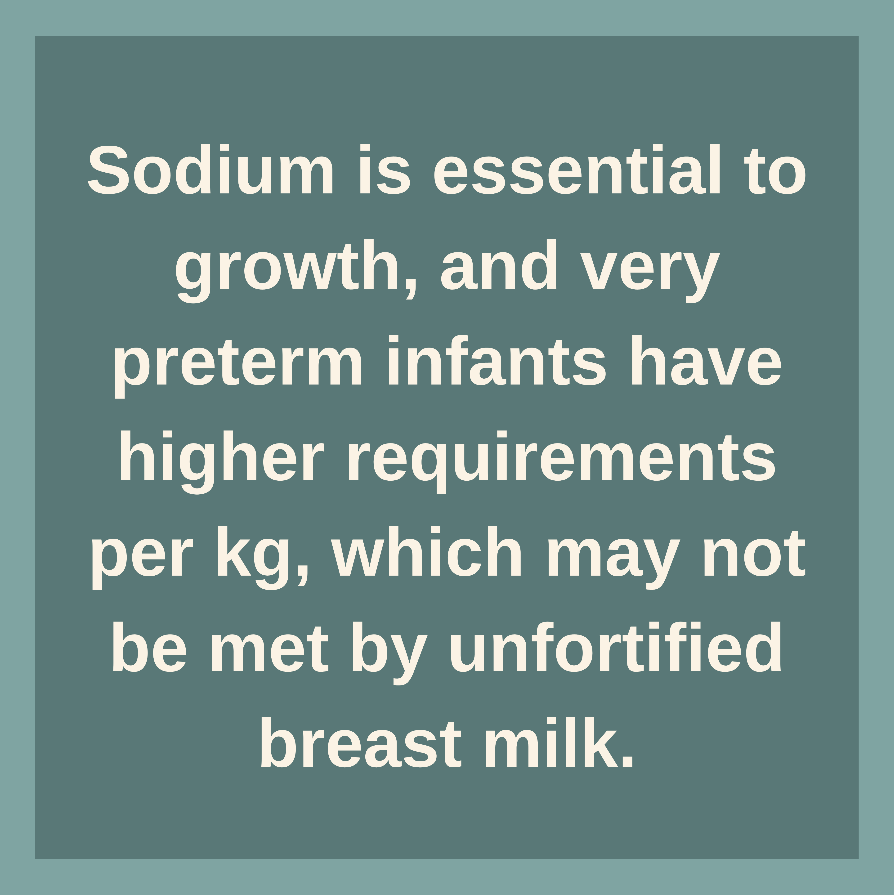
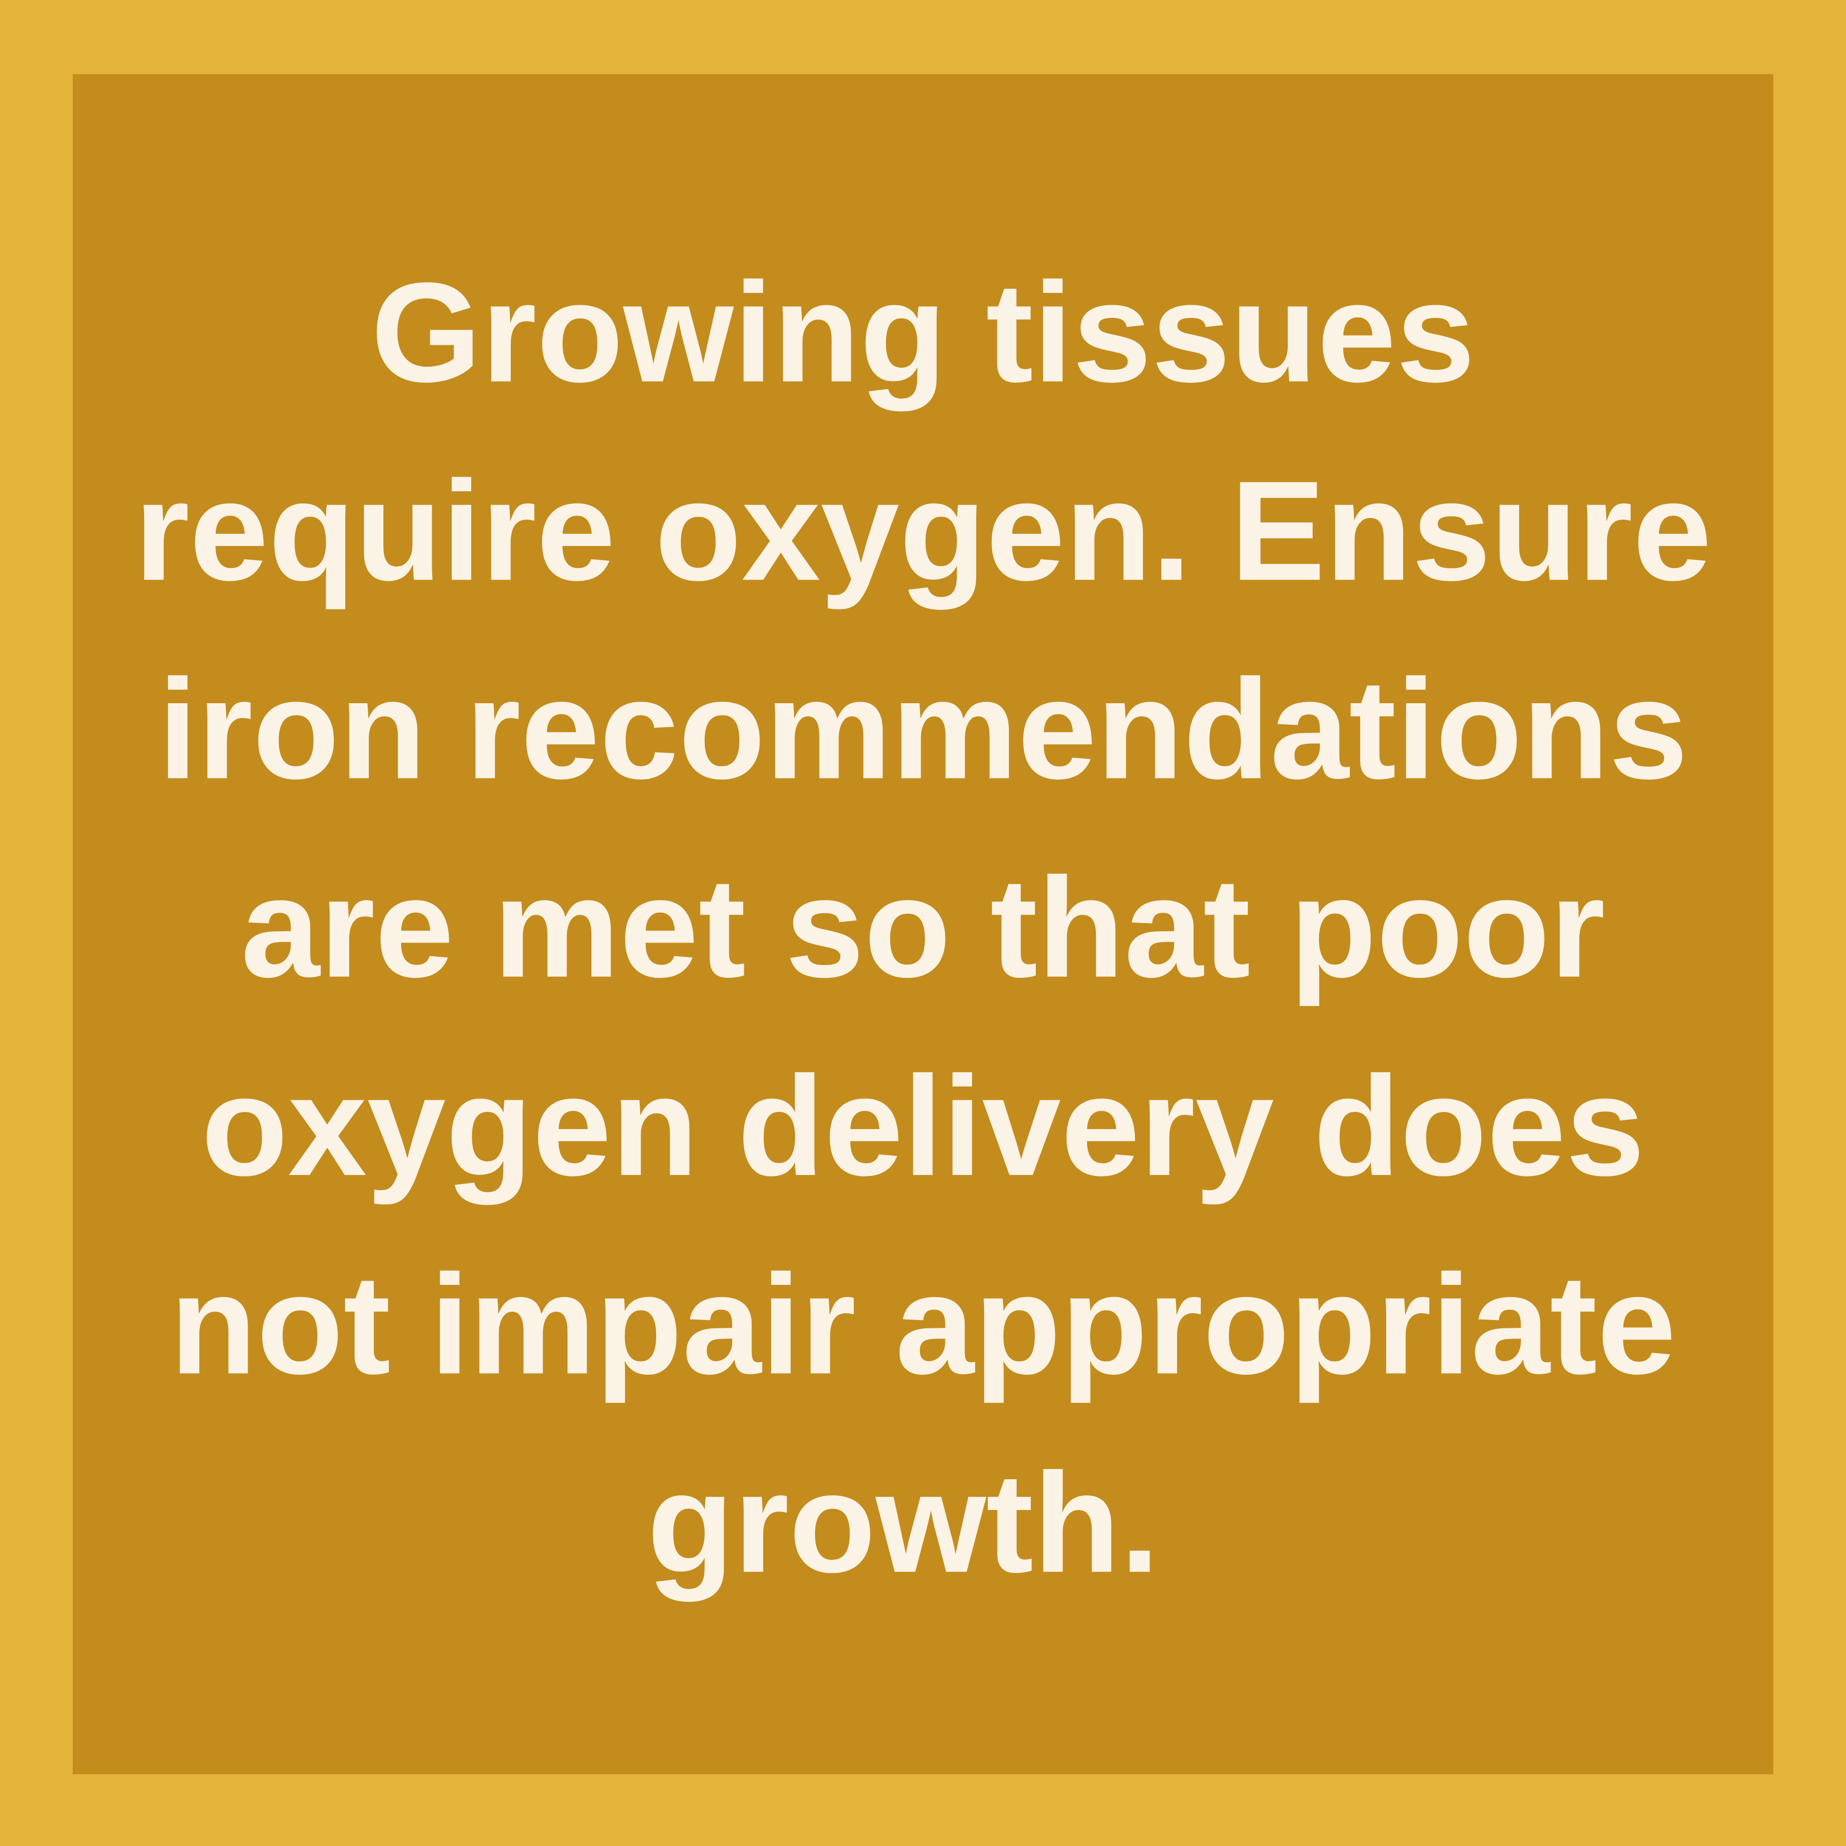


Causes of growth faltering in preterm infants
Notes:
The cards on this slide show 5 common causes of growth faltering in preterm infants.
With the exception of sodium, disturbance of other electrolytes and minerals rarely result in slow growth alone, but biochemical assessment may be helpful in the assessment of slow growth. Whilst addressing the specific needs of certain genetic and/or other conditions might be helpful, this is beyond the scope of this course.
It is important to recognise and understand these common causes, but equally important to know what questions to ask in practice to conclude why your patient is experiencing growth faltering. Healthcare workers should remember to have the mother assessed for psychological issues, infection etc., as this may greatly affect her milk production. In the following three sections we present three key considerations.

Slide 17
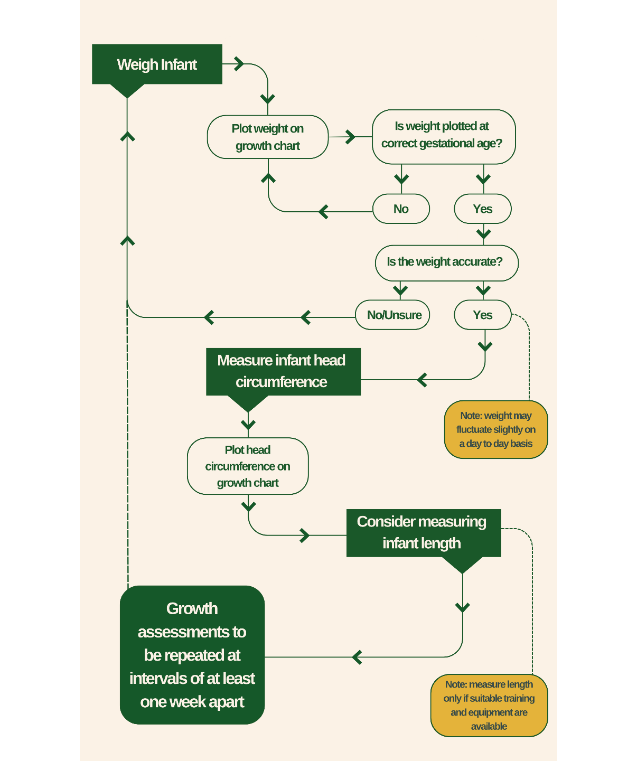
Is the growth chart correctly completed?
Notes:
There are several common mistakes that can occur when taking infant growth measurements and filling in the growth chart. Read through the flowchart on this slide to explore the potential sources of error, and read on to see more questions that should be asked.
Is the growth proportional?
Measurement of head and length will provide information about body composition. It is common to see that linear growth is maintained, even when weight gain is slow. Slow length gain may indicate insufficient protein or mineral intake. Infants fed on a high energy but low protein diet may appear to gain weight appropriately, but may in fact be depositing fat mass rather than lean mass.
Is the infant well?
Infants who have had recent systemic illness, such as NEC or sepsis, are unlikely to have tolerated adequate macronutrient intakes and will not have gained weight. There is some evidence that attempting to maintain high macronutrient intakes during acute illness may be harmful, and some authorities suggest decreasing nutrient intakes to 50-70% for the 2-3 days when an infant is acutely unwell. However, there are no good RCTs in preterm infants. Weight gain often starts to increase quickly when the infant is better.
What is the infant's overall ‘fluid status’?
Some infants with acute illness such as NEC or sepsis retain fluid and may appear to gain weight, but the weight gain is water. As these infants recover, there is a diuresis and weight loss that might take several days. Re-establishing nutrient intakes can take several days. Preterm infants with high fluid losses can become dehydrated.
Fluid loss in the urine or stool is usually obvious, but extremely premature infants can have high transepidermal water losses (water lost through the skin) up to 50ml/kg/day, which are not visible. During these rapid changes in fluid status, measurement of serum sodium is useful.
A key principle is to focus on maximising MOM intake rather than focusing purely on weight gain. Weight gain is important, but it is only one element of a holistic approach to nutritional assessment.
References for slides 13-17
Villar, J., Giuliani, F., Barros, F., Roggero, P., Coronado Zarco, I.A., Rego, M.A.S., Ochieng, R., Gianni, M.L., Rao, S., Lambert, A. and Ryumina, I. (2018). Monitoring the postnatal growth of preterm infants: a paradigm change. Pediatrics, 141(2).
Young, A., Beattie, R.M. and Johnson, M.J. (2023). Optimising growth in very preterm infants: reviewing the evidence. Archives of Disease in Childhood-Fetal and Neonatal Edition, 108(1), pp.2-9.
Fenton, T.R., Cormack, B., Goldberg, D., Nasser, R., Alshaikh, B., Eliasziw, M., Hay, W.W., Hoyos, A., Anderson, D., Bloomfield, F. and Griffin, I. (2020). “Extrauterine growth restriction” and “postnatal growth failure” are misnomers for preterm infants. Journal of Perinatology, 40(5), pp.704-714.
Cole, T.J., Statnikov, Y., Santhakumaran, S., Pan, H., Modi, N., Neonatal Data Analysis Unit and Preterm Growth Investigator Group. (2014). Birth weight and longitudinal growth in infants born below 32 weeks’ gestation: a UK population study. Archives of Disease in Childhood-Fetal and Neonatal Edition, 99(1), pp.F34-F40.

Slide 18
Macronutrients
24 weeks: Very limited fat stores at 24 weeks, but fats are still present in low amounts in neural tissues (brain and eyes) and cell membranes.
3rd trimester: The proportion of protein and minerals remains relatively constant throughout the 3rd trimester.
37 weeks: Fat mass increases significantly from <1-2% at 24 weeks to >15% at term.
Did you know? Human infants at birth are one of the ‘fattest’ newborns on the planet!
Notes:
We first introduced macronutrients (protein, fat, carbohydrate, and water) in module 2, where we also discussed breast milk composition and the risks and benefits of fortifying breast milk in relation to macronutrient needs.
In this step, we will discuss the specific macronutrient requirements of preterm and LBW infants in more detail. You will learn how macronutrient requirements and recommendations are calculated, and consider the role of macronutrients and fluid requirements.
Understanding fetal growth estimates
Foetal ultrasounds have been used to study typical growth patterns in-utero between 24-40 weeks gestation. Fetal ultrasound estimates weight using measurements such as abdominal circumference, HC, and femur length. Other growth studies use weight at birth in infants born prematurely. The data upon which growth estimates and charts are based all have strengths and weaknesses.
Studies from the WHO, INTERGROWTH-21st and other groups (e.g. Fenton et al.) show that growth rates are highest in the most immature fetuses, with growth of ~20g/kg/day at 24 weeks, decreasing to ~10g/kg/day at 36-40 weeks.
Just as in childhood, there are normal ranges, and some babies grow faster or slower due to genetic and other factors. Therefore, the optimal weight gain for an individual baby can never be known.
Macronutrient requirements in preterm infants
How are macronutrient requirements calculated?
To determine macronutrient needs in a preterm infant, basic science studies assess body composition. These studies reveal changes in body composition of preterm infants, some of which are shown in the graphic on this slide.
Using growth data and body composition studies in preterm and term infants, dietary protein, fat, and energy requirements for the preterm infant on a daily basis can be estimated.

Slide 19

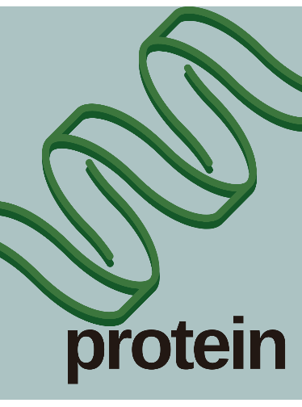
Macronutrients in preterm infants
Notes:
Water
Water is an essential macronutrient. It is a ‘carrier’ of nutrients, enables excretion of waste products, for example urinary urea, and is required by every cell in the body for normal physiological function. Preterm infants require higher water intakes because of higher surface area and thin skin, and because nutrient intakes are higher. Very preterm infants need a fluid intake of ~150-180ml/kg/day. Higher intakes especially of MOM up to 200-220ml/kg/day may support improved growth and avoid growth faltering especially in extremely preterm infants.
Proteins
On average, preterm infants at 24-32 weeks will store around 2g/kg/day of new body protein (cells, organs, plasma proteins etc.) They also lose up to 1-1.5g/kg/day of protein in the urine, stool and other losses. This means a typical very preterm infant will need a dietary protein intake of around 3.5g/kg/day. Some extremely preterm infants may need more, up to 4g/kg/day or more. It is not possible to meet these high protein intakes with breast milk alone.
Fats
Fat is transferred across the placenta from the mother, however the amount of fat transferred is relatively small. Most fat stored in the fetus is actually synthesised by the fetus themselves, although the placenta must transfer small amounts of Essential Fatty Acids (EFA). The term ‘essential’ means they cannot be made by humans and must be included in the diet. EFA include linoleic acid and alpha-linolenic acid which are converted into longer chain fatty acids such as arachidonic acid and DHA. Using a similar process to protein estimation, a very preterm infant 24-32 weeks will need a dietary fat intake of around 4.8-8.1g/kg/day
Carbohydrate
The fetus receives carbohydrates in the form of glucose via the placenta. Glucose is provided in high amounts and mainly provides energy. Fats also provide energy, but unlike glucose, fatty acids are also incorporated into new tissues. Small amounts of carbohydrates are stored in muscles and body organs as glycogen. Glycogen stores in preterm infants are limited. A very preterm infant needs a dietary carbohydrate intake of around 11-15g/kg/day.

Slide 20
What is energy used for?
Notes:
Energy
Fats and carbohydrates provide energy. However, some energy is also obtained from transplacental amino acids in utero. When infants are breastfeeding, about half of the energy comes from carbohydrate and half from fat. An approximate 50:50 balance can therefore be seen as a reasonable objective in preterm infants.
Where there is insufficient energy available, protein can be catabolised. Dietary protein that is used for energy can not then be used to make new tissue. If the body needs more energy than available, then body protein will have to be catabolised. This breakdown of lean tissue will impair muscle and organ function and result in malnutrition. A very preterm infant needs a dietary energy intake of ~115-140kcal/kg/day.
What is energy used for?
Energy is required for essential activity such as breathing, digestion, enzyme activity, heart function, and cell membrane functions. For example, lots of energy is required for the sodium/potassium pump that operates in every cell, every second of the day. Energy is also expended during processing of the diet, so called “diet induced thermogenesis”. Finally energy is also required for growth and tissue repair and turnover.

Slide 21
Protein Digestion
Dietary protein in milk provides the building blocks of:
Lean tissue, e.g. muscles, brain, and other organs.
Body proteins, e.g. plasma proteins, hormones, antibodies.
What are peptides?
  Peptides are chains of 20 or more amino acids, arranged like a string of pearls.
Notes:
The graphic on this slide shows how milk proteins are digested into peptides and absorbed through the gut. Read through to learn more.
Transplacental amino acids for the fetus
The mother provides amino acids to the fetus in the 3rd trimester via placental transfer, so the fetus in-utero does not receive protein. There are ~20 different amino acids in humans. Human milk, cow milk, and transplacental blood all provide differing proportions of amino acids. Transplacental amino acid transfer provides many more amino acids than theoretically needed. This might improve metabolic flexibility due to changing demands. Amino acids that are not used for lean tissues are catabolised to provide energy.

Slide 22
Normal protein turnover and losses
Notes:
Normal physiological processes mean that plasma proteins and proteins in cells and tissues are continually broken down and synthesised into new proteins. The process of protein turnover is less than 100% efficient and therefore results in “waste products” - primarily as urea in the urine.
Body cells are also continually replaced. Intestinal epithelial cells (enterocytes) are continually shed in the stool. Enterocyte turnover is extremely rapid – they are fully replaced every few days! Protein can also be lost in secretions, and from the skin.
Summary
A working knowledge of macronutrient requirements and how they are estimated enables more logical clinical practice. Fetal growth is rapid, and nutrient requirements are very high, especially in infants <28 weeks gestation. Providing additional dietary macronutrients or feeding at higher milk volumes may enable weight gain closer to fetal references. There is a lack of data from low- and middle-income settings on how best to meet nutrient needs when resources are limited.
References for slides 18-22
Embleton, N.D., Moltu, S.J., Lapillonne, A., van den Akker, C.H., Carnielli, V., Fusch, C., Gerasimidis, K., van Goudoever, J.B., Haiden, N., Iacobelli, S. and Johnson, M.J. (2022). Enteral nutrition in preterm infants (2022): a position paper from the ESPGHAN committee on nutrition and invited experts. Journal of Pediatric Gastroenterology and Nutrition, 76(2) pp.10-1097.

Slide 23
Micronutrients - minerals, electrolytes, and trace elements
Preterm and LBW infants are at risk of a number of micronutrient deficiencies, including:
Minerals - e.g. calcium and phosphorus
Electrolytes - e.g. sodium and potassium
Trace elements - e.g. iron and zinc
Vitamins
Notes:
In this step, we will consider the specific needs for minerals, electrolytes, and trace elements in preterm and LBW infants, and gain an understanding of the requirements for supplementation of zinc and iron.

Slide 24
Minerals
Notes:
Minerals are very important for a wide range of cellular functions, and mineral deficiencies can cause significant problems in preterm and LBW infants.
Serum calcium concentrations are tightly maintained, and even in the presence of significant bone mineral loss, the serum calcium concentration may remain at a normal level.
Whilst 80% of phosphorus is found in bone minerals, the other 20% is present in lean tissue (e.g. muscles) and is critical for normal intra-cellular energy metabolism. Low serum phosphate may result in muscle weakness, for example of respiratory muscles. However, biochemical measurement of serum phosphate is not widely available in resource limited settings.
Whilst there are multiple reasons why calcium concentrations may be low, two relatively common situations are seen in preterm and LBW infants. These are shown in the graphic on the right hand side of the slide.
Significant accumulation of calcium and phosphorus into the bones of the infant occurs during the 3rd trimester of pregnancy. Very preterm infants miss out on this time period, so often become mineral deficient. However, supplementation is not straightforward, especially in resource-poor settings. Breast milk fortifiers provide additional calcium and phosphorus, but are expensive. Individual phosphorus supplements are not widely available.

Slide 25
Electrolytes
Notes:
Electrolytes, especially sodium and potassium, are involved in normal function of every cell. Potassium deficiency is uncommon in stable preterm and LBW infants unless there are excess intestinal losses or diuretic administration.
Sodium requirements in preterm infants are high (~3-5mmol/kg/day or greater) so deficiency is more common. Very preterm infants may lose significant sodium in the urine in the first few days due to immature renal tubular function. Infants may also have excess intestinal sodium losses (diarrhoea or stoma) or urinary losses due to diuretics. Oral sodium supplements are not widely available in resource poor settings so routine supplements are not common. However, sodium deficiency should be considered in the assessment of a preterm infant with sub-optimal weight gain.

Slide 26
Trace Elements
Notes:
Trace elements are essential dietary components involved in a range of cellular and metabolic processes. In preterm and LBW infants the most important are iron and zinc, and supplements may be needed. The graphic on this slide shows daily recommended intakes for preterm infants of six well-known trace elements. In the vast majority of preterm and LBW infants, these intakes are met with breastmilk.

Slide 27
Trace Elements
Notes:
Iron
Iron is involved in production of haemoglobin, but it is important to recognise that iron is essential for normal brain development. Iron deficiency can impair neuro-development even if anaemia is not present. Breast milk is naturally low in iron because excess iron in the gastrointestinal (GI) tract may cause inflammation or affect the amount of healthy bacteria.
Breast fed term infants do not require iron supplements, but preterm and LBW infants need around 2mg/kg/day whilst they are breast fed. Iron supplements do not need commencing until 2-4 weeks of age. Supplements should be continued after discharge as long as breastfeeding and no alternative source of iron (e.g. iron rich complementary foods).
Zinc
Zinc is involved in growth, tissue repair, and immune defence. Most enzymes in the body require zinc. Zinc deficiency may occur when there are excess GI losses such as diarrhoea or stoma losses (post bowel surgery), but can also occasionally occur in LBW infants who are breastfed.
Worldwide, zinc deficiency is a common and treatable cause of stunting. Zinc deficiency may result in poor growth, impaired wound healing and a typical rash. The rash looks like eczema, and is common on the chin but also occurs on other parts of the body. It may be difficult to measure zinc concentration in many hospitals, but zinc supplements are not toxic (unlike iron) so a therapeutic trial in an infant with classic symptoms might be considered. It is not certain whether routine zinc supplements are required in preterm and LBW infants.
Iodine
Iodine deficiency remains prevalent in many parts of the world, including Africa, and is considered to be the single largest cause of loss of neurocognitive function globally. It can be prevented in the general population by use of iodised salt. Preterm and LBW infants are not specifically at increased risk of iodine deficiency, but can be at risk of excess when antiseptic containing iodine is used.
Copper
Copper deficiency is incredibly rare in preterm and LBW infants and might only be seen in infants on prolonged parenteral nutrition. Other trace elements that are essential, but where deficiency is not reported in preterm and LBW infants, include selenium, manganese, molybdenum, and chromium.

Slide 28
Notes:
Strategies and Interventions
The high mineral demands of very preterm infants can be difficult to achieve, and many infants develop osteopenia, which may result in bone fractures, poor growth, and impaired muscle function. Although breast milk has relatively low amounts of calcium and phosphorus for the preterm infant, breast milk bionutrients such as growth factors, improve bone strength and adult bone mineral density (Fewtrell et al., 2009). Interventions such as physiotherapy and passive movements appear to encourage bone mineral deposition in preterm infants (Vignochi C et al., 2008). It seems likely that positioning in the incubator and KMC will have similar benefits on bone mineral deposition.
Delayed cord clamping has been shown to improve haemoglobin concentration and iron stores, and may also be beneficial in preterm and LBW infants. The impact of breast milk, physiotherapy, delayed cord clamping, and other interventions emphasise that promoting good nutritional status involves more than simply nutrients.
Summary
Micronutrients are an essential dietary component and are present in breast milk. However, in specific preterm and LBW infants, supplements may be appropriate including calcium, sodium, iron, and zinc. Hospitals should develop local guidelines for nutritional management and use of supplements. Hospitals should promote holistic nutritional care by supporting activities such as positioning, physiotherapy, and KMC, and promote the use of mother’s own breast milk.

Slide 29
WHO Recommendations
Notes:
References for slides 23-29
Embleton, N.D., Moltu, S.J., Lapillonne, A., van den Akker, C.H., Carnielli, V., Fusch, C., Gerasimidis, K., van Goudoever, J.B., Haiden, N., Iacobelli, S. and Johnson, M.J. (2022). Enteral nutrition in preterm infants (2022): a position paper from the ESPGHAN committee on nutrition and invited experts. Journal of Pediatric Gastroenterology and Nutrition, 76(2), pp.10-1097.
Fewtrell, M.S., Williams, J.E., Singhal, A., Murgatroyd, P.R., Fuller, N. and Lucas, A. (2009). Early diet and peak bone mass: 20 year follow-up of a randomized trial of early diet in infants born preterm. Bone, 45(1), pp.142-149.
Vignochi, C.M., Miura, E. and Canani, L.H. (2008). Effects of motor physical therapy on bone mineralization in premature infants: a randomized controlled study. Journal of Perinatology, 28(9), pp.624-631.
Domellöf, M. (2017). Meeting the iron needs of low and very low birth weight infants. Annals of Nutrition and Metabolism, 71(Suppl. 3), pp.16-23.
WHO (2022). WHO recommendations for care of the preterm or low-birth-weight infant. World Health Organization. Available at: https://www.who.int/publications/i/item/9789240058262

Slide 30
Micronutrients - vitamins
Folic acid supplements in pregnancy reduce the risk of neural tube defects.
Notes:
In this step, we will explore the vitamin needs of preterm and LBW infants. We will explain the differences between water and fat soluble vitamins, and use our knowledge to determine what vitamin supplements to use in clinical practice.
Vitamins are essential dietary components involved in all aspects of physiology and metabolism. Preterm and LBW infants very rarely present with obvious signs of deficiency, but ensuring adequate intake is essential. If breast milk or regulated infant formula is used, then the only vitamin that requires nutritional supplements in otherwise healthy preterm and LBW infants is vitamin D. However, intramuscular vitamin K is usually given at birth.
Water soluble vitamins
Water soluble vitamins are absorbed quickly in the GI tract and are involved in multiple complex metabolic steps. A detailed knowledge of water soluble vitamins is not needed for routine neonatal practice.
Preterm and LBW infants have low stores of water soluble vitamins but all of their dietary needs will be fully met if they receive breast milk or formula feeds. There are many types of water soluble vitamins including B vitamins such as thiamine, niacin, riboflavin and B6, and vitamin C.
Folate is a specific water soluble B vitamin. Folic acid supplements in pregnancy reduce the risk of neural tube defects. There is no strong evidence that folic acid supplements are needed in preterm and LBW infants, but some hospitals will still administer them. Some studies show that low vitamin B12 concentrations are more common in African infants than previously recognised (Bellows et al., 2017), but routine supplementation is not currently recommended.

Slide 31

Fat soluble vitamins
Notes:
Fat soluble vitamins include vitamins A, D, E, and K - or "ADEK". These vitamins are absorbed alongside fat in the gut. Their specific functions are shown in the cards on this slide.
Preterm and LBW infants have low stores of fat soluble vitamins and are at risk of deficiency. Breast milk contains adequate concentrations of vitamins A, D, and E for term infants, but many authorities recommend supplements for preterm and LBW infants. There are few good studies in African settings to support this, but there is general agreement that vitamin D supplementation is helpful. Read below to learn more about the role of each fat soluble vitamin.
Vitamin A
Vitamin A (retinol) plays an important role in multiple physiological processes and especially in lung maturation. Preterm infants often have lower plasma concentrations. Vitamin A metabolism is highly complex and low levels in preterm infants may also be due to poor GI absorption and/or impaired hepatic function, such as cholestasis. Vitamin A deficiency rarely presents with clinical signs in newborn infants but it may result in broncho-pulmonary dysplasia (BPD, also called chronic lung disease) among preterm infants.
Vitamin A supplements may be beneficial in preterm infants but the available data relating to infants cared for in African settings is limited. High dose intramuscular supplementation with vitamin A may reduce the risk of BPD, but this is not widely practiced even in high-income settings because it requires regular intramuscular injections.
Vitamin D
Vitamin D is critical for bone health, immune function, and respiratory status.
Vitamin D deficiency may present early as hypocalcaemia with signs of tetany or convulsions. Vitamin D deficiency is common in dark skinned or obese mothers, especially if they have a poor diet or pre-eclampsia. This may also lead to poor fetal growth.
Supplementation is widely practiced for preterm and LBW infants. The exact amount required varies, but many hospitals give 400iU/day in addition to the amount of vitamin D the baby receives from milk. Infants who are vitamin D deficient may need higher doses (up to 800-1000iU/day). Vitamin D supplementation may also be beneficial after discharge.
Vitamin E
Vitamin E is involved in antioxidant defence and so deficiency may be especially relevant for preterm and LBW infants. There are occasional reports of haemolytic anaemia associated with vitamin E deficiency in preterm infancy, which is more likely to occur when there is cholestasis and associated fat malabsorption. However, there are few high quality RCTs, so the optimal intake is uncertain. There is no good evidence that routine supplementation is needed in African settings, but many multivitamin preparations used in infancy contain vitamin E and it is generally considered safe.
Vitamin K
Vitamin K is only present in breast milk in low concentrations, and deficiency may rarely present as haemorrhagic disease of the newborn. Vitamin K is also required for bone health. Intramuscular injection at birth is common in many parts of the world. If preterm and LBW infants receive intramuscular vitamin K at birth, then regular supplements are not needed unless the baby develops cholestasis, which impairs fat absorption.
Routine vitamin supplementation for preterm and LBW infants
High quality RCTs to support the use of vitamin supplements are generally lacking, especially in African contexts. However, many authorities agree that supplementation with vitamin D 400iU/day is helpful, and some recommend higher intakes up to 800-1000iU/day.
There are no good data to support routine supplementation with other vitamins. However, vitamin D is most easily obtained using multivitamin preparations. These preparations also contain vitamin A and/or vitamin E, but whether these are essential for preterm and LBW infants is not certain. However, they will not be harmful in the concentrations provided, and may be beneficial in populations where vitamin A deficiency is prevalent in childhood. It is not clear if routine folic acid supplementation is beneficial, but again it is unlikely to be harmful.
Summary
In summary, vitamins are essential for preterm and LBW infants. Water soluble vitamins are usually adequately met through breast milk or formula feeds. Fat soluble vitamins, such as vitamin A, D, E, and K, may require supplementation due to low stores in preterm and LBW infants. Maternal dietary intake has little effect on breast milk levels of vitamins, although there is some evidence that vitamin D levels may be increased in women who take vitamin D supplements. High-quality evidence supporting routine supplementation however remains lacking, especially in African contexts. Vitamin D supplementation is generally recommended at 400-1000iU/day, while supplementation with other vitamins is uncertain but unlikely to be harmful. Folic acid supplementation may not be necessary, but is also unlikely to be harmful.

Slide 32
WHO/ANNN Recommendations
Notes:
References for slides 30-32
Embleton, N.D., Moltu, S.J., Lapillonne, A., van den Akker, C.H., Carnielli, V., Fusch, C., Gerasimidis, K., van Goudoever, J.B., Haiden, N., Iacobelli, S. and Johnson, M.J. (2022). Enteral nutrition in preterm infants (2022): a position paper from the ESPGHAN committee on nutrition and invited experts. Journal of Pediatric Gastroenterology and Nutrition, 76(2) pp.10-1097.
World Health Organization. (2022). WHO recommendations for care of the preterm or low-birth-weight infant. Geneva.
Bellows, A.L., Smith, E.R., Muhihi, A., Briegleb, C., Noor, R.A., Mshamu, S., Sudfeld, C., Masanja, H. and Fawzi, W.W. (2017). Micronutrient deficiencies among breastfeeding infants in Tanzania. Nutrients, 9(11), p.1258.
WHO (2022). WHO recommendations for care of the preterm or low-birth-weight infant. World Health Organization. Available at: https://www.who.int/publications/i/item/9789240058262

Slide 33
Necrotising enterocolitis (NEC)
Notes:
In this step, we will describe the risk factors and pathology of necrotising enterocolitis (NEC). We will then go on to explore diagnosis of this disease, and understand how it can be prevented and treated.
What is NEC?
NEC is an inflammatory gut disorder that mainly occurs in very preterm infants but may also occur in term infants with cardiac disorders. NEC is closely associated with prematurity: incidence is ~5-10% in infants less than 28 weeks, but <5% in babies born at 28-32 weeks. Severe NEC has a mortality of >50%.
Whilst all common neonatal morbidities (such as retinopathy of prematurity, bronchopulmonary dysplasia, and sepsis) are associated with nutrition, NEC deserves special consideration.
Pathology
The pathology and causes of NEC are complex but appear to be due to a combination of 3 factors. These can be remembered using N-E-C: as shown on the slide above.
“NEC” is a histological term applied to a clinical syndrome. Histology shows inflammation of the gut epithelium that progresses to necrosis, and this may then lead to perforation. However, as there are multiple causes and the pathology of NEC is complex and varied, it probably represents more than a single disease.

Slide 34
NEC Clinical Presentation
Feed intolerance: Increased vomiting, larger gastric aspirates
Raised inflammatory markers: CRP
Abnormal AXR results: Abdominal X-ray (AXR), if available, may show classic intramural intestinal gas bubbles (pneumatosis), intestinal dilation, or pneumoperitoneum (free air due to perforation). AXR can be non-specific.
Notes:
Most infants with NEC are very preterm and many are SGA and/or IUGR. NEC typically occurs around 2-3 weeks of age but can present earlier or later. Presentation is usually over a few hours but it can present more slowly.
The graphic below summarises the clinical presentation of NEC, including test results for contexts where blood tests and Abdominal X-rays are available.

Slide 35
Differential diagnosis of possible NEC
Notes:
NEC shares similarities with multiple other conditions. For example, the systemic signs above are similar to sepsis. It is therefore important to ensure you have the correct diagnosis.
Read on to learn more about differential diagnosis of possible NEC.
Sepsis: there are no agreed diagnostic criteria for NEC and it can be very difficult to distinguish it from sepsis because this may also cause abdominal distension due to abnormal motility or ileus. Features can be very similar to NEC.
Spontaneous intestinal perforation (SIP): SIP may occur in extremely (<28w) preterm infants. This is typically a terminal ileal perforation without associated inflammation presenting in the first week of life.
Structural bowel disorders: infants may have bowel atresia, stenosis or malrotation. Most congenital bowel problems will present in the first 1-2 days (e.g. duodenal or jejunal atresia) but malrotation can present at any time. Infants who developed NEC may present with a later stricture. AXR and expert advice will be needed.
Food-related allergy or other colitis: Cow milk allergy is theoretically possible in preterm infants and may present with colitis (blood in stool) but this is exceptionally rare in breast fed infants.
AXR, haematology, and biochemistry are needed to conclusively distinguish NEC from these other pathologies. When these are not immediately available it may be safest to treat as “suspected NEC” by stopping feeds.

Slide 36
NEC Management and Risk Reduction
Notes:
Management
Immediate management of NEC consists of bowel rest and antibiotics. The following are other important points in the management of NEC:
Stomach contents should be aspirated and a gastric tube left on ‘free drainage’.
Milk feeds should be stopped, so intravenous fluids will be needed to prevent dehydration and hypoglycaemia.
Broad spectrum antibiotics should be commenced.
Healthcare staff should explain their concerns to the parents and encourage the mother to keep on expressing milk.
If the baby is very preterm and parenteral nutrition (PN) is not available, it is important to consider the risks of prolonged starvation.
If PN is available and symptoms do not progress, then the baby should be kept nil-by-mouth plus antibiotics for 5-7 days.
If there is no PN available, and the baby remains well, then cautiously restarting feeds after 2-3 days may be appropriate.
Patient management should be discussed with expert neonatologists, surgeons, and radiologists where possible.
Reducing the risk
The single intervention with the largest effect in reducing the risk of NEC is mother's own breast milk (MOM).
Studies show that if there is insufficient MOM then using Donor Human Milk (DHM) is preferable to infant formula. Other factors shown to reduce the risk are shown on the cards below. Explore the graphic on this slide and read the additional info below to learn more.
Avoiding unnecessary or prolonged courses of antibiotics. Unnecessary or prolonged courses of antibiotics disturb healthy bacteria in the gut.
Avoiding use of H2-blockers or PPI. Use of H2 blockers (e.g. ranitidine) or PPI (e.g. omeprazole) should be avoided unless absolutely essential. Gastric acid is a key line of defence against gut pathogens.
Avoiding use of feed thickeners. Feed thickeners may have been used to treat ‘reflux’.
Using standard unit based feeding guidelines. Feed increases with milk formula that are too fast increase the risk of NEC. Prolonged starvation (stopping milk feeds) impairs nutrient delivery to the gut epithelium and also increases the risk of NEC. A careful balance is therefore required, and standard unit based feeding guidelines can help with this.
Implementing infection control. Implementing infection control requires unit guidelines for hand washing and antibiotic regimes, and regular audit and quality improvement.
Using probiotics. Probiotics can be given to preterm infants, as some studies show they reduce the risk of NEC (see next step). Implementing infection control. Probiotics can be given to preterm infants, as some studies show they reduce the risk of NEC (see next step).
Summary
NEC is an inflammatory gut disorder that mainly affects very preterm infants. It is closely associated with prematurity, with higher incidence in infants born before 28 weeks gestation. NEC is complex and multifactorial, with inflammation of the gut epithelium leading to necrosis and potential perforation. Clinical presentation includes feed intolerance, abdominal distension, and systemic signs similar to sepsis. Immediate management involves bowel rest, antibiotics, and supportive measures. MOM is the most effective intervention in reducing the risk of NEC. Other factors that can reduce the risk are also discussed above. Consultation with expert neonatologists, surgeons, and radiologists is recommended for patient management.

Slide 37
ANNN Recommendations
Notes:
References for slides 33-37
Jasani, B. and Patole, S. (2017). Standardized feeding regimen for reducing necrotizing enterocolitis in preterm infants: an updated systematic review. Journal of Perinatology, 37(7), pp.827-833.
Cotten, C.M., Taylor, S., Stoll, B., Goldberg, R.N., Hansen, N.I., Sánchez, P.J., Ambalavanan, N., Benjamin Jr, D.K. and NICHD Neonatal Research Network. (2009). Prolonged duration of initial empirical antibiotic treatment is associated with increased rates of necrotizing enterocolitis and death for extremely low birth weight infants. Pediatrics, 123(1), pp.58-66.
Quigley, M., Embleton, N.D. and McGuire, W. (2019). Formula versus donor breast milk for feeding preterm or low birth weight infants. Cochrane Database of Systematic Reviews, 7.
Berrington, J. and Embleton, N.D. (2022). Discriminating necrotising enterocolitis and focal intestinal perforation. Archives of Disease in Childhood-Fetal and Neonatal Edition, 107(3), pp.336-339.

Slide 38
Probiotics
Probiotics are live bacteria that are given as a supplement to obtain a health benefit.
Notes:
In this step, you will learn about probiotics. We will explore what they are, their mechanisms of action, and the potential risks and benefits for preterm infants.
What are probiotics?
Probiotics are live bacteria that are given as a supplement to obtain a health benefit.
Probiotics are widely used for different diseases such as antibiotic induced diarrhea and gut inflammatory disorders in adults. Several studies have been conducted in preterm infants. However, there is uncertainty about whether they should be routinely used in preterm and LBW infants as there are potential risks and high quality products are not always widely available or affordable.
Probiotic preparations and products
Multiple different types of bacteria may have health benefits, but for preterm infants the majority are either Bifidobacteria or Lactobacilli. There are multiple different species including Bifido infantis, Bifido bifidum, Lacto reuteri, and Lacto acidophilus. Furthermore, there are several different strains of Bifido infantis depending on the commercial supplier.
When determining whether a probiotic is beneficial, the specific strain is likely to be important. Two different commercial preparations containing Bifido infantis may have different effects – one may work, and one may not. Factors that may determine probiotic efficacy include:
Type of infants who receive the probiotic, e.g. gestation of the infants
Whether the infant is breast or formula fed
Timing of start and duration of probiotics
Species and amount of live bacteria in the product
Quality control and assurance
Transport and storage conditions, and shelf life
Safety of the product, e.g. contamination

Slide 39
How do probiotics work?
Notes:
There are several ways in which probiotics may work, and many of these mechanisms may operate at the same time in preterm infants. Very few mechanistic studies have been undertaken in preterm and LBW infants, but many studies look at the effects on the types and patterns of gut bacteria. Studies show that different species and strains of probiotics exert different effects, and that probiotics may work differently depending on whether the infant is receiving breast milk or formula milk.
Some of the main mechanisms of probiotics are shown in the graphic on this slide.
As with any treatment, it is important not only to understand how it works, but the risks and benefits for patients.

Slide 40
Benefits of probiotics in preterm infants
Notes:
There have been more than 50 RCTs and several meta-analyses in preterm infants, using a large range of different commercial preparations and different combinations of species, although none of these were conducted in African settings. Alone, none of the studies have been able to detect a reduction in NEC. However, when taken overall, there is a moderate degree of certainty that probiotics have benefits for preterm infants. The statistics from some of these studies are shown on this slide.
Most of the RCTs did not report serious adverse effects. Bacteraemia due to a probiotic bacteria can occur, but the incidence is very low. The RCT data showing benefit is supported by a large number of observational studies.

Slide 41
Risks of probiotics
Notes:
Product contamination
The major risk with probiotics is product contamination. There have been several reports of death in preterm infants due to the use of contaminated products, especially with fungus. This is a global concern. Clinicians should take extreme care to consider these risks before routine introduction. The possibility for considering routine use is supported by the WHO, although further WHO organised trials are in planning. The risks can be minimised (but not completely avoided) by strict guidelines, careful product choice, infection control, and planning with local microbiology teams. Where a probiotic product is available for use, parents/carers should be informed about the potential risks and benefits.
Poor quality control
Poor quality control is a major concern with several products in current use. Most commercially available preparations are not produced to pharmaceutical grade quality and many are not adequately regulated. Several studies have shown that commercial products may not contain what the product label says, may contain additional bacteria, or may not even contain probiotic bacteria that are still alive.
Transfer of antibiotic resistance
There is a theoretical concern that use of probiotics could enable the transfer of antibiotic resistance within neonatal units.
Costs should also be considered. Whilst probiotics are generally not very expensive (US$1-5 per day), they must be given for several days or weeks.

Slide 42
Healthy bacteria in breast milk/Prebiotics
Healthy bacteria in breast milk can confer benefits to preterm infants.
Prebiotics are any compound that provides a fuel source for healthy bacteria
Notes:
Healthy bacteria in breast milk
It is normal for MOM to contain certain live bacteria. These probably come from different sources - either the surrounding skin or areola, healthy bacteria living in the milk ducts, or “backwash” from the baby’s mouth during breastfeeding. These bacteria may confer benefits to preterm infants.
Most importantly, human breast milk has specific components that promote the growth of healthy bacteria. In module 2, you learned that breast milk contains high concentrations of human milk oligosaccharides (HMOs). HMOs are short chain sugars that are not digested by the infant, but instead pass through the upper intestine into the lower intestine where they are used as a fuel source for healthy bacteria. HMOs therefore represent one of the key mechanisms that promote a healthy gut in newborn infants. They are not present in formula milk. There is no evidence that artificially synthesised human-like milk oligosaccharides added to formula milk reduce the risk of NEC.
Prebiotics
Prebiotics are different from probiotics. Prebiotics are any compound that provides a fuel source for healthy bacteria. Prebiotics may be naturally occurring, for example certain yogurts or chocolate, or they be artificially synthesised and added to foods, for example galactose or fructose oligosaccharides (GOS/FOS). There is no evidence that artificially synthesised prebiotics improve health in preterm and LBW infants despite what formula manufacturers may claim. The best prebiotics in the world are HMOs, found in MOM, as described above.
Summary
Studies show that supplemental probiotics given to preterm and LBW infants reduce serious disease and improve survival. However, the optimal product in terms of species and combination is not clear and there are important risks that need to be considered. Most trials have been conducted in higher income countries. The benefits of probiotics may vary depending on the type of milk fed, and may differ between hospitals and countries.

Slide 43
WHO/ANNN Recommendations
Notes:
References for slides 38-43
Sharif, S., Meader, N., Oddie, S.J., Rojas-Reyes, M.X. and McGuire, W. (2020). Probiotics to prevent necrotising enterocolitis in very preterm or very low birth weight infants. Cochrane Database of Systematic Reviews, (10).
Deshmukh, M. and Patole, S. (2021). Prophylactic probiotic supplementation for preterm neonates—a systematic review and meta-analysis of nonrandomized studies. Advances in Nutrition, 12(4), pp.1411-1423.
Beck LC et al. Strain-specific impacts of probiotics are a significant driver of gut microbiome development in very preterm infants. Nat Microbiol. 2022 Oct;7(10):1525-1535. doi: 10.1038/s41564-022-01213-w. Epub 2022 Sep 26. PMID: 36163498; PMCID: PMC9519454.
WHO (2022). WHO recommendations for care of the preterm or low-birth-weight infant. World Health Organization. Available at: https://www.who.int/publications/i/item/9789240058262

Slide 44
Case Study: Introduction
Complications in the mother:
Hypertension
Abnormal liver function
Delivery was made by C-section following antenatal steroids
Proteinuria
Notes:
Sade was born prematurely following a pregnancy complicated by pre-eclampsia. Her mother is a single parent and a factory worker with 2 other children.
Read through the complications shown on the slide.
In summary, Sade's mother developed complications with hypertension, proteinuria, and abnormal liver function and delivery was by C-section following antenatal steroids.

Slide 45
Case Study: Initial Care
What is the most appropriate initial method of care for Sade, at 31 weeks and 1020g?
KMC, continuous positive airway pressure (CPAP) and formula milk supplementation (if MOM unavailable)
Incubator care with dextrose saline, Hi-flow oxygen, and mother’s colostrum (if possible)
Incubator care with total parenteral nutrition, Hi-flow oxygen and formula milk (if MOM unavailable)
Incubator care with dextrose saline, continuous positive airway pressure (CPAP), and donor milk

Slide 46
Case Study: Discussion
Do you consider the growth pattern to be acceptable?
Would you change any of the care provided?
Discuss your answer.
Notes:
Sade’s mother was discharged home on day 3. Orogastric feeds commenced on day 1 and slowly increased to 175 ml/kg/d by day 14 when she commenced on a multivitamin containing vitamin D. On day 28, Sade remained well and her mother visited once a day to help establish breastfeeding. View Sade's growth chart on this slide.

Slide 47
Case Study: Expert Opinion
“The overall pattern of weight gain appears acceptable. However, she remains well below her birth centile and it might be appropriate to see if providing additional MOM, e.g. up to 200ml/kg/d, would be tolerated and improve weight gain. Vitamin supplements were started but Sade would probably benefit from iron supplements starting around 3-4 weeks of age. Her mother was discharged home, but we do not know if Sade is receiving regular KMC. We also need to know more about the family or home set up, and what help she has to look after her children. Other factors to consider might be: household food security, support with breastfeeding or expression including access to peer support and maternal mental health issues.”
Professor Nick Embleton
Consultant Neonatologist and Professor of Neonatal Medicine
Notes:
In this slide we look at an expert opinion of how to treat the infant and mother in this particular case study. Read through and consider similarities and differences in your patient management.

Slide 48
End of Module 4
From completing this step, you should now be able to:
Describe the expected growth patterns of preterm and LBW infants.
Describe the equipment and steps involved in accurately filling in a growth chart.
Explain the common causes of growth faltering, including key considerations in practice.
Explain the function of specific macro- and micronutrients in preterm and LBW infants.
Recall the required intakes of specific macro- and micronutrient in preterm and LBW infants.
Explain how to diagnose and manage NEC.
Review the benefits and risks of probiotics.
Notes:
In this module, we covered several key aspects of growth and nutrients, including growth monitoring, key dietary components, and some broader determinants of gut health and nutrition. We introduced growth monitoring and the necessary tools and knowledge required to fill out growth charts accurately. You learned the specific preterm and LBW requirements for macronutrients, micronutrients, and energy, as well as how protein is processed. Finally, you learned how to diagnose, manage, and reduce the risk of NEC, including the potential application of probiotics.
If you are unsure about any of these goals, make sure to go back through the previous steps and refresh yourself.

