Slide 1


Module 5: Guidelines, Parents, and Discharge.

Slide 2
Introduction to Module 5
The key learning objectives from this module include:
Apply your knowledge of nutritional status to preterm and LBW infants with different presentations.
Define the key terms: guidelines, audits, quality improvement, policies, and protocols.
Describe the ABCDE tool for holistic assessment of nutrition.
Explain the role of guidelines in nutritional care, including examples.
Explain the role of audits and quality improvement in nutritional care, including examples.
Recall the different stages of the PDSA Cycle and what they involve.
Explain the role of policies in nutritional care, including examples.
Explain the importance of involving parents in nutritional care and the steps you can take to achieve this during the antenatal phase, immediately after birth, and during the hospital stay.
Explain the key information parents need to know ahead of discharge.
Notes:
Welcome to Module 5: Guidelines, Parents, and Discharge.
In this module, we will cover the use of guidelines, including their utilisation and production, as well as how they are linked with audits and quality improvement (QI) processes. We will explore how parents/carers can be involved in infant care during their stay in the hospital, and also look at what the parents/carers need to know and understand post-discharge.
Holistic nutrition assessment using the ABCDE tool
Throughout this presentation, we have emphasised that good nutritional management of preterm and LBW infants requires consideration of more than simply nutrient intakes. We have also highlighted that measurement of weight gain alone does not give a holistic view of the infant's nutritional status. Now, we will explain a practical approach to assessing nutrition in preterm and LBW infants in a hospital setting.

Slide 3
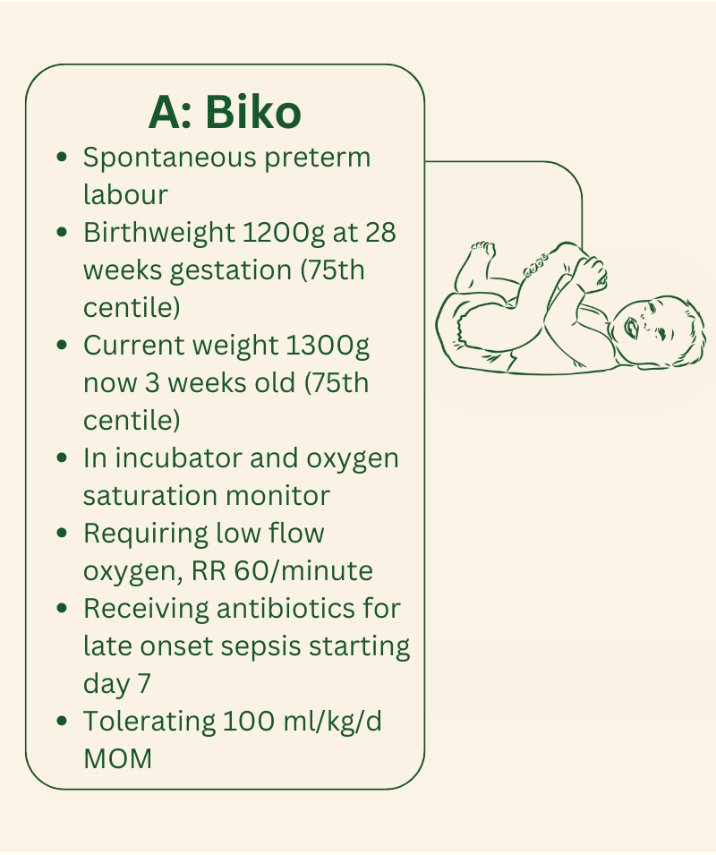
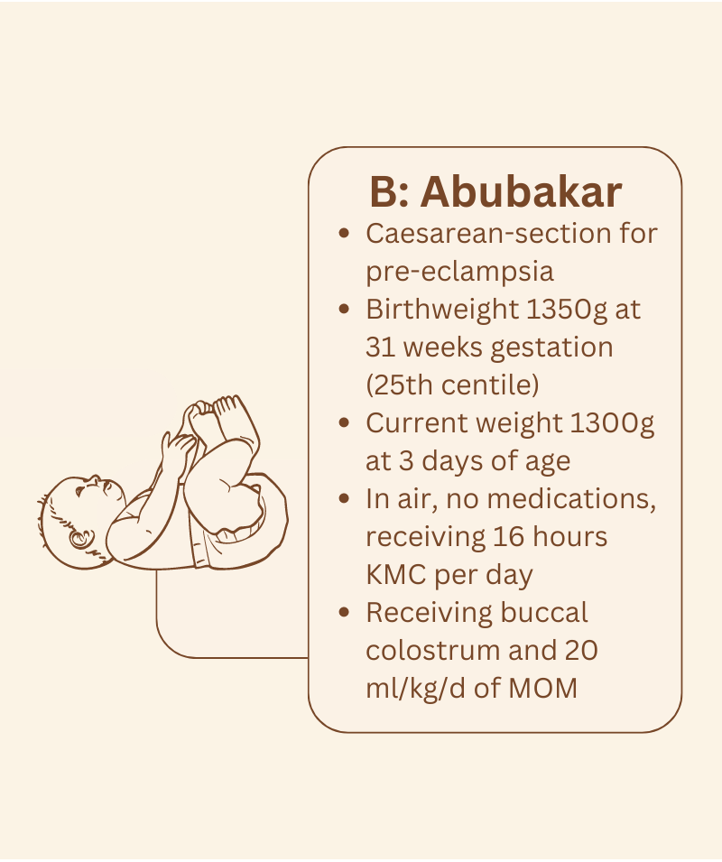
Nutritional status
Notes:
Nutritional status
‘Respiratory status’ can be assessed by respiratory rate (RR), chest sounds on auscultation, chest X-ray (CXR), and oxygen saturations. ‘Cardiac status’ can be assessed by heart rate, blood pressure, heart murmurs, and electrocardiogram (ECG). However, it is not immediately obvious how to assess ‘nutritional status’.
Nutritional status considers…
Individual baby factors, e.g. degree of prematurity, weight, postnatal age.
Current clinical status, e.g. feed tolerance, ongoing illness.
Dietary intakes, e.g. breast milk intakes, supplements.
Environmental factors, e.g. noise levels, parent involvement, KMC.
Compare these two babies, who both weigh 1300g, and consider how their nutritional status and management might differ.
Expert Opinion
“Biko has only gained 100g since birth, has ongoing signs of illness (oxygen requirement) which may be due to a previous episode of late onset sepsis, and is still not tolerating ‘full feeds’. Abubakar on the other hand has been born IUGR, but is well enough to receive KMC and is starting to tolerate MOM. Although they both weigh 1300g it is apparent that their nutritional status is different.”
African Neonatal Nutrition Network

Slide 4
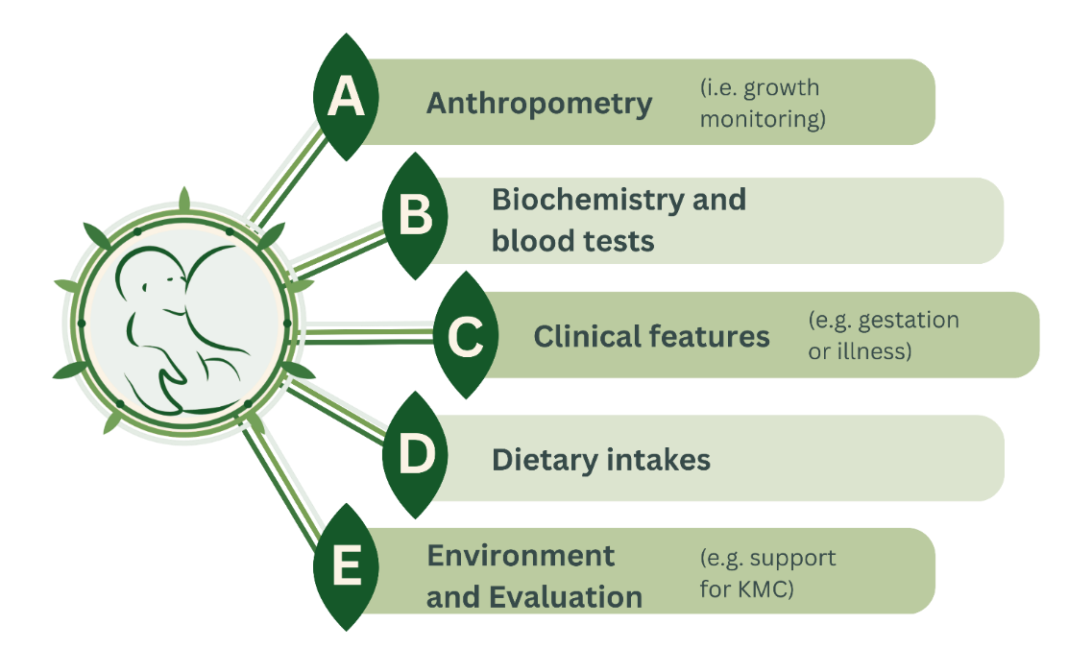
ABCDE Tool
Notes:
ABCDE Tool
Several factors impact on nutritional status. Planning nutritional management requires greater knowledge than simply the current weight. The ABCDE tool considers these issues in a holistic assessment, which can be completed at the cotside or with the mother if the baby is receiving KMC.
A – anthropometry
Anthropometry is the study of the measurements and proportions of growth. As a minimum, hospitalised preterm and LBW infants should be weighed regularly (every 2-3 days) and have head circumference (HC) measured at least once a week, however is it worth noting that it usually takes 3-4 days before a change in weight gain can be detected. Measurement of linear growth may be helpful but requires a robust technique, training, and a length board. Inaccurate or imprecise length measures are not useful. Routine measurement of mid-upper arm circumference in hospitalised preterm and LBW infants is not routinely practised, but may be useful in later infancy.
Measurements should be plotted on a weekly basis, and the growth chart reviewed on ward rounds and with the entire clinical team including parents/carers. It is important to assess whether the HC is in proportion to weight – are they growing on similar centiles?
B - biochemistry and bloods
Below are some of the different measurements under biochemistry and bloods
Glucose: whilst nutrient intakes are established, regular measurement of blood glucose is useful
Electrolytes: In most stable preterm/LBW infants, regular measurement of electrolyte concentration is not needed. Consider measuring sodium concentration in: sick infants, infants with excess fluid intakes or losses, diuretics, or among stable preterm infants with slow growth
Minerals: Early, acute hypocalcaemia should be considered in sick newborn infants, especially those with convulsions or tetany. Low phosphorus or calcium intakes impair bone development - in this situation serum calcium is often normal, and phosphate concentration may be low or high due to the effect of parathyroid hormone
Haemoglobin: anaemia may be a cause of slow growth. Ensure at-risk infants receive iron supplements
Vitamins & trace elements: It is not necessary to measure trace elements or vitamin concentrations. Provide multivitamin (or Vitamin D) supplements and iron according to WHO guidelines. It is not necessary to measure zinc concentration before a trial of supplements are offered to infants with typical signs of zinc deficiency
Other measures: It is common practice in high-resource settings to measure Alkaline Phosphatase as a marker of bone turnover. High concentrations in combination with low phosphate concentrations may indicate need for additional Vitamin D, e.g. increase to 800-1000iU per day, and mineral supplements. Urea, ferritin, parathyroid hormone, serum phosphate, vitamin D concentrations and other biochemical measures may occasionally be helpful in specific situations.
C – clinical
Consider the specific clinical condition of an infant, asking several key questions.
Are there any clinical signs such as tetany, jaundice, pallor, unusual skin rashes, eye signs?
Does the infant have higher requirements, e.g. needs for catch-up following acute illness, or excess intestinal losses, or is there respiratory illness that may require higher energy intakes?
Does the baby look thin or wasted, and might this be a sign of IUGR?
D - dietary intake
Record and assess the infant’s actual dietary intake, including volume of breast milk intake, intravenous (IV) fluids, and any additional sources of nutrients or supplements. It is helpful to assess the actual intake using the last complete 24 hour period, rather than simply what was prescribed.
E - environment & evaluation
Consider the hospital and the infant’s environment.

Slide 5
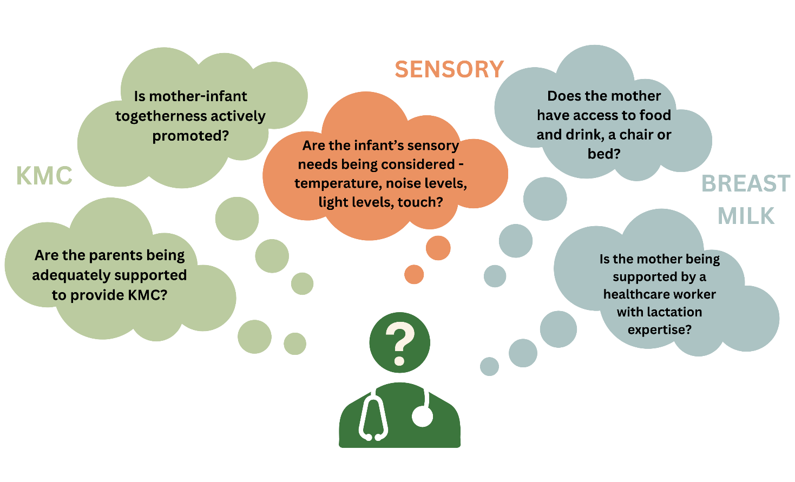
Environment and Evaluation
Notes:
An overall evaluation of the factors considered in the ABCDE approach should be conducted, and a plan written in the medical notes. What is your interpretation of the growth chart? What changes to clinical management might help, such as commencement of iron supplements? Do you need to update and/or discuss with parents/carers, and what suggestions do you have (if any) for blood tests? Standard ABCDE templates can be developed for each neonatal unit.
References (slide 1-5)
Embleton, N.D. (2022). Fifteen-minute consultation: ABCDE approach to nutritional assessment in preterm infants. Archives of Disease in Childhood-Education and Practice, 107(5), pp.314-319.

Slide 6
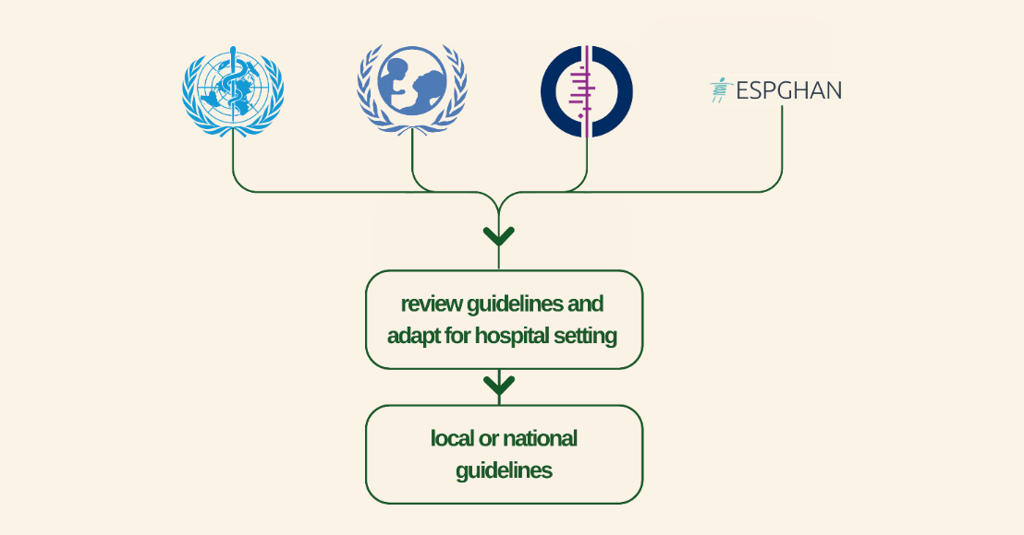
Guidelines
Notes:
We will now describe the development and use of feeding and nutrition guidelines for individual neonatal units. We will use the example of ‘probiotics to reduce the risk of NEC in preterm infants’ to explain some of the issues.
What are guidelines?
Clinical practice guidelines are recommendations for healthcare workers about the care of patients with specific conditions (e.g. preterm or LBW infants). They should be based upon the best available research evidence and practice experience, and can include value judgements, such as statements that discussion with parents/carers is appropriate. They are designed to optimise patient care, and should describe any relevant benefits and harms. For example, whilst probiotics may reduce the risk of NEC there is a risk of harm from contaminated products.
Ideally, they should include a ‘standard’ of care that can be audited (e.g. start probiotics after MOM has been tolerated) to ensure the guidelines are being followed. Guidelines are designed to be useful in day-to-day practice and provide advice for typical or common situations. They cannot describe management in every situation encountered. Importantly, they must be relevant for the specific healthcare context where they will be used.
Reviewing the evidence
It takes considerable time to search for and review evidence. Organisations like Cochrane have significant resources and expertise to systematically review all available literature and conduct a meta-analysis (MA, see glossary). Reviewing the literature for even a relatively simple question such as ‘Should we give our babies probiotics?’ might identify over 1,000 research studies or trials. Individual hospitals and units do not have the resources to review this amount of information. For this reason, most local or national hospital-based clinical practice guidelines are based on advice or guidance from WHO, Cochrane, or UNICEF, or from other organisations such as the European Society of Paediatric Gastroenterology, Hepatology and Nutrition (ESPGHAN). However, these recommendations must be adapted to ensure they are relevant and workable for the individual hospital setting. For example, probiotics may be effective in European hospitals, but less effective or even harmful in resource poor settings where the types of antibiotics, probiotics, and gut bacteria differ.

Slide 7
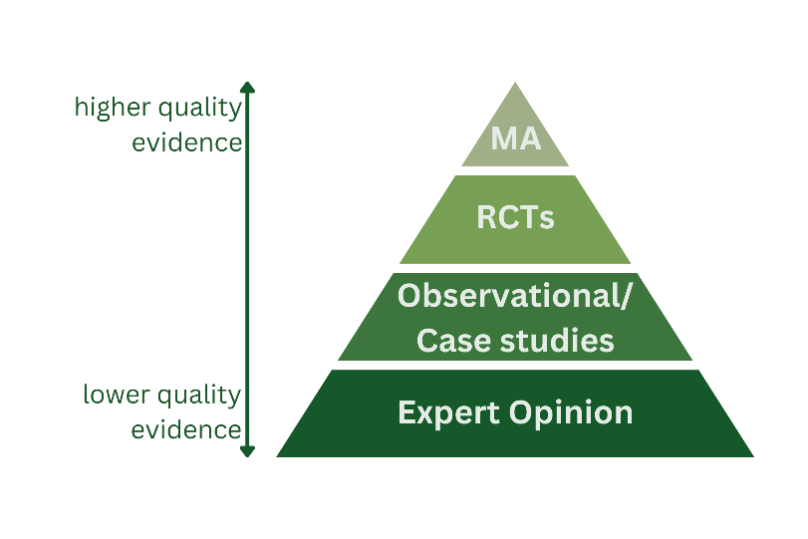
Level of evidence
Notes:
A hierarchy can be used to rate the quality of the evidence for a specific question.
MA: the highest level of evidence comes from large systematic reviews and MA that combine (“meta-analyse”) the results of several RCTs.
RCTs: if a large, high-quality MA is not available, the next level of evidence will come from individual randomised controlled trials (RCTs).
Observational/Case studies: if there are no RCTs, then the results of observational or case-control studies can be considered. Small observational studies or case studies represent the lowest level of evidence.
Expert Opinion: if no good studies/data are available, the expert opinion of specialists can be very valuable when making recommendations.
The current Cochrane MA of probiotics to reduce NEC (Sharif et al., 2020) reviews the results from 56 RCTs – more than almost any other intervention in neonatal practice.

Slide 8

Grade or certainty of Recommendations
Risk of bias: Example: the study was not blinded.
Inconsistency: Example: the different studies came to different conclusions.
Indirectness: Example: using an indirect outcome such as pyrexia as a sign of infection rather than a blood culture.
Imprecision: Example: the small studies give less precise results.
Publication bias: Example: studies with a ‘positive’ finding are more likely to be published.
Notes:
Grade or Certainty of Recommendations
Guidelines should consider the highest quality evidence, but this does not mean that lower levels of evidence can be ignored. Observational studies including 10,000s of patients might actually provide more useful evidence than a single RCT of 50 patients. For example, there are no RCTs of the benefit of vitamin K at birth compared to placebo, but there is strong evidence from large epidemiological studies that vitamin K at birth reduces the risk of haemorrhagic disease. In some cases, there are no good studies, and recommendations can be made using ‘expert consensus’.
Many organisations including Cochrane use the GRADE approach (Grading of Recommendations Assessment, Development and Evaluation) for assessing certainty (or quality) of evidence. GRADE assessments of certainty consider five domains, shown on the slide.
Risk of bias: Example: the study was not blinded.
Inconsistency: Example: the different studies came to different conclusions.
Indirectness: Example: using an indirect outcome such as pyrexia as a sign of infection rather than a blood culture.
Imprecision: Example: the small studies give less precise results.
Publication bias: Example: studies with a ‘positive’ finding are more likely to be published.
After assessing the evidence and study quality, the GRADE approach gives four levels of the certainty of evidence for a given outcome:
High – the authors have a lot of confidence that the true effect is similar to the results of the available studies/MA.
Moderate – the authors believe the true effect is probably close to the studies/MA results.
Low – the true effect may be quite different from the results available.
Very low – the true effect is probably very different.
When considering the evidence for the use of probiotics to reduce NEC, the authors of the Cochrane review (Sharif et al., 2020) consider the evidence as low-to-moderate certainty. Although there are 56 RCTs and the risk reduction of NEC is highly significant, there are a lot of uncertainties with the studies including high risk of bias, inconsistency, and publication bias. Furthermore, there are several case studies of bacteraemia caused by probiotics, and case studies of preterm babies who died from contaminated products. This evidence may not appear in RCTs.

Slide 9
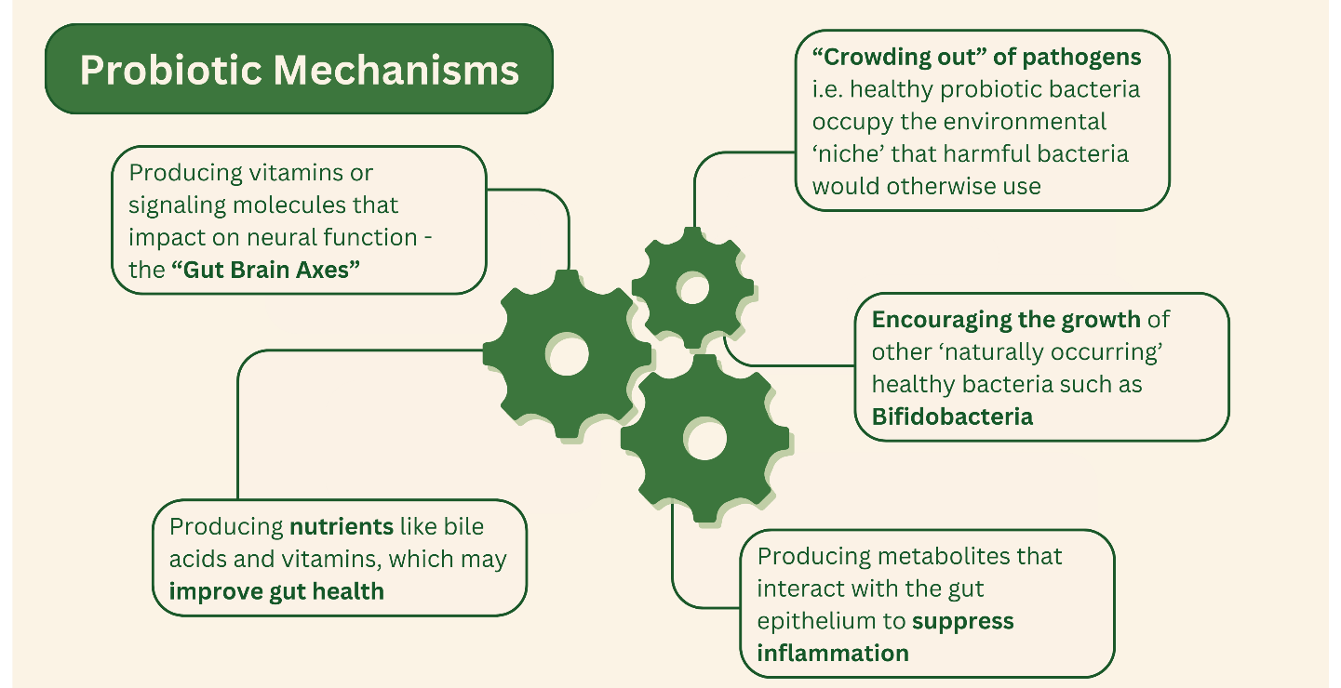
Hospital context and population
Notes:
Probiotics may be beneficial for preterm infants due to several different mechanisms.
Because bacteria change between different hospitals and settings, the effectiveness of probiotics may differ. Probiotics work best when they can actively multiply. To do this they need a food/energy source such as HMOs. Probiotics may therefore be less effective in formula fed babies. The main benefit of probiotics appears to be in reducing NEC, however, NEC primarily occurs in babies <28 weeks gestation. In hospitals where there are few babies less than 28 weeks, or where the rates of NEC are very low, they may be less effective.
Organisations such as WHO and ESPGHAN make recommendations based on the best available evidence, but many of the studies are conducted in high-income settings. This is especially true for neonatal feeding studies, and emphasises that guidelines must be developed and adapted for specific local, regional, or national situations. Our African Neonatal Nutrition Network (NeoNuNet) collaboration identified no RCTs of feeding or nutrition interventions for preterm infants that had been conducted in sub-Saharan Africa (Akinodolire et al., 2020; Tongo et al., 2022) despite high risks of disease (Nabwera et al., 2021). Furthermore, we identified significant challenges in how key feeding related diseases are diagnosed (Staunton et al., 2022). Without consistency and agreement on how key diseases such as NEC or sepsis can be diagnosed, conducting RCTs is very challenging.

Slide 10

Advantages and disadvantages of standardisation
Decrease in NEC: Standardised guidelines are associated with lower rates of NEC on neonatal units.
Increase in head circumference and discharge weight: Quality improvement (QI) projects aimed at implementing so-called ‘Potentially Better Practices’ using standardised guidelines improved discharge weight and head circumference.
Notes:
There is good evidence that using guidelines in clinical practice improves outcomes. This is shown in the 2 graphics here.
Decrease in NEC: Standardised guidelines are associated with lower rates of NEC on neonatal units (Jasani et al., 2017).
Increase in head circumference and discharge weight: Quality improvement (QI) projects aimed at implementing so-called ‘Potentially Better Practices’ using standardised guidelines improved discharge weight and head circumference (Bloom et al., 2003).
Guidelines are therefore key to improving nutrition in preterm and LBW infants.
However, where there is no good evidence available, there is a risk that a guideline could promote a clinical practice or intervention that is not beneficial. For example, withholding enteral feeds for several days even in healthy preterm infants used to be considered good practice and was common. There is also no good evidence on how best to feed preterm and LBW infants born to HIV-positive mothers. Whilst healthcare workers recognise that there are no good RCTs, it would be inappropriate to make firm recommendations without good evidence. Therefore, healthcare workers must consider the evidence carefully and be aware of the limitations and challenges in developing guidelines. Striking the right balance between promoting good practice, whilst not enforcing practices where evidence is lacking, is an important task for clinicians.

Slide 11
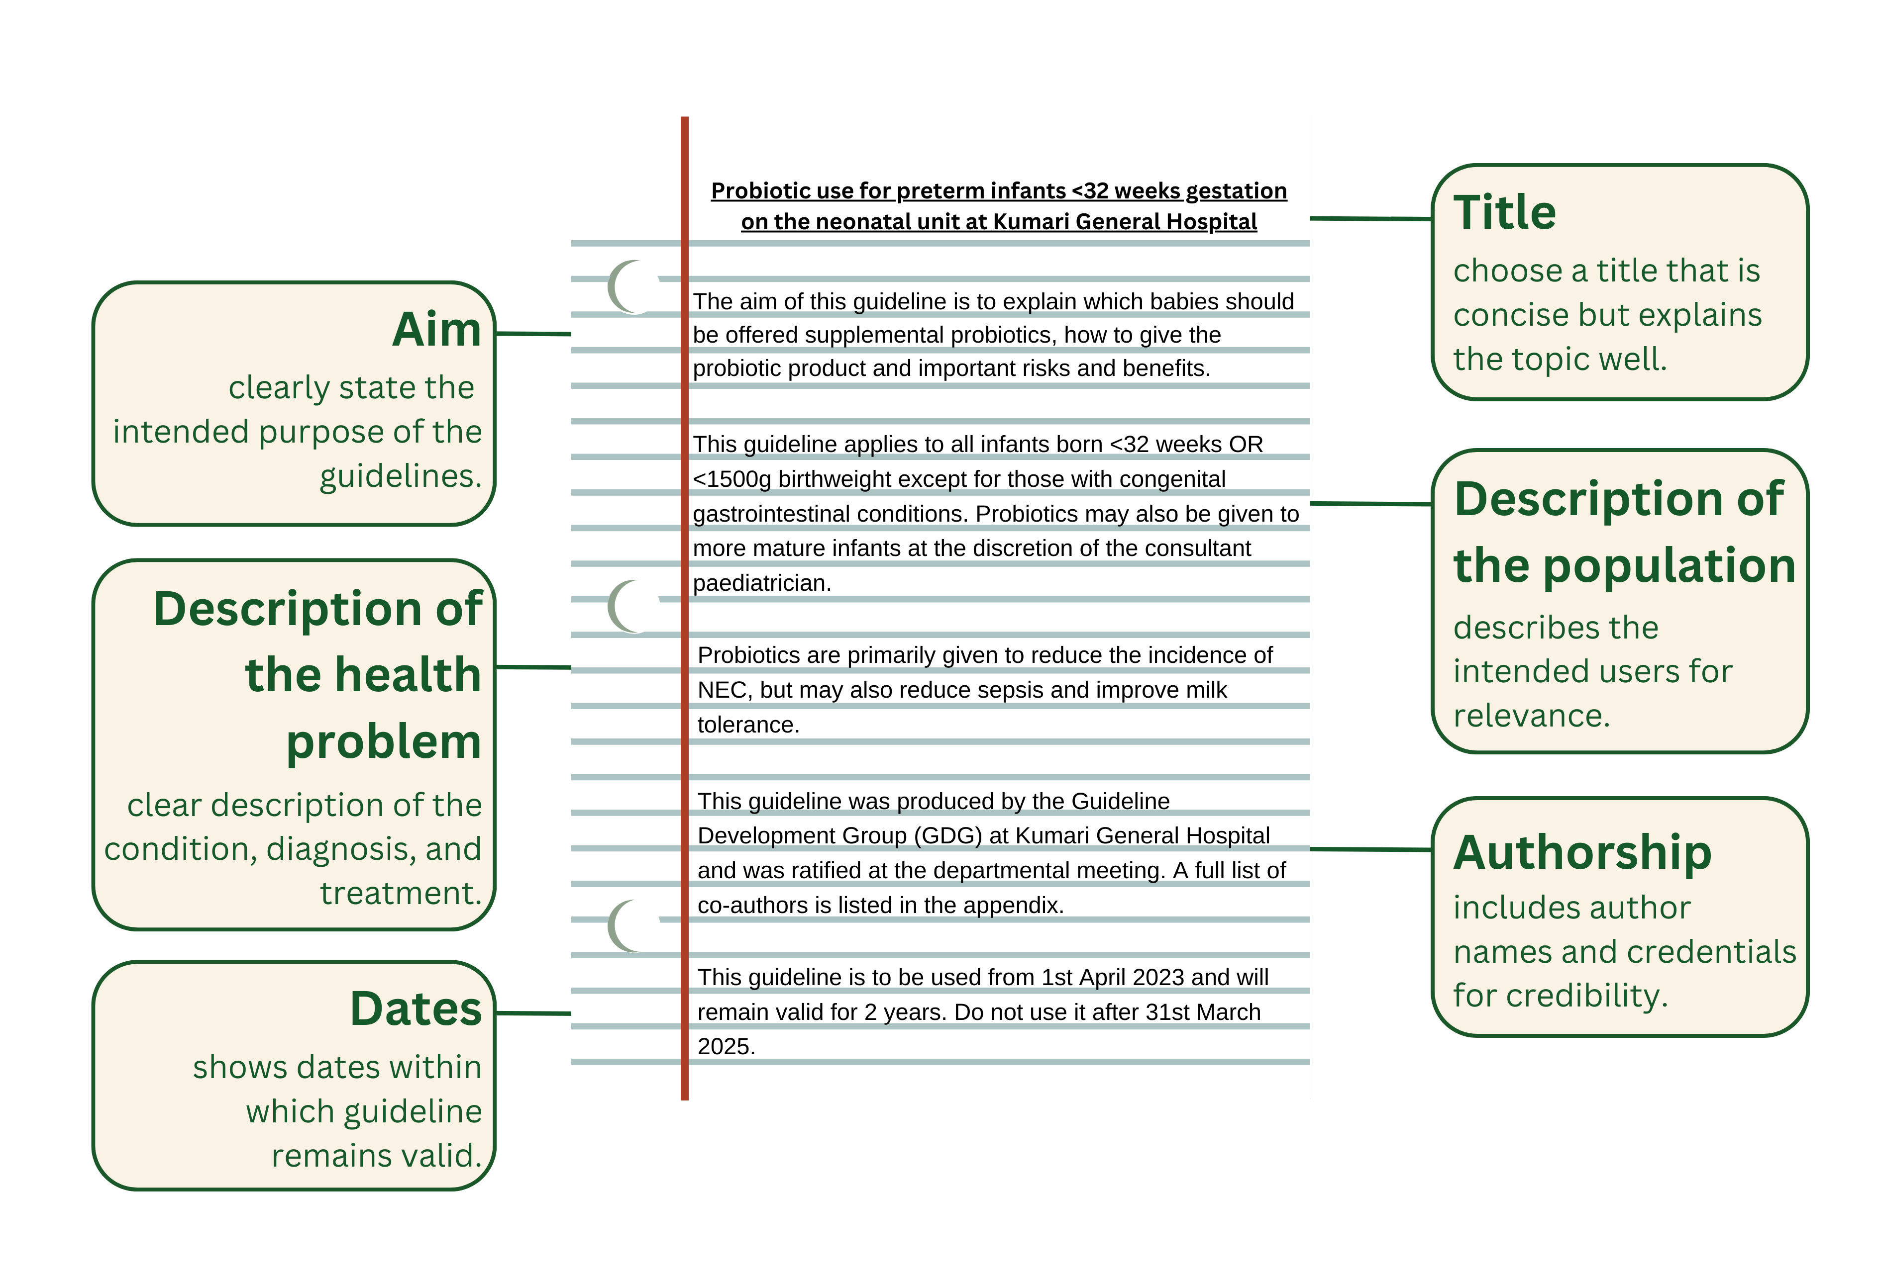
Key elements to include when writing a guideline
Notes:
There are several elements to include when writing a guideline, and a detailed description is beyond the scope of this eLearning course. However, the following points can be considered:
It is also very important to include evidence when writing guidelines. Wherever possible, all recommendations should be based on the results of high-quality clinical trials.
Summary
Guidelines are an essential tool to improve nutrition in preterm and LBW infants and must be available on all neonatal units. Guidelines should have clear statements about standards that can be audited and used as part of QI.
References (slide 6-11)
WHO (2022). WHO recommendations for care of the preterm or low-birth-weight infant. World Health Organization. Available at: https://www.who.int/publications/i/item/9789240058262
Akindolire, A., Talbert, A., Sinha, I., Embleton, N. and Allen, S. (2020). Evidence that informs feeding practices in very low birthweight and very preterm infants in sub-Saharan Africa: an overview of systematic reviews. BMJ Paediatrics Open, 4(1).
Tongo, O.O., Olwala, M.A., Talbert, A.W., Nabwera, H.M., Akindolire, A.E., Otieno, W., Nalwa, G.M., Andang'o, P.E., Mwangome, M.K., Abdulkadir, I. and Ezeaka, C.V. (2022). Enteral Feeding Practices for Very Preterm and Very Low Birth Weight Infants in Nigeria and Kenya. Frontiers in Pediatrics, 10, p.892209.
Nabwera, H.M., Wang, D., Tongo, O.O., Andang’o, P.E., Abdulkadir, I., Ezeaka, C.V., Ezenwa, B.N., Fajolu, I.B., Imam, Z.O., Mwangome, M.K. and Umoru, D.D. (2021). Burden of disease and risk factors for mortality amongst hospitalized newborns in Nigeria and Kenya. PloS One, 16(1), p.e0244109.
Scholes, S., Fat, L.N., Moody, A. and Mindell, J.S. (2023). Does the use of prediction equations to correct self-reported height and weight improve obesity prevalence estimates? A pooled cross-sectional analysis of Health Survey for England data. BMJ Open, 13(1), p.e061809.
Embleton, N.D., Moltu, S.J., Lapillonne, A., van den Akker, C.H., Carnielli, V., Fusch, C., Gerasimidis, K., van Goudoever, J.B., Haiden, N., Iacobelli, S. and Johnson, M.J. (2022). Enteral nutrition in preterm infants (2022): a position paper from the ESPGHAN committee on nutrition and invited experts. Journal of Pediatric Gastroenterology and Nutrition, 76(2) pp.10-1097.
Sharif, S., Meader, N., Oddie, S.J., Rojas-Reyes, M.X. and McGuire, W. (2020). Probiotics to prevent necrotising enterocolitis in very preterm or very low birth weight infants. Cochrane Database of Systematic Reviews, 10.
Jasani, B. and Patole, S. (2017). Standardized feeding regimen for reducing necrotizing enterocolitis in preterm infants: an updated systematic review. Journal of Perinatology, 37(7), pp.827-833.
Bloom, B.T., Mulligan, J., Arnold, C., Ellis, S., Moffitt, S., Rivera, A., Kunamneni, S., Thomas, P., Clark, R.H. and Peabody, J. (2003). Improving growth of very low birth weight infants in the first 28 days. Pediatrics, 112(1), pp.8-14.

Slide 12

Audit and quality improvement (QI)
Notes:
Now we will learn about audit and QI in healthcare, including how they are closely linked and used to improve patient care and outcomes through systematic review of care against explicit criteria. QI involves a series of steps (Plan, Do, Study, Act), and is supported by WHO, UNICEF, and many other organisations. Nutritional practice provides many opportunities for audit and QI.
How are guidelines, audit, and QI linked?
Healthcare professionals aim to provide high quality care and continually improve that care so patient outcomes improve year on year. This cannot be achieved without measuring outcomes. This process is highlighted in the graphic below.
Quality Improvement (QI) uses that audit data to plan improvements. Audit assesses whether the standard is achieved. Guidelines describe how to provide care for common conditions and situations, and ideally provide a ‘standard’ against which healthcare outcomes can be assessed.
Whilst many important aspects of healthcare can be measured, not everything that is important can be measured. For example, it might be very difficult to conduct an audit measuring whether healthcare workers speak to mothers respectfully.
Audit and QI are closely linked. Audit in healthcare settings tends to be focused on patient activity including:
Process audits, e.g. how many infants in the last 3 months were hypothermic on admission to the neonatal unit?
Outcome audits, e.g. how many infants developed sepsis or NEC in the last 12 months?
QI includes clinical audit activity, but might also include other aspects in the healthcare setting, such as evaluation of teaching or education on the unit, or provision of food and drink for parents/carers and staff.
What is clinical audit?
Clinical audit is a QI process that aims to improve patient care and outcomes through systematic review of care against explicit criteria. Where needed, changes are made and the process is repeated to confirm improvement. Audit measures current patient care and outcomes against criteria (standards). Standards can be incorporated into clinical guidelines when they are developed. An example might be provision of KMC with a standard that 90% of LBW infants admitted to the neonatal unit will receive KMC within 24 hours of admission. WHO, UNICEF, and many other organisations strongly support the use of audit and QI.

Slide 13
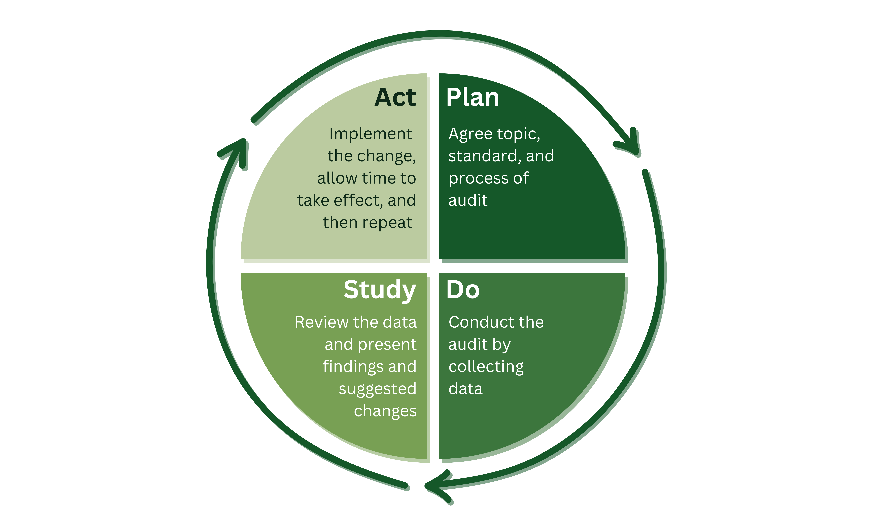
The PDSA Cycle
Notes:
QI involves a series of steps, which can be broken down into Plan, Do, Study, Act.
P – Plan
Agree what care process or outcome you want to study. Agree what standard you aim to achieve, and plan the audit - who will do it, how and when.
D – Do
Conduct the audit. Collect the data by reviewing medical and nursing notes, or by speaking to parents/carers or staff, or by simply observing the practices taking place on the unit today.
S – Study
Review data with various members of a multidisciplinary team to ensure the team feels 'ownership' of the QI project. Present findings to team and discuss possible changes to improve outcomes.
A – Act
Implement the changes. This might be education and training sessions to raise awareness, re-writing guidelines or providing additional resources. Allow time for the changes to take effect e.g. 3-6 months, and then repeat the cycle.

Slide 14

Audit and QI for neonatal nutrition
Photo provided by African Neonatal Nutrition Network partners with parental consent.
Notes:
Audit and QI are not the most popular topics amongst healthcare workers! Data collection can be time consuming and monotonous. Sometimes there is a reluctance to accept we are not doing as good a job as we would like. However, QI can be rewarding. When audits initially showed outcomes were not optimal, but the whole team worked together to improve care, it can play an important role in team building and greatly improve staff satisfaction and motivation. Staff satisfaction plays an important role in staff recruitment and retention. Furthermore, QI does not have to involve the provision of additional costly resources and remains one of the most cost-effective interventions to improve patient outcomes.
Nutritional practice provides many opportunities for audit and QI. Some projects can be extremely quick – data can be collected over a few hours and presented within the next few days. Other projects can take months.
A snap-shot audit can collect data at one point in time. For example, how many babies eligible to receive KMC are actually receiving or received it today? How many babies who meet the criteria for Vitamin D and iron supplements actually have them prescribed?

Slide 15
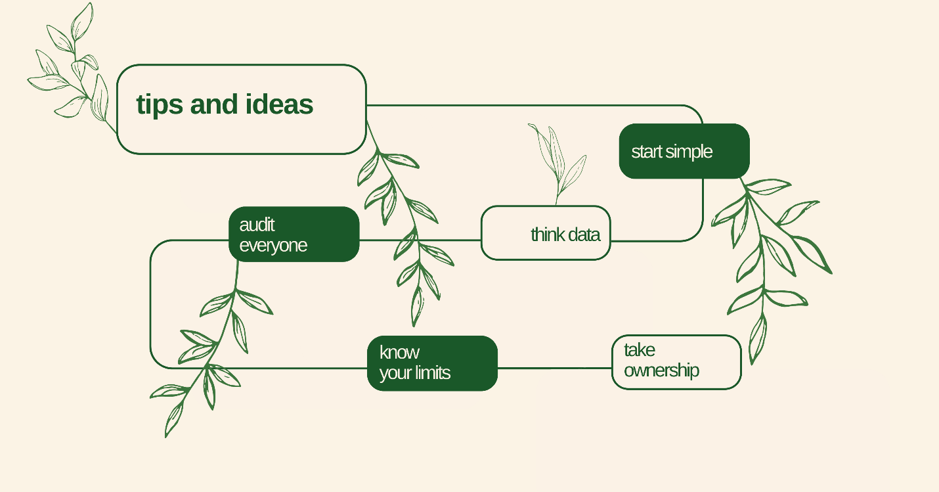
Tips and ideas
Notes:
Start simple: Choose a topic that already has a guideline, an audit standard and that is important to you and the team (including parents). Data collection that takes days and weeks may result in people losing interest and enthusiasm.
Think data: Choose a topic where you can access or collect the data easily. Audits using data in medical/nursing notes are ideal, but a snap-shot audit can be done in a couple of hours by simply observing activity on the unit.
Audit everyone: Audit all eligible patients. This is best done by auditing consecutive admissions or every infant/mother on the neonatal unit on that day. Sometimes, notes might be difficult to find, or data might not be clearly recorded. Excluding those cases from the audit will not give the correct overall picture.
Know your limits: Don’t be too ambitious. Research studies often recruit 100’s of patients. This isn’t necessary for an audit. If the standard is only achieved in 10/20 consecutive patients there is probably no need to collect more data before you review the results and plan your QI.
Take ownership: Audit your own activity. For QI projects to succeed, everyone involved must feel ownership of the project. It is often not appropriate for one specialty/team to audit the activity of another, and can even have a negative impact on the team. For example, an external dietician reviewing the feeding practices of the nursing team.

Slide 16


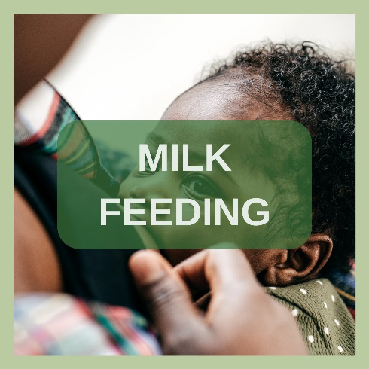
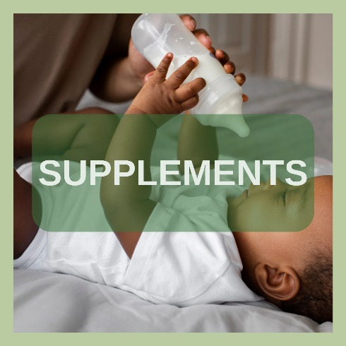

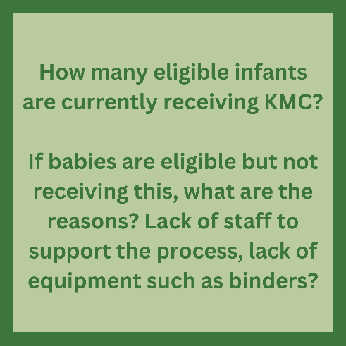
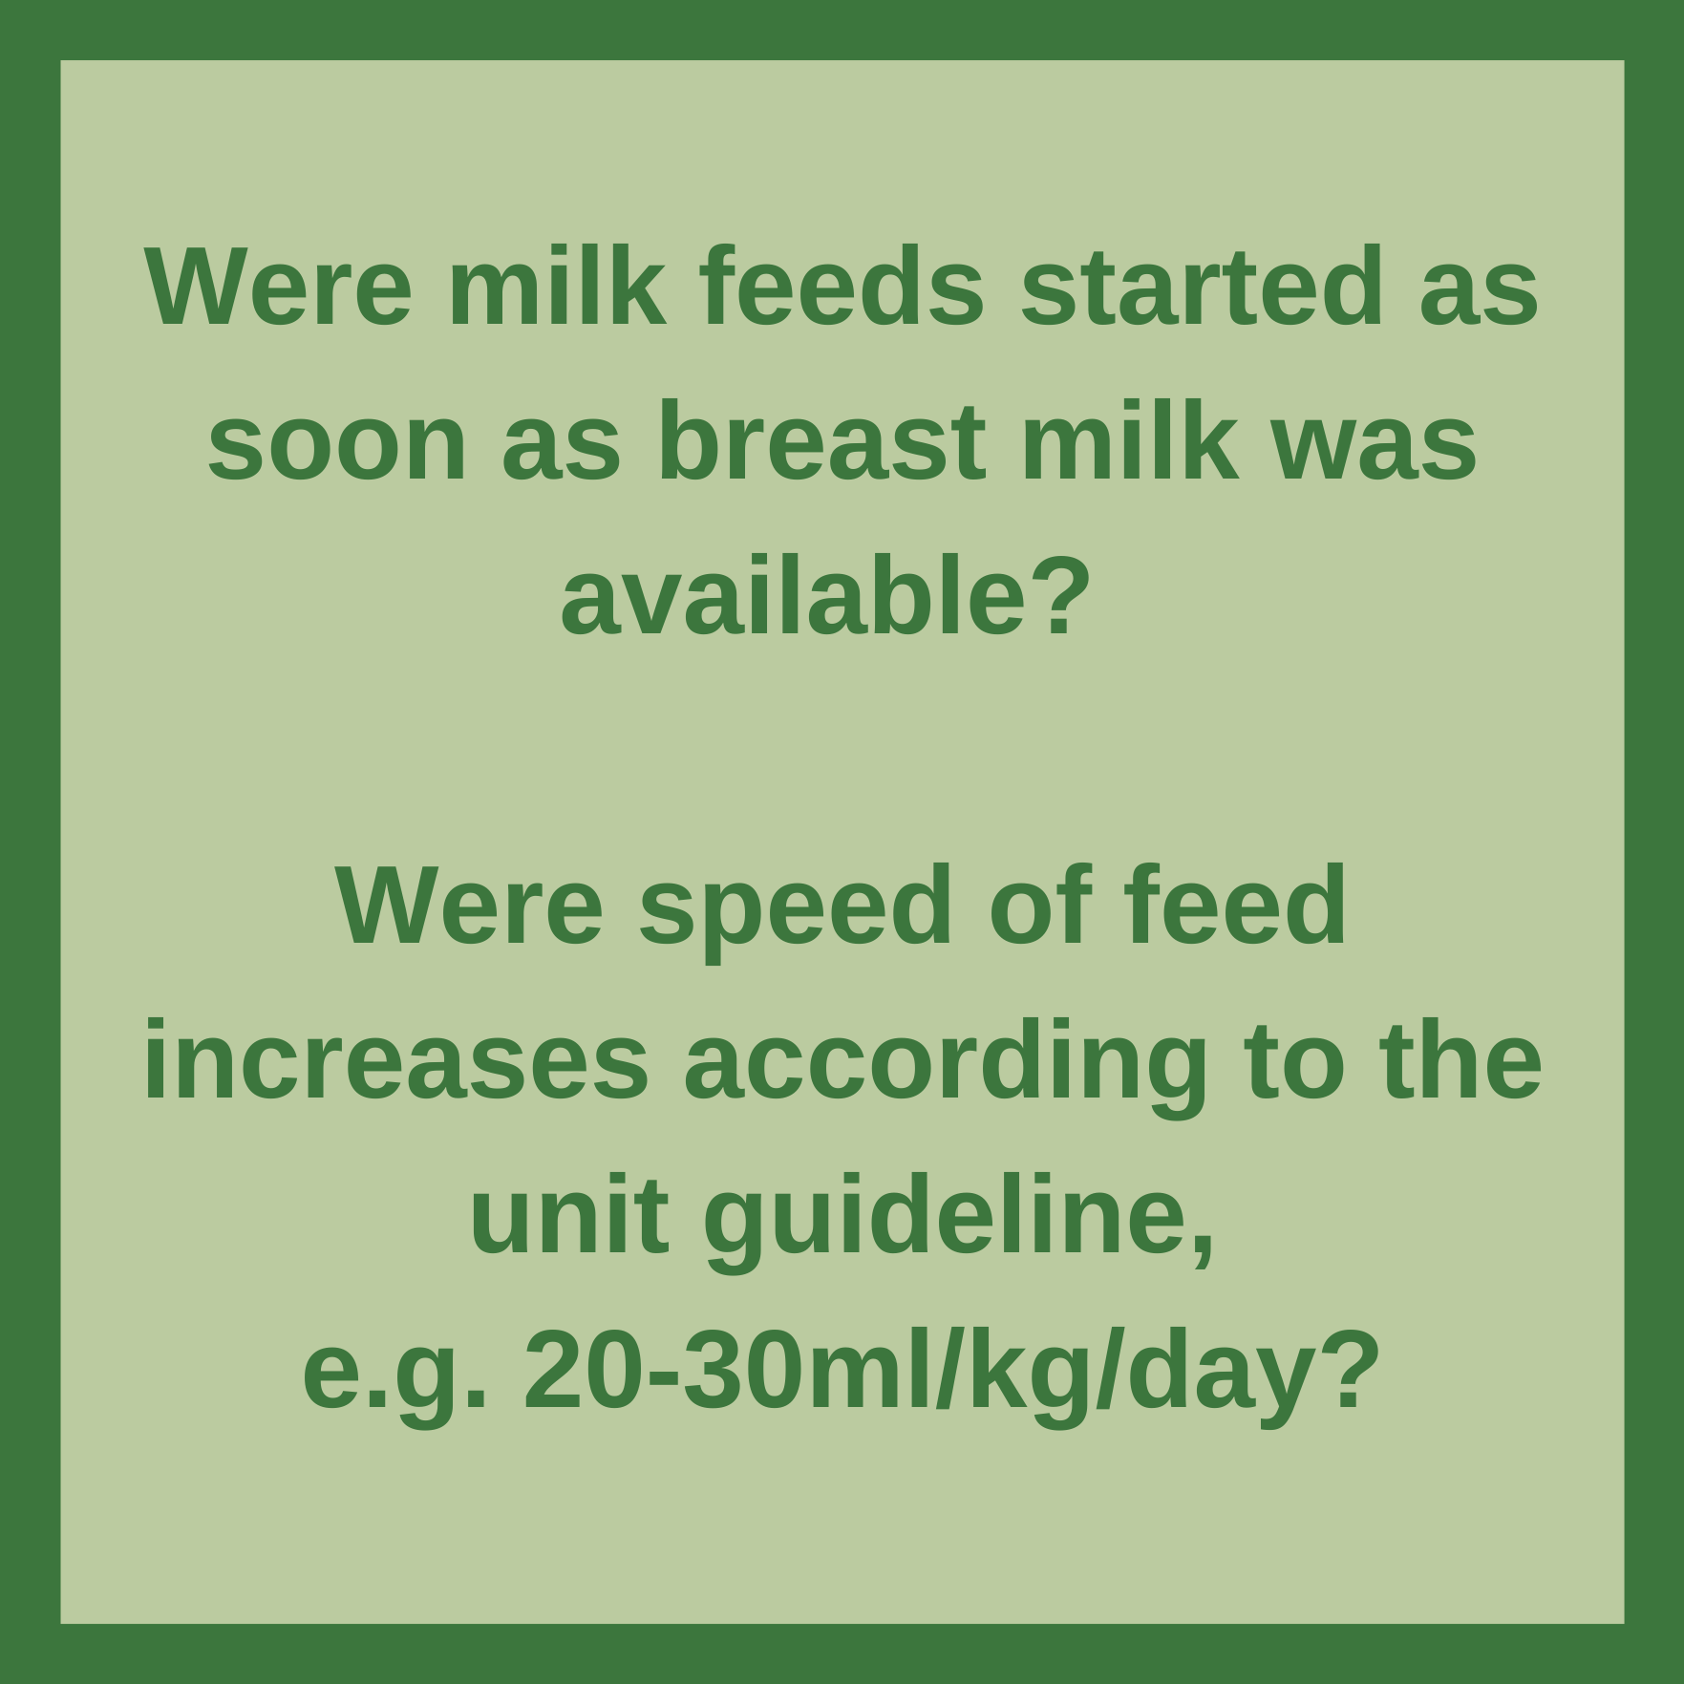
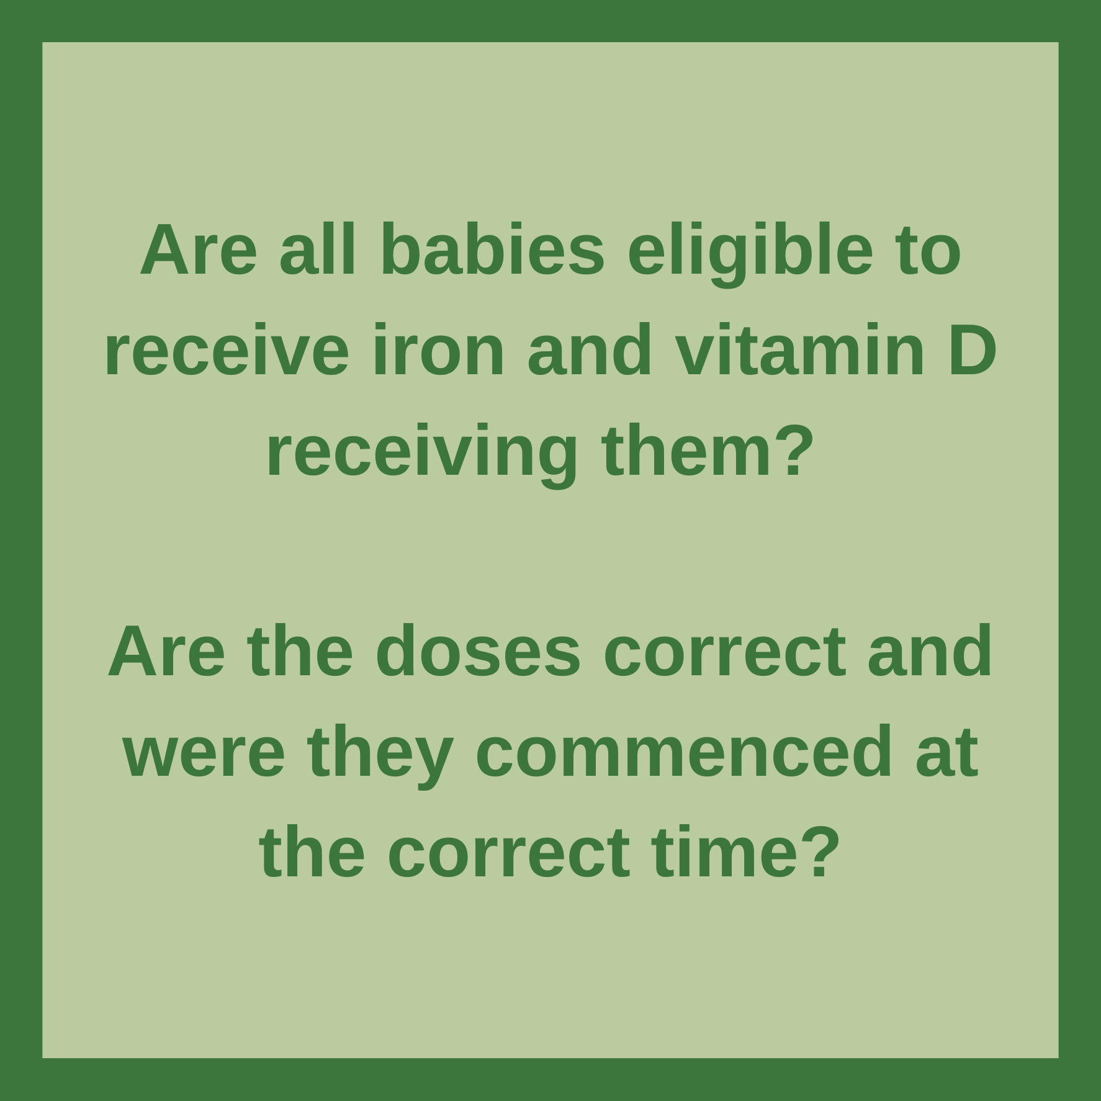
Standards that can be audited

Slide 17




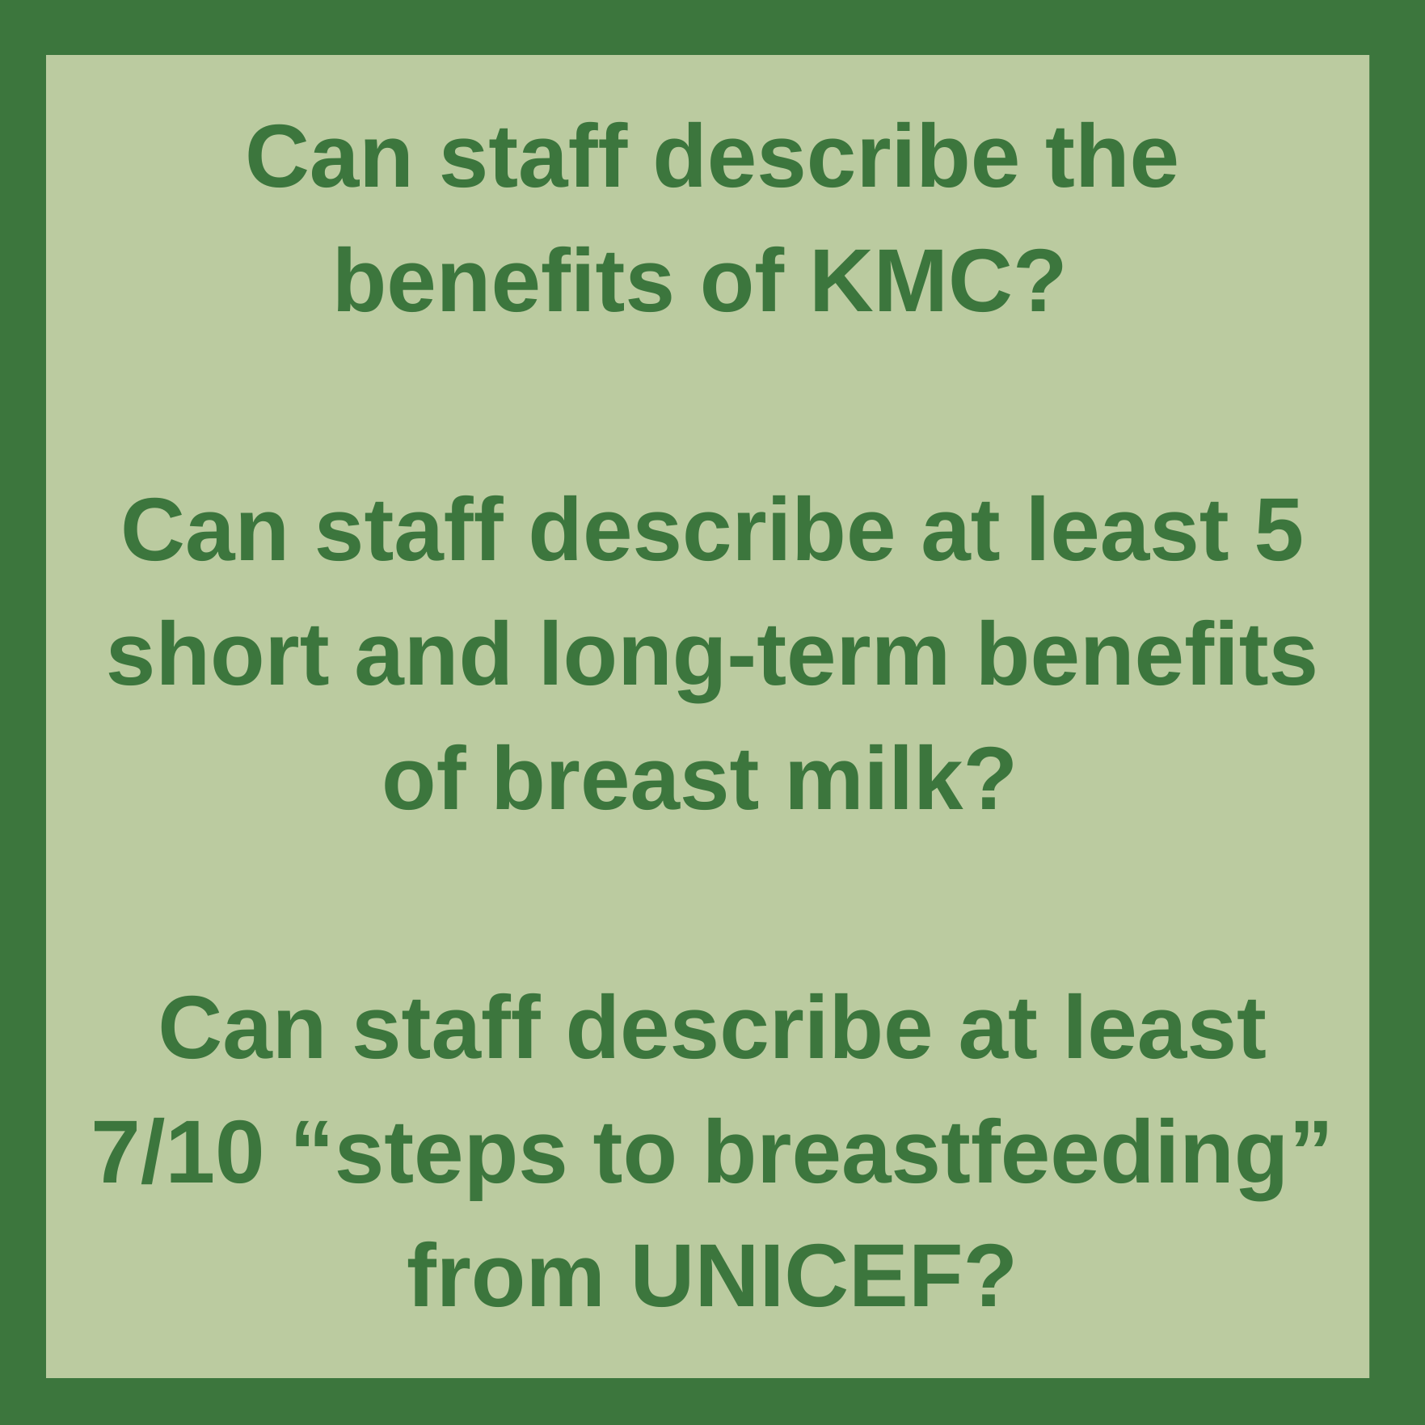
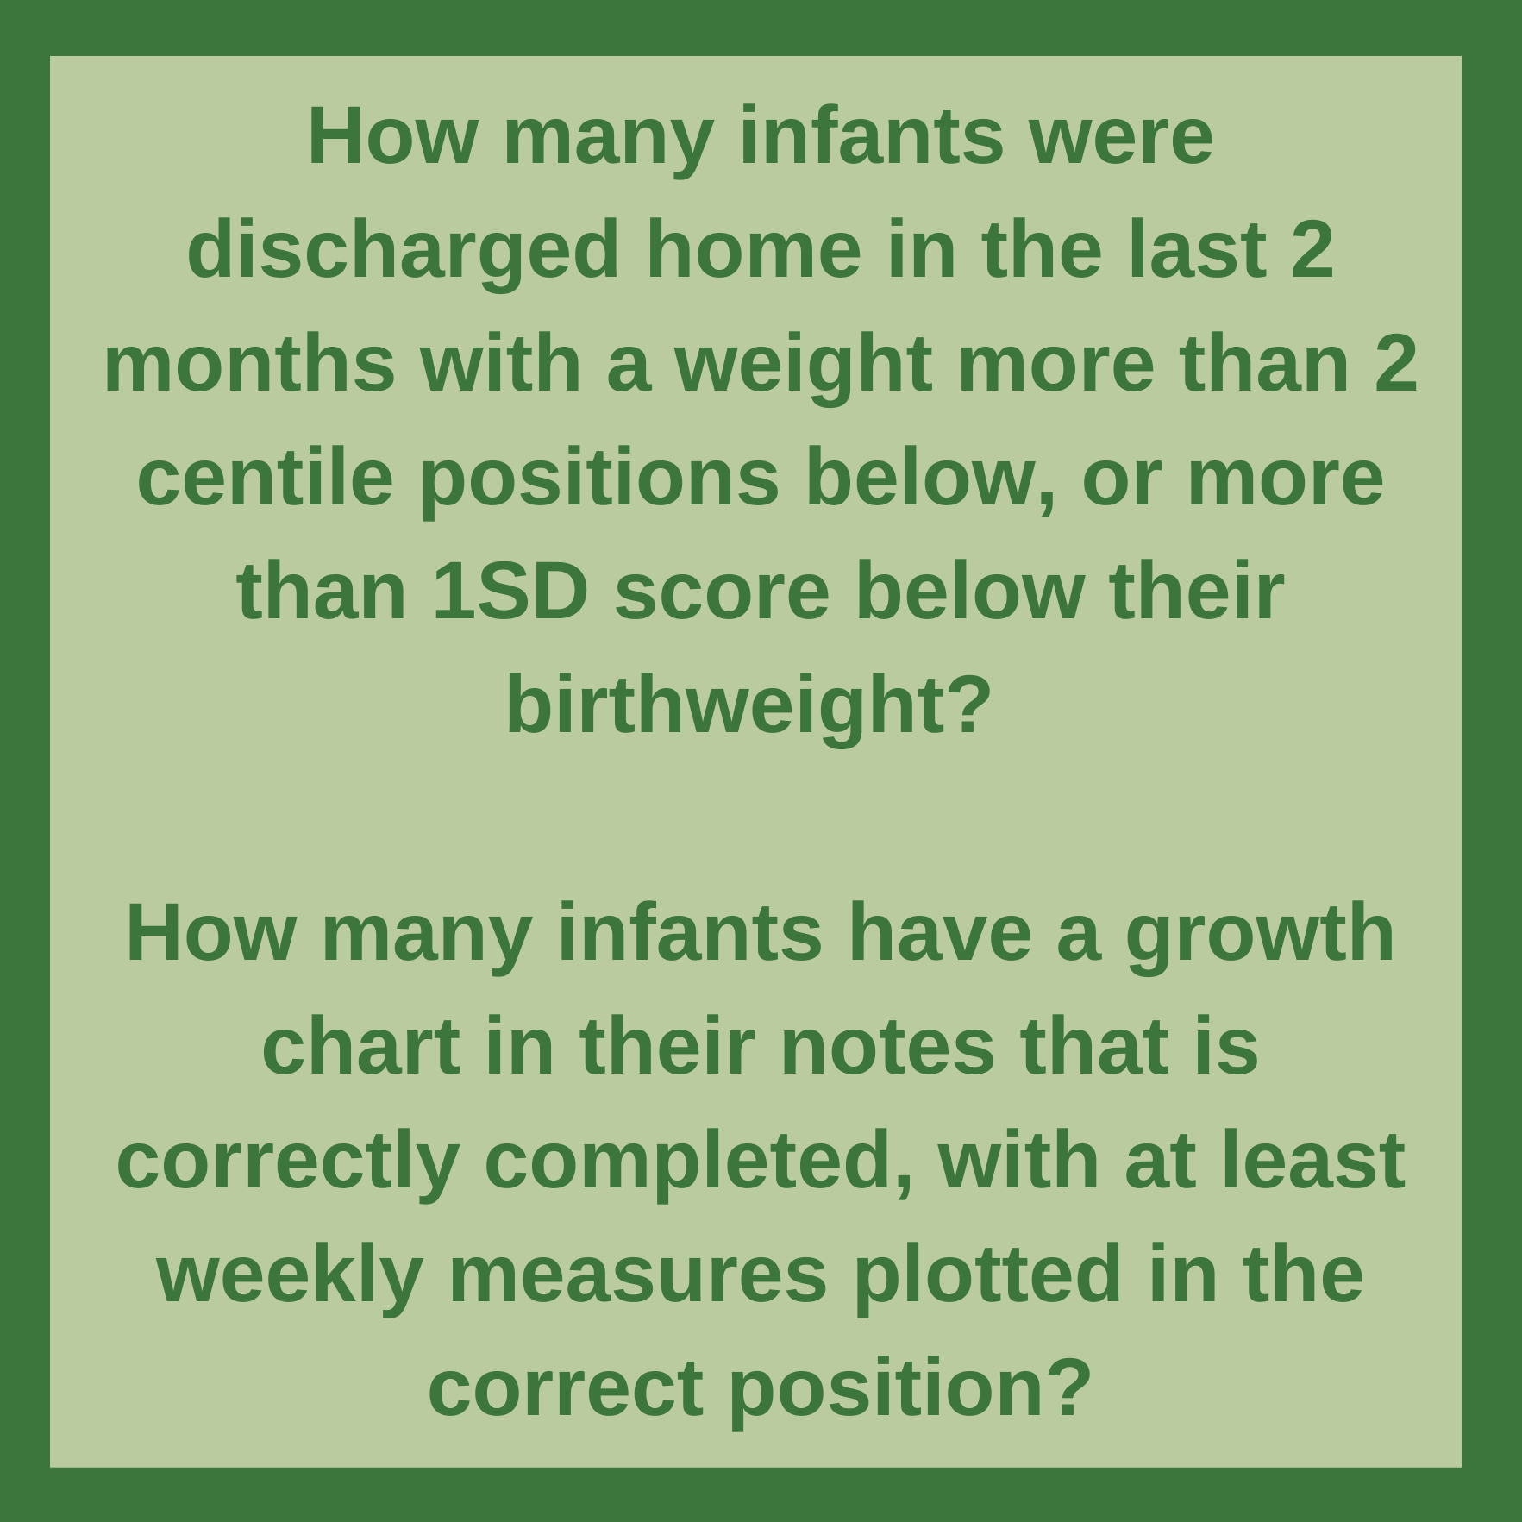
Standards that can be audited
Notes:
References (slide 12-17)
Fang, L., Wu, L., Han, S., Chen, X. and Yu, Z. (2021). Quality improvement to increase breastfeeding in preterm infants: systematic review and meta-analysis. Frontiers in Pediatrics, 9, p.681341.
Bloom, B.T., Mulligan, J., Arnold, C., Ellis, S., Moffitt, S., Rivera, A., Kunamneni, S., Thomas, P., Clark, R.H. and Peabody, J. (2003). Improving growth of very low birth weight infants in the first 28 days. Pediatrics, 112(1), pp.8-14.
Sneve, J., Kattelmann, K., Ren, C. and Stevens, D.C. (2008). Implementation of a multidisciplinary team that includes a registered dietitian in a neonatal intensive care unit improved nutrition outcomes. Nutrition in Clinical Practice, 23(6), pp.630-634.

Slide 18
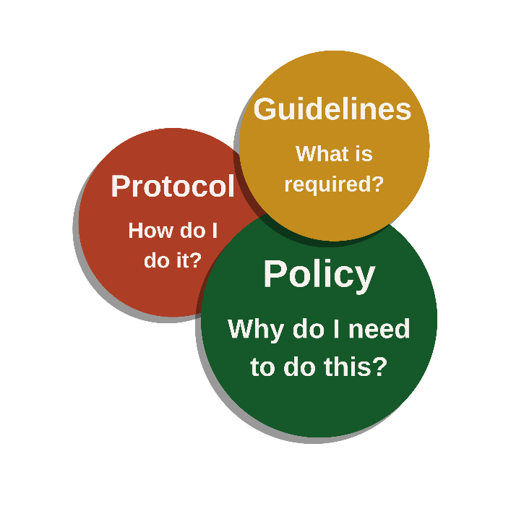
Hospital policies
Notes:
Here, we will learn about the differences between policies, guidelines, and protocols in healthcare settings, and how they apply to neonatal nutrition. We will also touch on various hospital policies that are relevant to neonatal nutrition, such as the promotion of breastfeeding, parental rights, and treatment of HIV-positive mothers. It is important to be aware of these policies and advocate for their implementation.
Policies differ from guidelines and protocols.
Guidelines: What is required? Guidelines direct the actions of healthcare staff for specific populations (e.g. newborn infants) and conditions (e.g. prematurity) using an evidence base alongside experience and clinical opinion. They should include a standard but acknowledge that there may be situations in which the approach may be adapted.
Policy: Why do I need to do this? A policy indicates the position and values of the organisation, for example the hospital. A policy on supporting KMC will set out how the hospital intends to comply with national and/or international standards and best practice, for example WHO or UNICEF recommendations.
Protocol: How do I do it? A protocol is a written plan of action for a specific situation. Protocols are more explicit and specific than guidelines and include descriptions of what is done, when and how. For example, the management of newborn seizures or severe hypoglycaemia is likely to follow a unit based protocol.
Protocols are established procedures that guide healthcare providers in specific clinical situations. They outline step-by-step instructions to ensure consistent and standardised care delivery. Like policies, protocols involve collaboration between healthcare professionals and are designed to promote patient safety and quality of care.
Guidelines help healthcare staff deliver care on a day-to-day level. Variations to clinical practice may be necessary to deal with specific situations. For example, the approach to MOM may differ if the mother is HIV-positive. In contrast, policies are mandatory and are explicit about what actions must, or must not, be performed.
Policies describe operational aspects of healthcare including intent and rules. Policies help organisations to achieve their desired outcome, such as being a Baby Friendly Hospital. Whilst guidelines are written, approved, and used at a departmental/ward level, policies are likely to involve healthcare and managerial staff at a senior level, such as the hospital executive team.

Slide 19
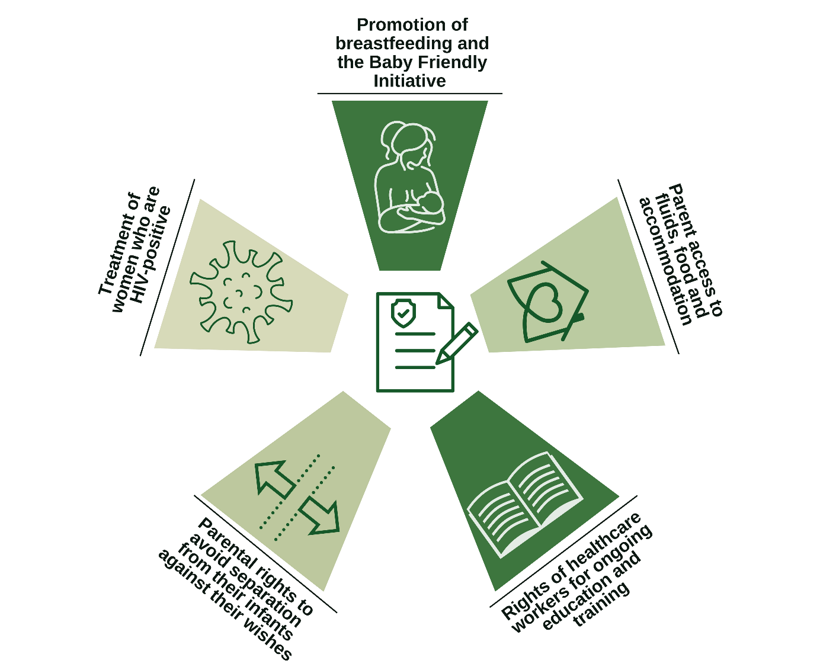
Hospital and neonatal unit policies relevant to nutrition
Notes:
Whilst few neonatal or paediatric ward staff are involved in creating hospital policies, it is important to be aware of their existence and advocate that they are followed. If policies don’t exist, raise the issue with your line manager!

Slide 20
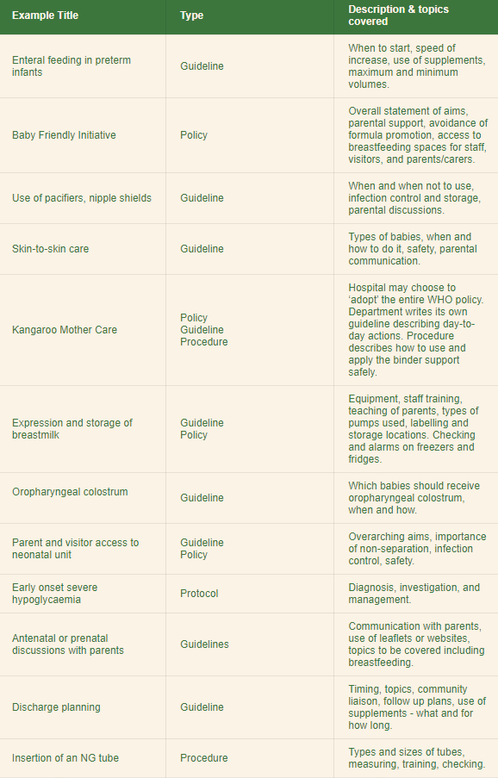
Examples
Notes:
A neonatal unit might have up to 100 or more guidelines, policies, protocol, or procedure documents. Where any document spans more than 1-2 sides it is important to have a brief executive summary of less than half a page that covers the key issues briefly. These are some examples related to nutrition that might be important
Summary
Policies, guidelines, and protocols are all important tools in healthcare, but they serve different purposes. Guidelines provide direction for healthcare staff on how to manage specific populations and conditions using evidence-based approaches, but they acknowledge that there may be situations where adaptation is necessary. Protocols are more specific and describe what actions should be taken in a particular situation. Policies set out the position and values of an organisation, such as a hospital, and are mandatory. They help organisations achieve their desired outcomes, such as being a Baby-Friendly Hospital. Healthcare staff should be aware of the policies, guidelines, and protocols that are relevant to their work and strongly encourage their implementation.

Slide 21

Parents/carers
Photo provided by African Neonatal Nutrition Network partners with parental consent.
Notes:
We will now learn about the importance of parental/carer involvement in the nutritional management of preterm and LBW infants. We will explore why this is important, what should be discussed, and how healthcare staff can communicate the benefits of nutritional management to new parents.
Parents/carers are often overwhelmed when they have a sick preterm and LBW infant requiring hospital care. Parents have a right to accessing information about their baby and being involved in every aspect of their infant’s care, including decisions and practical activities (Kolossa, 2021).
Parental/carer involvement in feeding and nutrition can help fulfill the parents’ need and wish to act as a mother or father, facilitate bonding, and help with breast milk provision. As discussed earlier, KMC can reduce mortality and serious morbidity such as sepsis. Nutrition management therefore provides opportunities for parents/carers to make a positive contribution to their infant’s recovery from illness. KMC and the benefits of breast milk mean that parents must be at the centre of nutritional care.

Slide 22
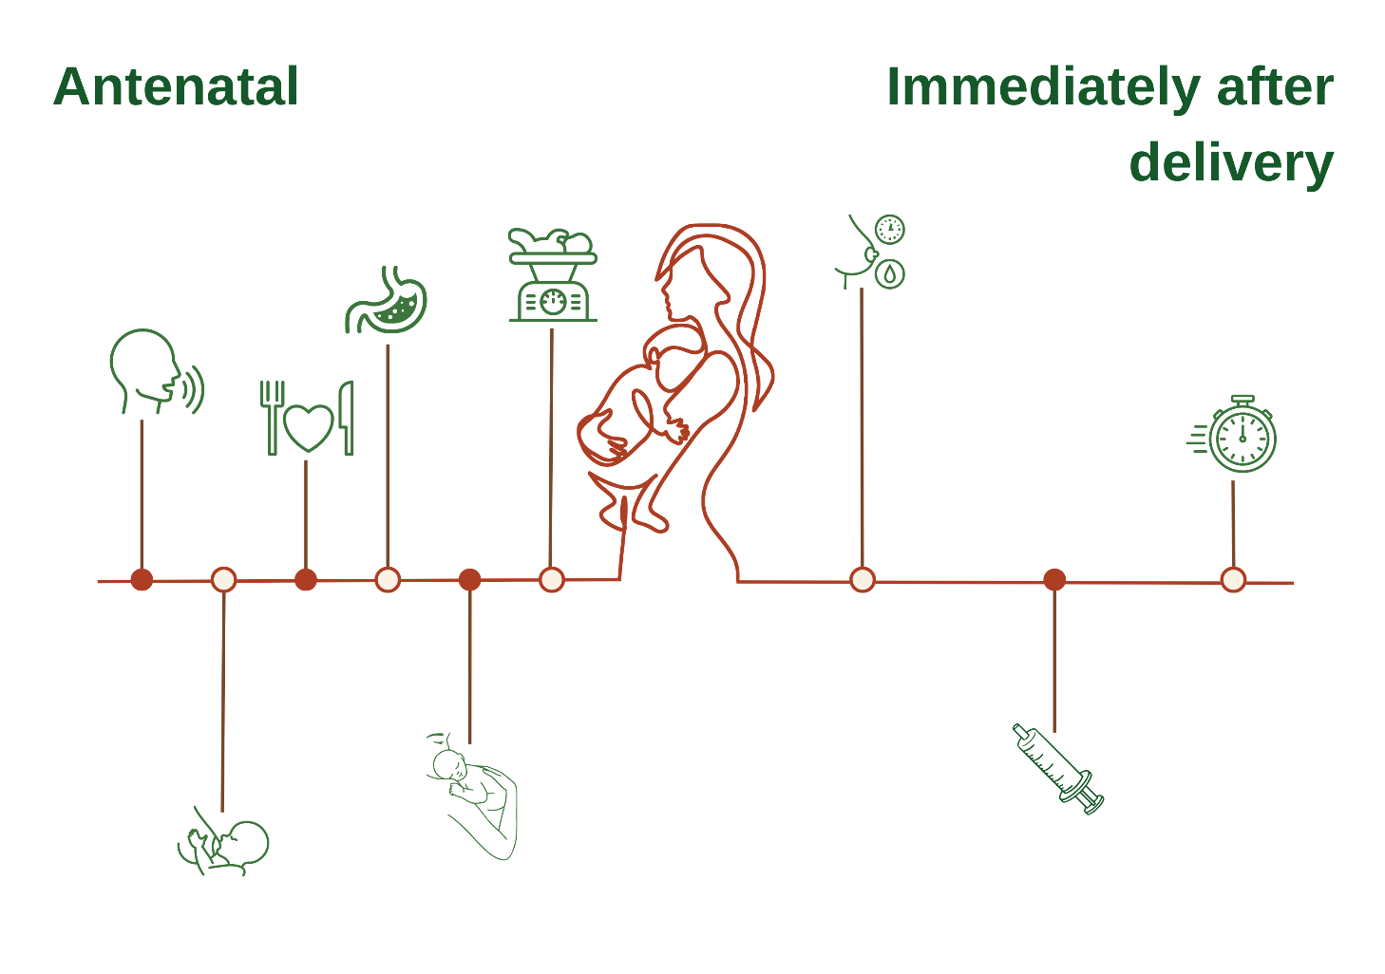
Early parental involvement
Notes:
Parents/carers should be provided with key information in the antenatal period (during pregnancy). Immediately after delivery, supporting the mother to provide immediate KMC (iKMC) and colostrum is important where possible. Early parental involvement can be visualised on a timeline.
From left to right:
Speaking to both parents about the benefits of breast milk.
How to express breast milk.
Information about maternal diet & healthy eating.
What a gastric tube is and how it is used.
KMC - what it is and how to do it.
Expectations about birthweight and growth.
Support for early breast milk expression especially colostrum.
Involving parents in giving oro-pharygeal colostrum.
How to do iKMC where this is possible.

Slide 23
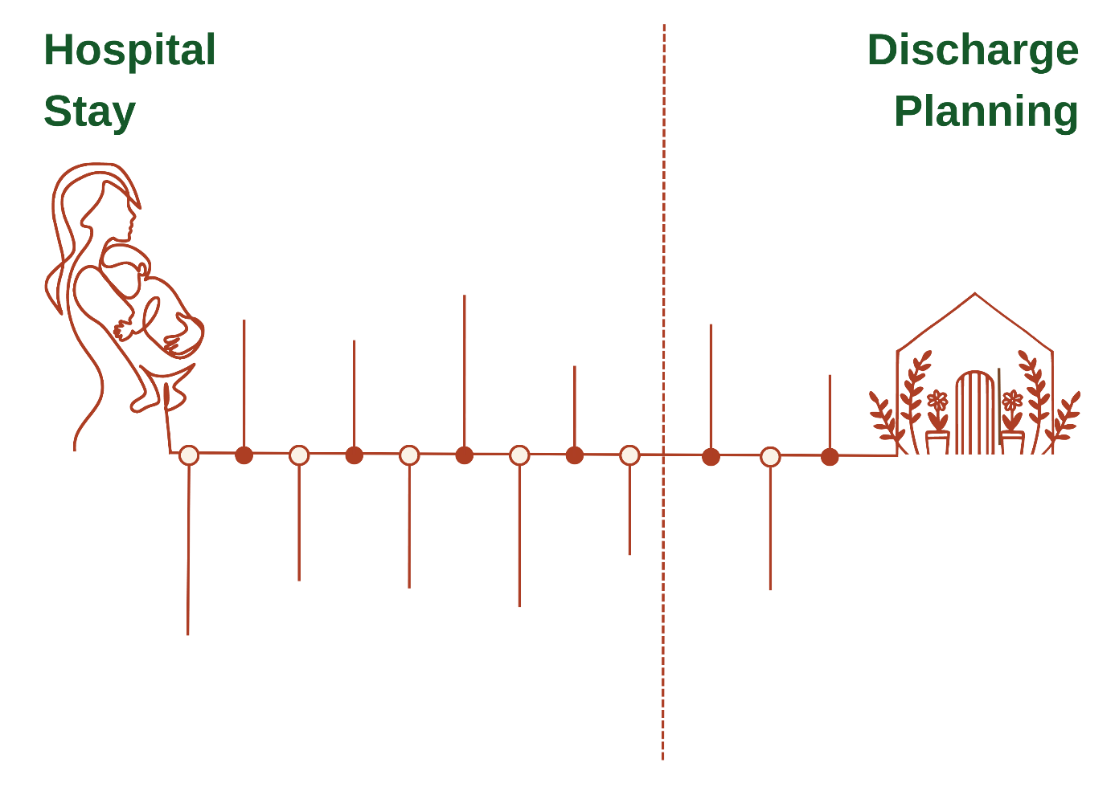
Parental/carer involvement during the hospital stay
Notes:
Hospital stay, left to right:
KMC and MOM expression.
‘Mouth care’ using MOM.
Giving MOM during painful procedures.
Ensuring mother-infant togetherness and unrestricted access.
Teaching parents/carers to give gastric tube or cup feeds.
Parental/carer help when weighing and measuring infants.
Ward rounds - asking parents/carers to present the baby’s medical history.
Review of growth charts.
Shared decisions about supplements e.g. iron and multivitamins.
Discharge planning, left to right:
Explaining the continuing role of any supplements.
Setting realistic expectations around growth, feeding and sleep.
Ensuring babies have follow up plans that parents understand.

Slide 24
Conversations with parents/carers
“....have you got a few minutes so I can explain to you how we can help you provide Kangaroo Mother Care and breast milk for your baby? I can tell you what KMC is, and how you can express your breast milk. I can tell you how this will help your baby cope with some of the common problems of being premature or small. Would now be a good time to tell you a bit more about those things?”
Notes:
Nurses and doctors have a duty to inform parents/carers about the available options for nutritional management. Staff should explain what KMC is and offer it as an option, rather than insist this is the only option available. In most African settings, breastfeeding is the norm, but this may not be true in other countries or settings.
The benefits of breast milk should be explained, ideally starting the conversation in the antenatal period. For example, if a woman is admitted in preterm labour, the initial discussion will include the risks and consequences of preterm delivery for the infant such as respiratory complications, and what common procedures happen immediately after delivery. Following this, it might be helpful to say:

Slide 25
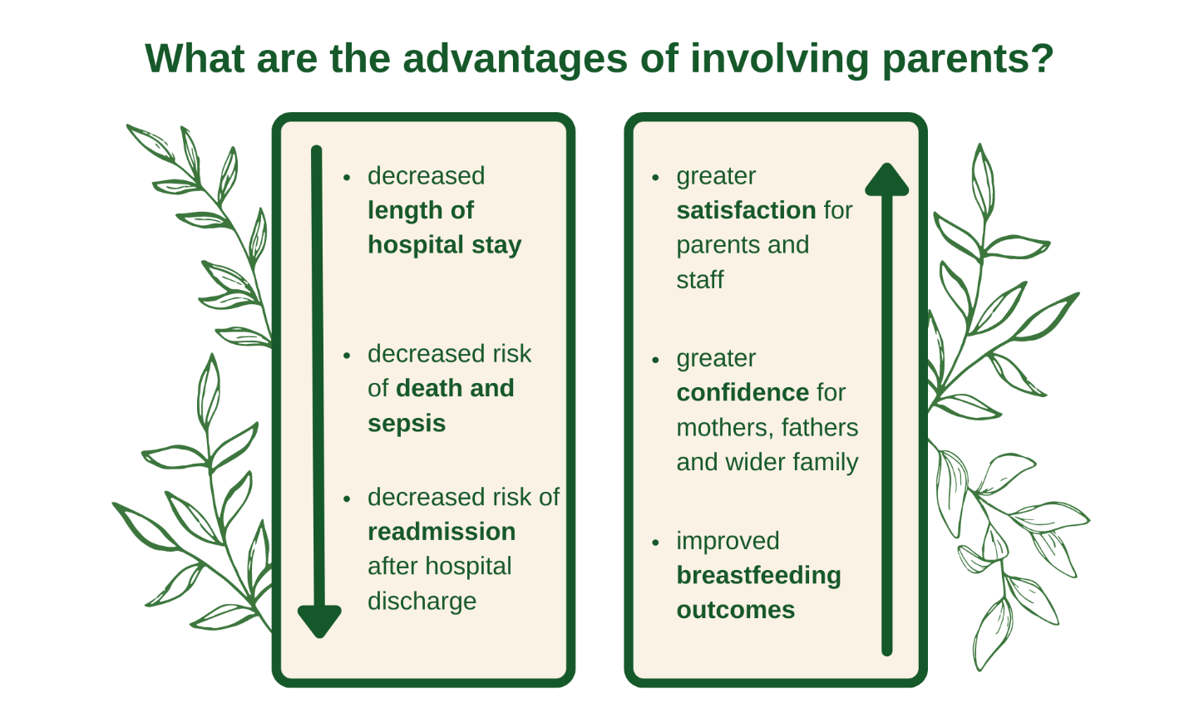
Advantages of parental/carer involvement
Notes:
In addition to the rights of parents/carers to be involved in caring for their baby there are many other advantages of parental involvement in nutrition, some of which are shown on the screen.
It is important to recognise that these benefits are also true for fathers (Melnyk, 2006). Parents/carers who are not able to be actively involved in nutritional care and decision making are more likely to be stressed, anxious, depressed, or even angry (Ionio, 2016).
Resources for parents/carers
Speaking to parents/carers directly about ways in which they can be involved is the best way to help parents/carers feel included. However, some parents/carers value information leaflets, and access to websites and other resources such as short video clips. Written leaflets can include QR codes that parents/carers can scan in order to access resources on the internet. Resources can explain the benefits of KMC and breast milk, and describe the other opportunities to be involved in their infants’ nutritional care. Written leaflets can be especially useful in the first few days, when parents/carers are overwhelmed and may forget what has been said. It is common for parents/carers to ask the same question more than once.
Whilst some women are happy to express breast milk at the cotside, demographic, cultural, and ethnic factors play an important role. Where possible, facilities to express breast milk in private should be provided, either a separate room or perhaps just a curtain or screen. Parents/carers and especially mothers expressing breast milk need access to quiet areas to rest, eat, and drink, as well as washroom facilities.
Parents/carers need resources that allow them to be at the cotside 24 hours a day, including chairs and free access to the hospital. Parents/carers like to know about ‘routine’ activities on the neonatal unit such as the timing of ward rounds, how often the baby is weighed, where the growth is plotted, and how feed volumes are calculated. Parents may be too scared to ask, or may not know what questions they can ask. Offering parents/carers the opportunity to speak and suggesting topics they may want to know about is an important aspect of nutritional care.

Slide 26

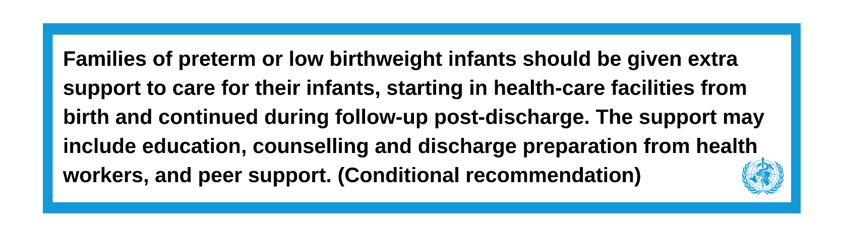
WHO recommendations
Notes:
Summary
Parental/carer involvement is crucial in neonatal nutrition for preterm and LBW infants. This includes access to information and active participation in care decisions, especially regarding KMC and breastfeeding. This involvement strengthens the parent-infant bond, reduces mortality and serious morbidity, and aids the baby's recovery. Conversations should start early, emphasising the benefits of breast milk and KMC. When implemented successfully, parental/carer involvement can lead to shorter hospital stays, decreased risks, greater satisfaction, improved breastfeeding, and increased confidence. Providing resources like leaflets and online materials is a good way to support parental/carer inclusion. Overall, parental/carer involvement is vital for optimal neonatal nutrition and well-being.
References (slide 18-26)
Craig, J.W., Glick, C., Phillips, R., Hall, S.L., Smith, J. and Browne, J. (2015). Recommendations for involving the family in developmental care of the NICU baby. Journal of Perinatology, 35(1), pp.S5-S8.
Embleton, N.D., Moltu, S.J., Lapillonne, A., van den Akker, C.H., Carnielli, V., Fusch, C., Gerasimidis, K., van Goudoever, J.B., Haiden, N., Iacobelli, S. and Johnson, M.J. (2022). Enteral nutrition in preterm infants (2022): a position paper from the ESPGHAN committee on nutrition and invited experts. Journal of Pediatric Gastroenterology and Nutrition, 76(2), pp.10-1097.
Ionio, C., Colombo, C., Brazzoduro, V., Mascheroni, E., Confalonieri, E., Castoldi, F. and Lista, G. (2016). Mothers and fathers in NICU: the impact of preterm birth on parental distress. Europe's Journal of Psychology, 12(4), p.604.
Kolossa, S., Mader, S., Pfeil, J. and Zimmermann, L.J. (2021). Involving Parents in Feeding Their Preterm Infants. Nutritional Care of Preterm Infants, 122, pp. 281-288. Karger Publishers.
Melnyk, B.M., Feinstein, N.F., Alpert-Gillis, L., Fairbanks, E., Crean, H.F., Sinkin, R.A., Stone, P.W., Small, L., Tu, X. and Gross, S.J. (2006). Reducing premature infants' length of stay and improving parents' mental health outcomes with the Creating Opportunities for Parent Empowerment (COPE) neonatal intensive care unit program: a randomized, controlled trial. Pediatrics, 118(5), pp.e1414-e1427.
Örtenstrand, A., Westrup, B., Broström, E.B., Sarman, I., Åkerström, S., Brune, T., Lindberg, L. and Waldenström, U. (2010). The Stockholm Neonatal Family Centered Care Study: effects on length of stay and infant morbidity. Pediatrics, 125(2), pp.e278-e285.
WHO (2022). WHO recommendations for care of the preterm or low-birth-weight infant. World Health Organization. Available at: https://www.who.int/publications/i/item/9789240058262

Slide 27
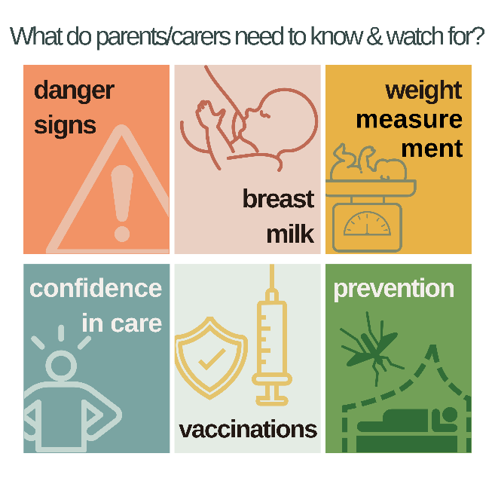
Discharge
Notes:
We have focused on in-hospital nutrition support for preterm and LBW infants. We will now provide brief information that might be helpful for parents/carers in preparing them for discharge. Many neonatal units develop a “discharge package” with a checklist of items to consider.
We will discuss the technical aspects of discharge, but also highlight the importance of support from healthcare professionals, other parents, and communities
Discharge planning
On the screen is come key information parents will need to know ahead of discharge.
Danger signs: Parents/carers should know how to identify danger signs (i.e. signs of severe illness) including losing weight and seeking medical attention promptly.
Breast milk: Parents/carers should understand the importance of giving their infant exclusive breastfeeding/mother’s own milk until the infant is 6 months of age - unless their medical team has advised otherwise for medical reasons.
Weight measurement: Parents/carers should understand the importance of having their infant weighed every week at their local health centre or dispensary until they achieve 3kg. Beyond 3kg, the frequency of visits can be guided by the progress of the infant, the national guidance and agreement with family. The infant is expected to have regained their birth weight by 14 days.
Confidence in care: Healthcare teams should ensure the mother is confident with care giving practices including KMC, breastfeeding/cup feeding with MOM, hand hygiene and identifying danger signs.
Vaccinations: Parents/carers should ensure that the infant receives all scheduled vaccinations.
Prevention: In malaria-endemic areas, parents/carers should ensure that post-discharge, mothers and their preterm LBW infants sleep under an insecticide-treated bednet.
Common daily supplements
Although breast milk meets the micronutrient requirements of full-term infants, it does not for preterm and LBW infants. Preterm and LBW infants therefore need supplements such as iron and vitamin D until at least 6 months corrected age. In some settings, additional calcium and phosphate supplements may be used.
Iron supplementation (2-3mg/kg/day) is recommended starting at 2 weeks of age for preterm and LBW infants fed on breast milk to prevent iron deficiency anemia. Iron is essential for haemoglobin, but also vital for brain development. Several RCTs have shown that inadequate iron intakes are associated with worse infant brain development. However, prolonged or excessive dietary iron intakes especially in very preterm infants who have received multiple blood transfusions could lead to iron overload.

Slide 28
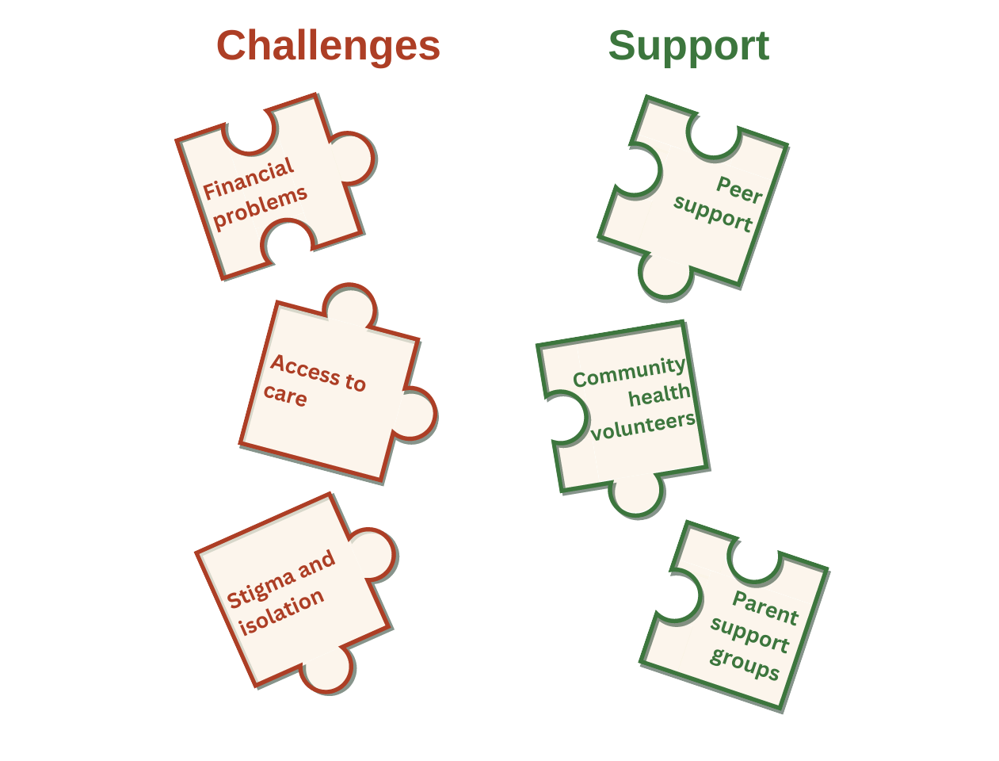
Community support
Notes:
Community support
Community support is a vital component of the continuity of care for mothers, their preterm and LBW infants, and families. The graphic below shows some of the challenges that mothers and families face post-discharge, as well as some of the possible sources of support.
Summary
We have covered the important aspects of preparing parents/carers for their preterm and LBW infant's discharge. Parents/carers should be aware of danger signs indicating severe illness and the significance of exclusive breastfeeding or MOM. Regular weight checks and proper care practices like KMC and hand hygiene are also essential, as well as vaccinations and sleeping under an insecticide-treated bednet, particularly in malaria-endemic areas. Preterm and LBW infants may require additional supplements such as iron and vitamin D. Post-discharge, community support from health volunteers and support groups can help address some of the challenges associated with caring for a preterm and LBW infant.

Slide 29
End of Module 5
From completing this module, you should now be able to:
Apply your knowledge of nutritional status to preterm and LBW infants with different presentations.
Define the key terms: guidelines, audits, quality improvement, policies, and protocols.
Describe the ABCDE tool for holistic assessment of nutrition.
Explain the role of guidelines in nutritional care, including examples.
Explain the role of audits and quality improvement in nutritional care, including examples.
Recall the different stages of the PDSA Cycle and what they involve.
Explain the role of policies in nutritional care, including examples.
Explain the importance of involving parents in nutritional care and the steps you can take to achieve this during the antenatal phase, immediately after birth, and during the hospital stay.
Explain the key information parents need to know ahead of discharge.
Notes:
In this module, we explained the use of guidelines, audit, QI, policies, and protocols, including how they are linked and examples of each. We explored how parents/carers can and should be involved in infant care during their stay in the hospital, and also looked at what parents/carers need to know and understand to ensure safety of the infant after they have been discharged from the hospital.
If you are unsure about any of these goals, make sure to go back through this presentation and refresh yourself.

